Slide 1
Ethers

Slide 2
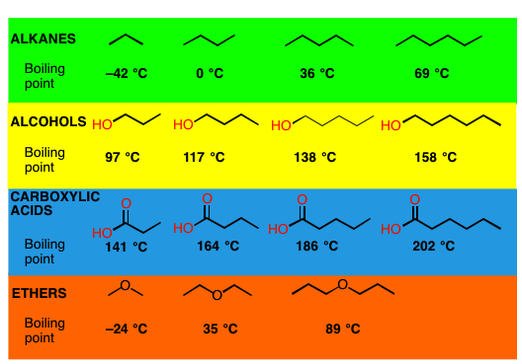

Slide 4

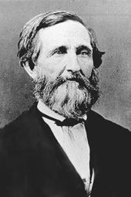


Slide 5
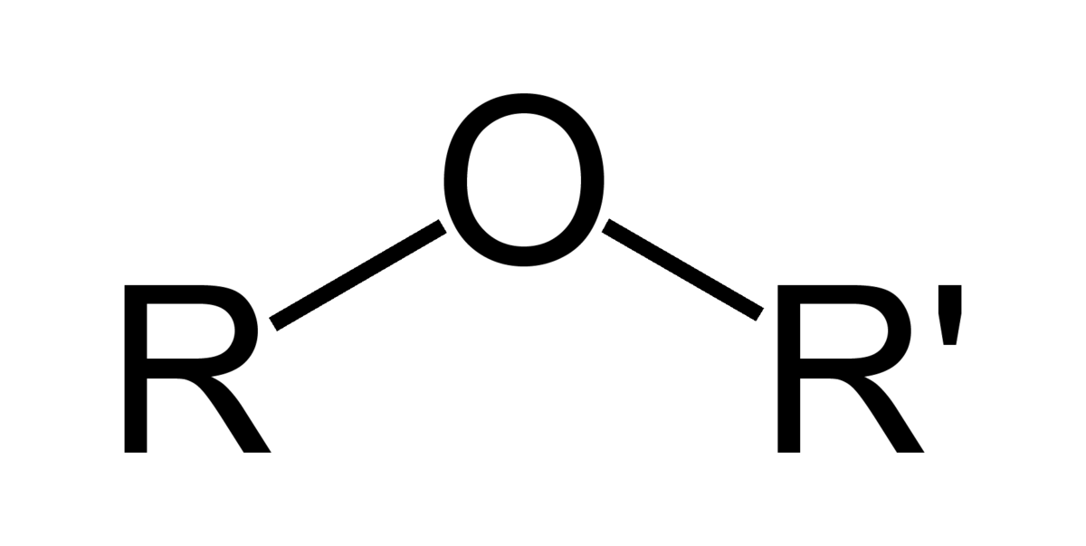

Ethers

Slide 6
Draw methyl propyl ether:

