Slide 1
Fisher Projections

Slide 2
Fisher Projections

Slide 3
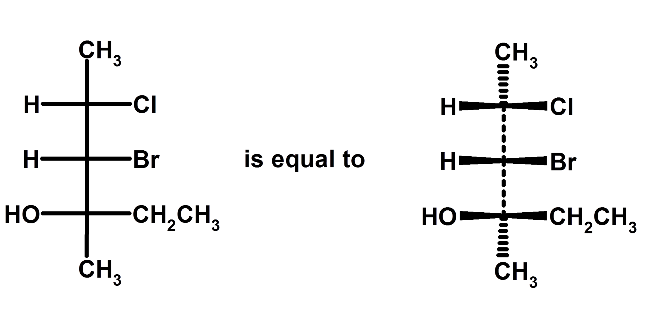
Fisher Projections

Slide 4
