Slide 1
Esters

Slide 2
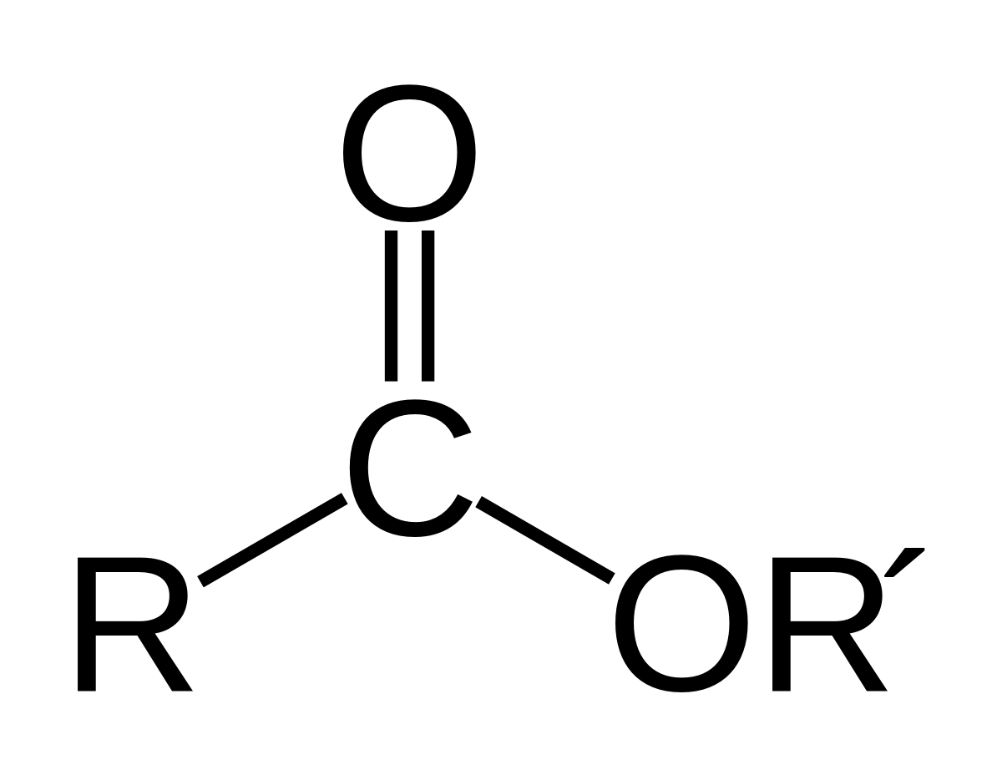

Esters

Slide 3


Slide 4
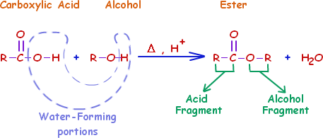
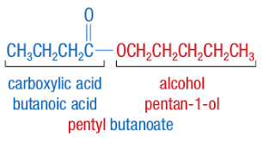
Naming Esters

Slide 5
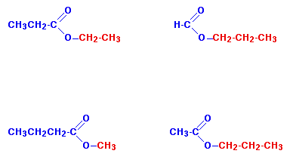

Slide 6
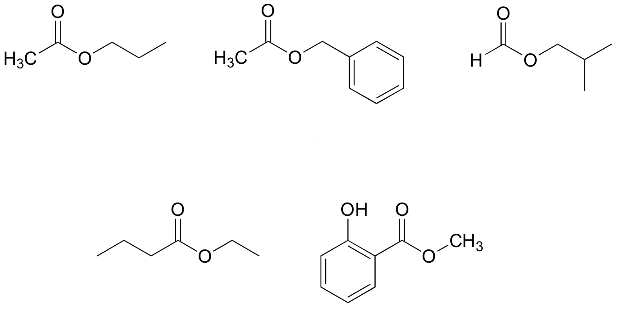

Slide 7
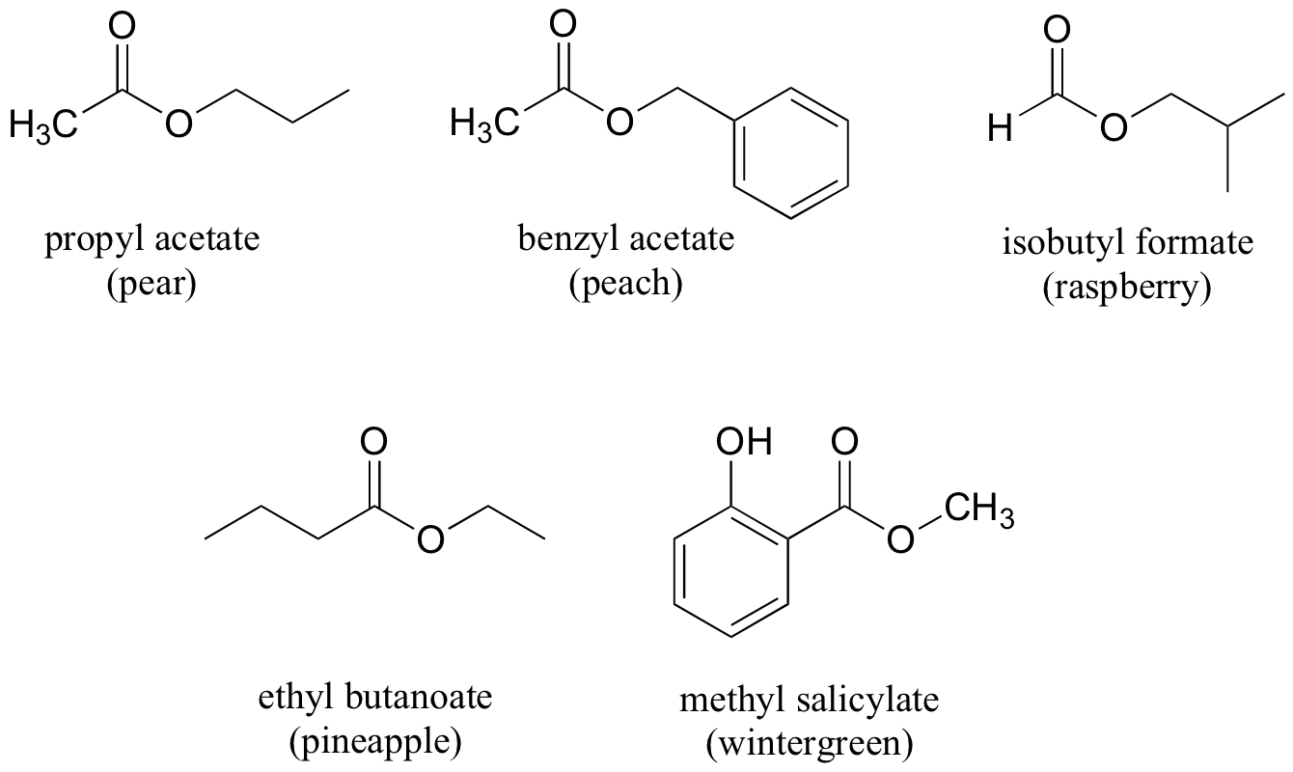

Slide 8
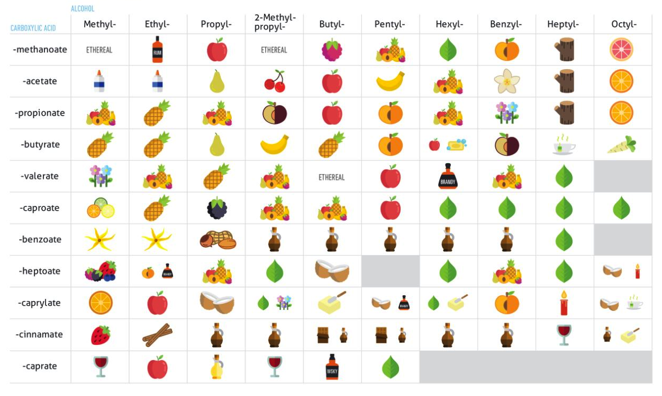

Slide 9
Condensation Reactions : Esters

Slide 10

Hydrolysis Reactions : Esters

Slide 11
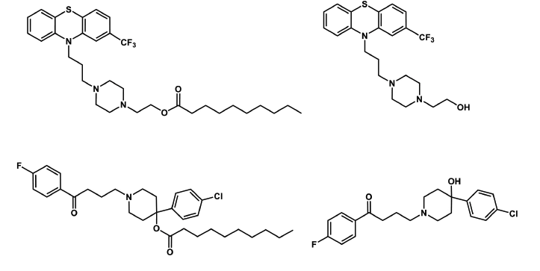
Notes:
Fluphenazine decanoate
Haloperidol decanoate

