Slide 1
Amides

Slide 2
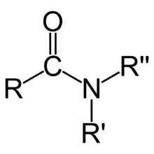
Amides

Slide 3

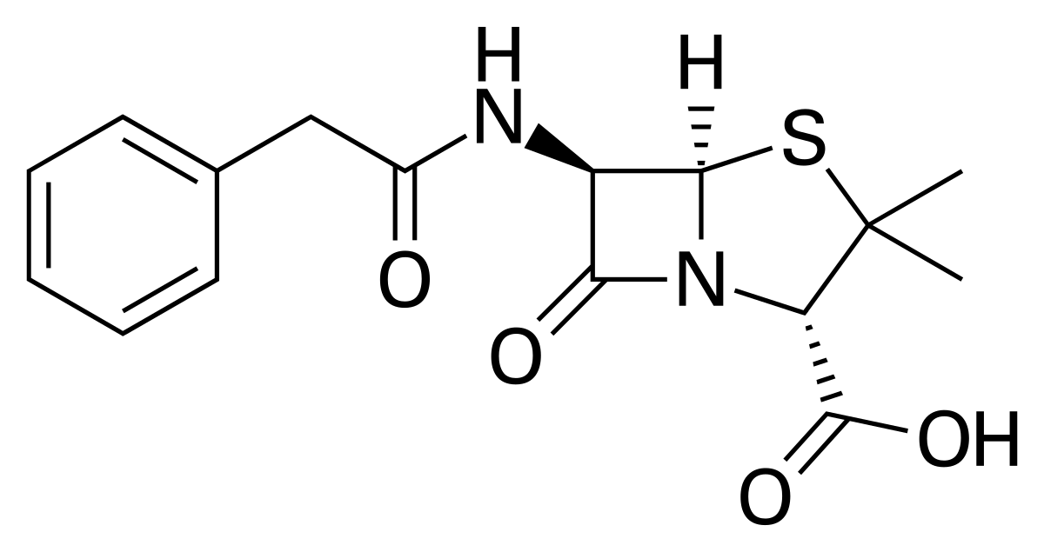
Amides

Slide 4

Condensation Reactions : Amides

Slide 5
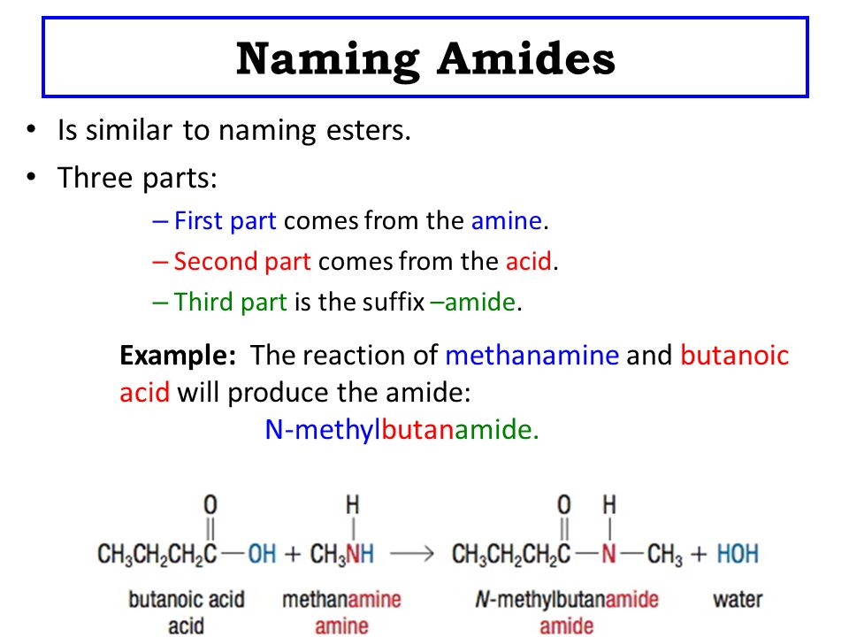

Slide 6
