Slide 1
Polymers

Slide 3
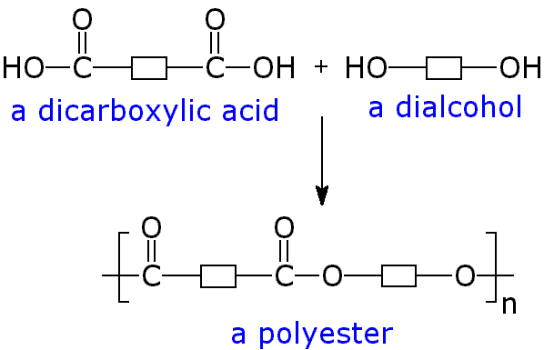

Slide 4
Polyesters : Made from dialcohols and diacids

Slide 6
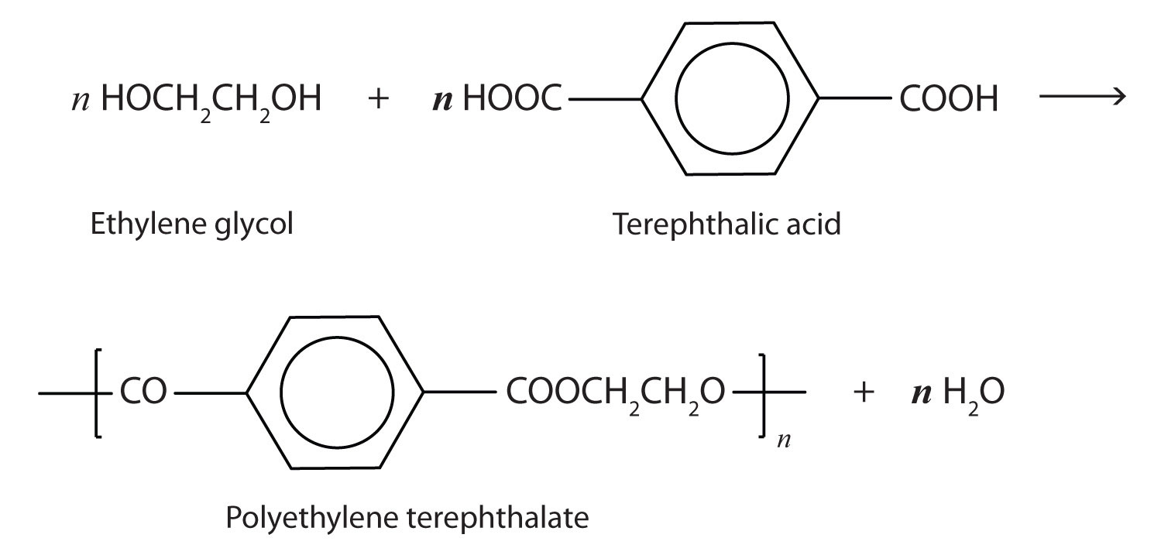
PET (polyethylene terephthalate)

Slide 7
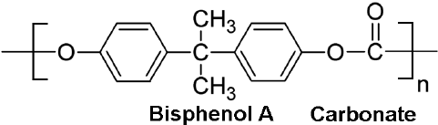
Notes:
polycarbonate

Slide 8
Polyamides : made from diamines and diacids

Slide 10
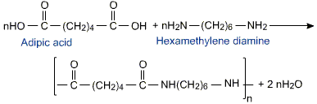
Nylon 6,6

Slide 11
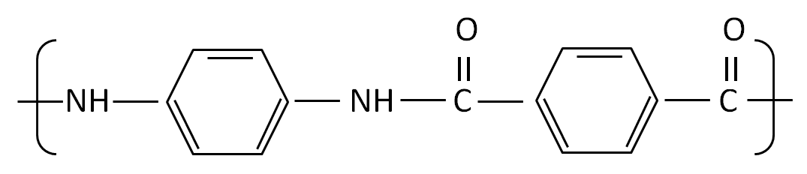
Kevlar

Slide 12
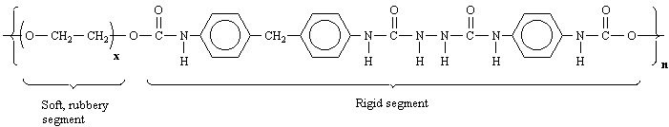
Notes:
Spandex

Slide 13
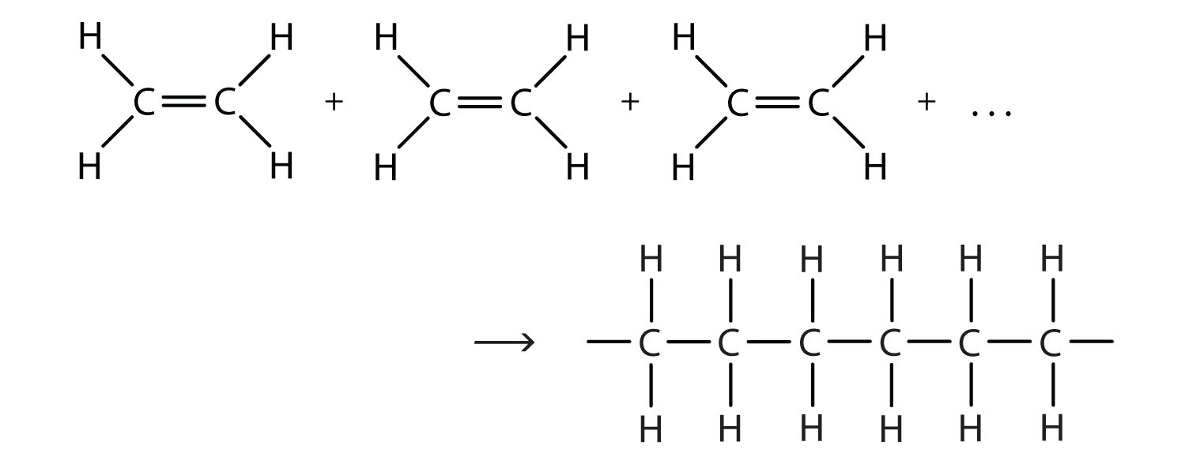

Slide 14
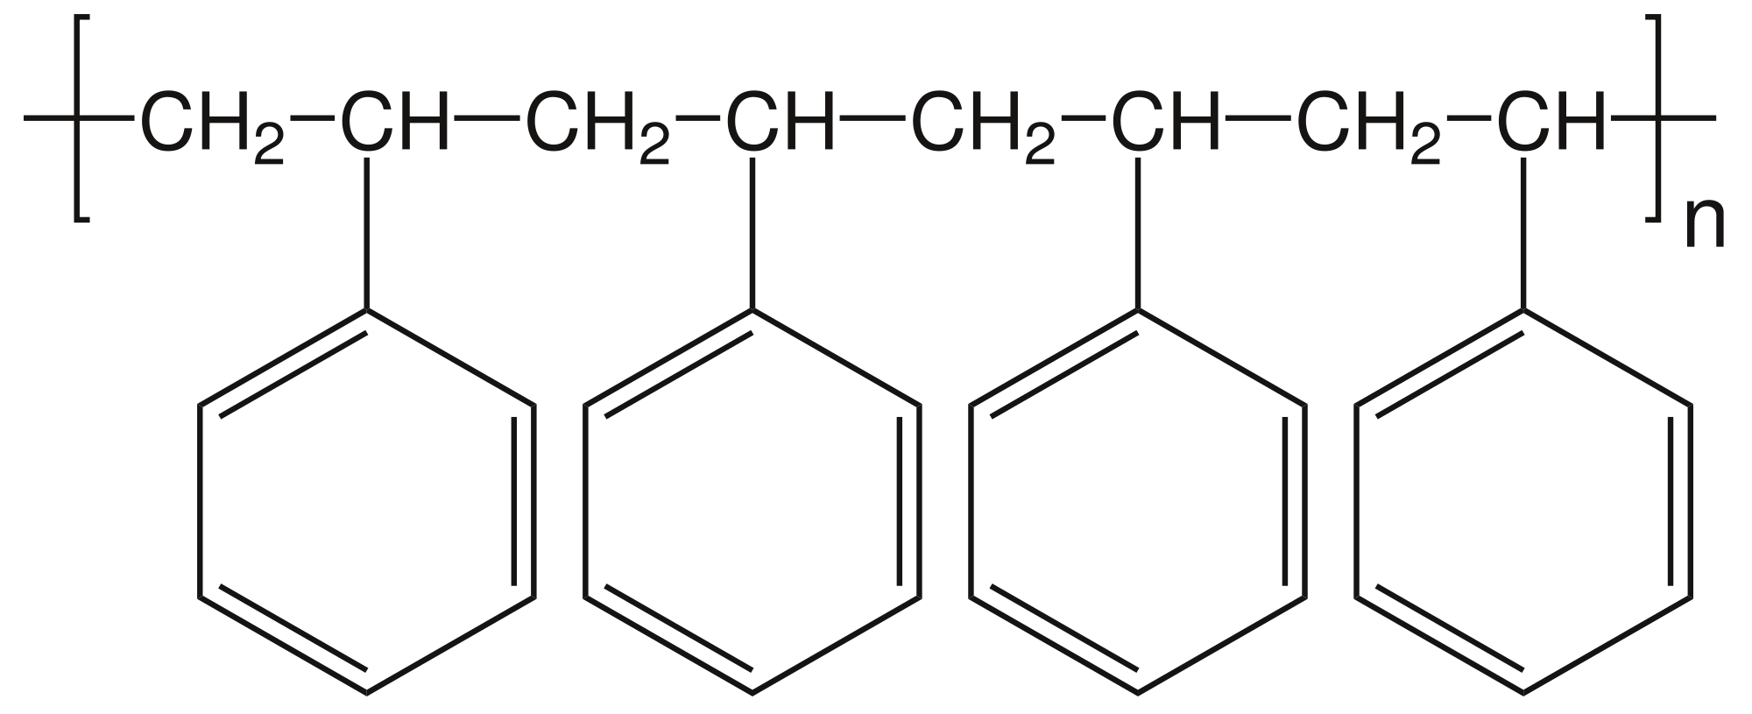

Slide 15
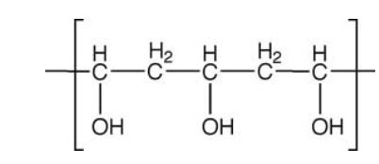
Notes:
Polyvinyl alcohol

Slide 16
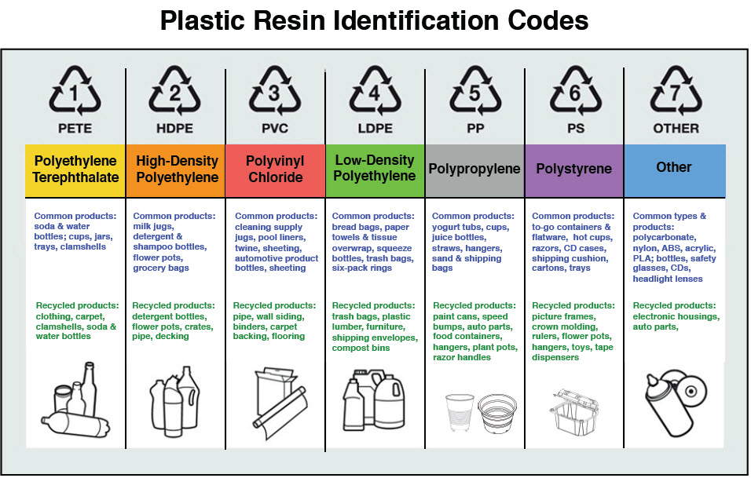

Slide 17
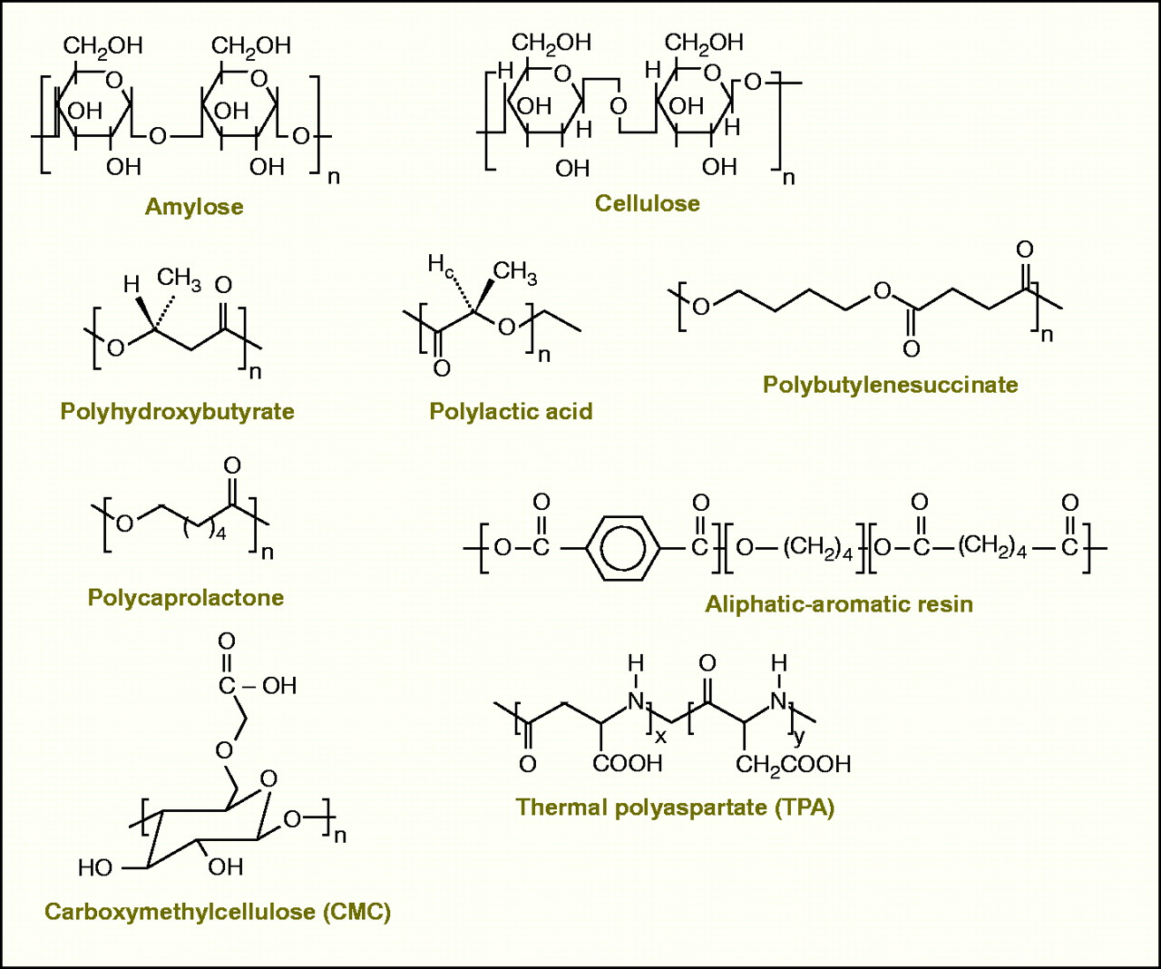
Biodegradable Polymers

Slide 18
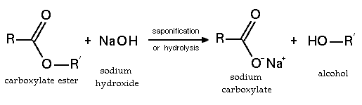
Hydrolysis Reactions : Esters

Slide 19
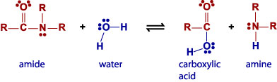
Hydrolysis Reactions: Amides

