Slide 1
Disaccharides and Polysaccharides

Slide 2
Glycosidic Bonds

Slide 3
Nomenclature of Disaccharides
It is necessary to indicate:
The monosaccarides in order (nonred.→ red.)
The anomers used (α or β)
The isomer used (D or L)
The ring form (p or f)
Location of the glycosidic bond
α -D-glucopyranosyl-(1→2)-β-D-fructofuranoside
α-D-Glcp-(1→2)-β-D-Fruf
Glc-α -(1→2)-Fru
Sucrose

Slide 4
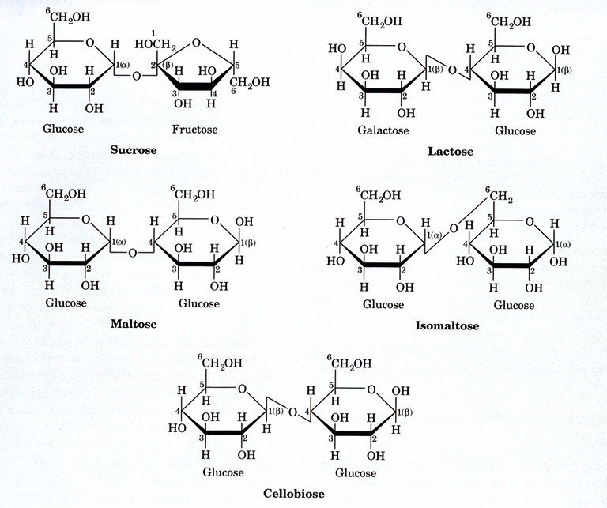
Disaccharides

Slide 5
Hydrolysis of Polysaccharides

Slide 6
Biological Roles of Carbohydrates

Slide 7
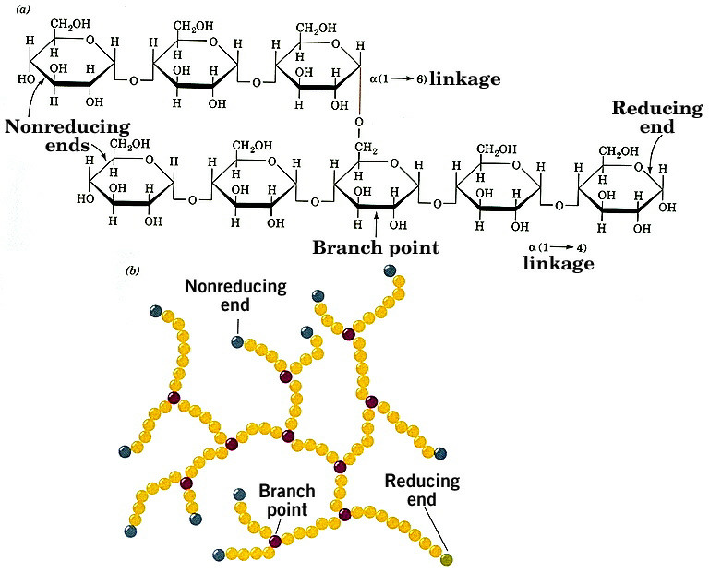
Glycogen

Slide 8
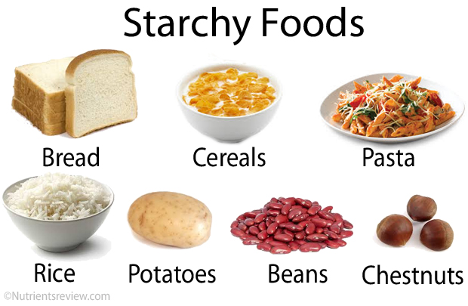
Starch
Two forms: amylose and amylopectin
Most starch is 10-30% amylose and 70-90% amylopectin
Branches in amylopectin every 12-30 residues
Amylose has alpha(1,4) links, one reducing end

Slide 9
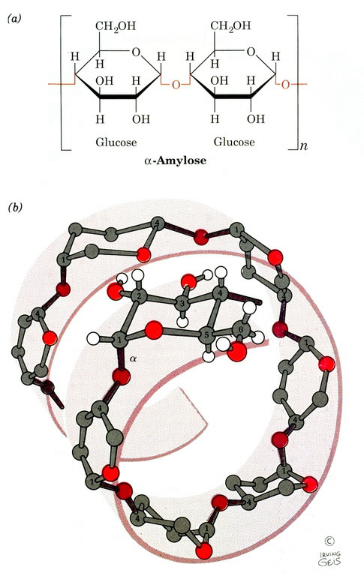
Amylose

Slide 10
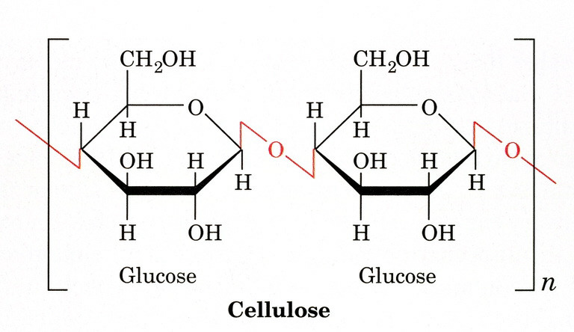
Cellulose

Slide 11
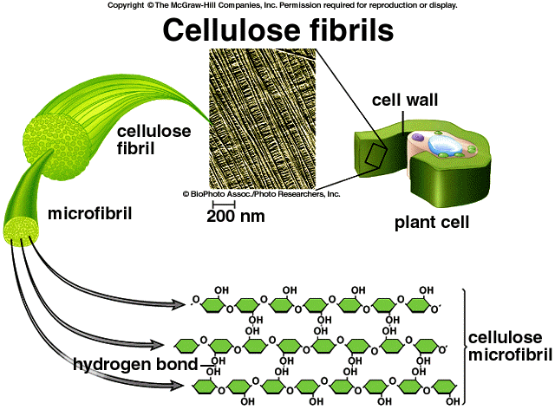

Slide 12
