Slide 1
Hybridization and Shapes of Molecules

Slide 2
Lewis Structures

Slide 3
# of bonds
C: H: O: N: Cl/Br/F/I:
CH₂O
CH₃NH₂

Slide 4
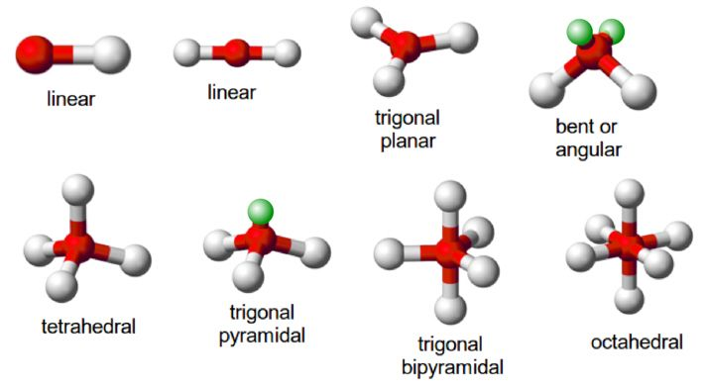
Shapes and Molecules (Valence Shell Electron Pair Repulsion)
Electron Geometry
Molecular Geometry

Slide 5
Draw the Lewis structure and give the molecular geometry for the carbon in CH₃OH
What is the electron geometry and molecular geometry of the O in CH₃OH?

Slide 6
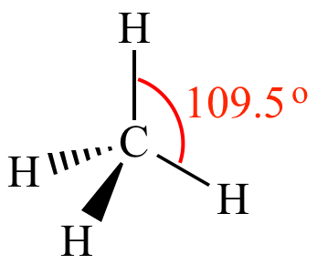
Carbon with 4 single bonds is tetrahedral
Electron configuration for C is

Slide 7
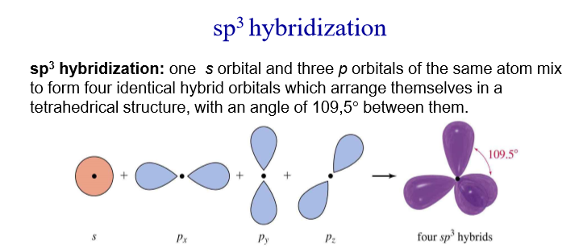
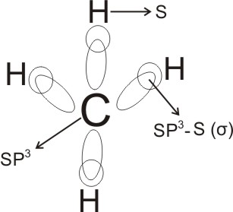
How we get 4 orbitals pointing in a tetrahedral shape

Slide 8
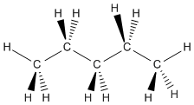
Drawing with dashes and wedges

Slide 9
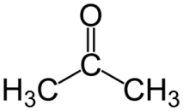
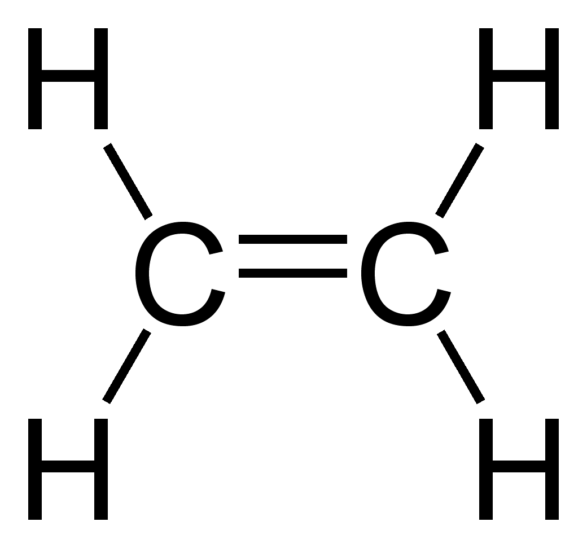
Carbons with double bonds are trigonal planar

Slide 10
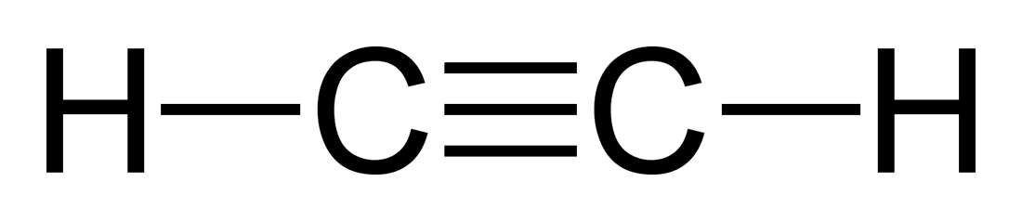
Carbons with triple bonds are linear

Slide 11
