Slide 1
Amino Acids

Slide 2
Amino Acids
Building Blocks for Proteins
Proteins used for…..
Enzymes for catalysis
Structural support
Transport
Signalling
Can be used as “fuel”

Slide 3
Amino Acids

Slide 4
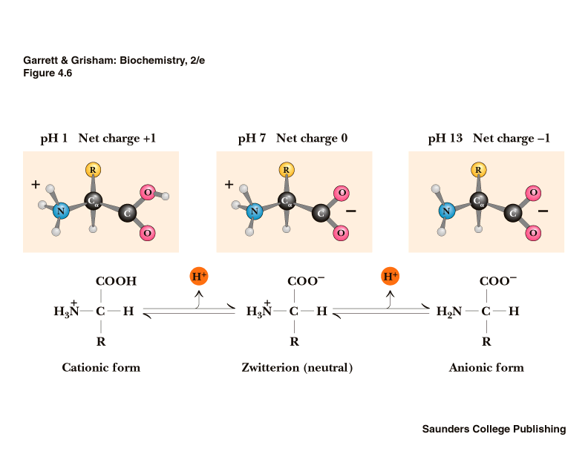
Amino Acids are Charged

Slide 5
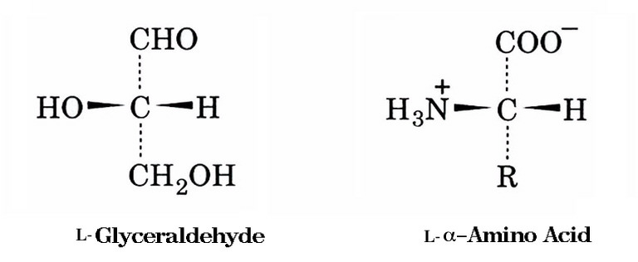
Zwitterions
Optically active (exception = Glycine)

Slide 6
Common Amino Acids
There are 20 common amino acids which are classified by their side chains (R) as:
Hydrophobic
Polar Neutral
Polar Charged

Slide 7
Hydrophobic

Slide 8
Polar Neutral

Slide 9
Charged Amino Acids

