Slide 1
Polypeptides

Slide 2
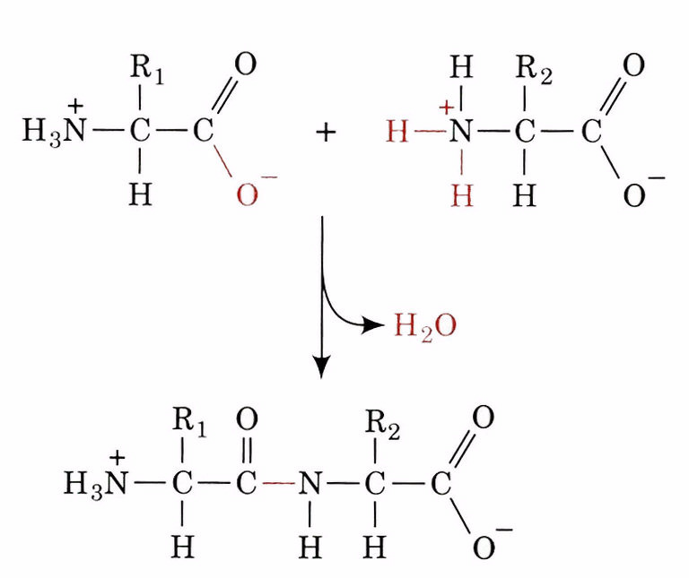
Amide Bonds (Peptide Bonds)

Slide 3
Rotation Around Amide Bonds
There is limited rotation around the peptide bond because
it has partial double bond character.

Slide 4
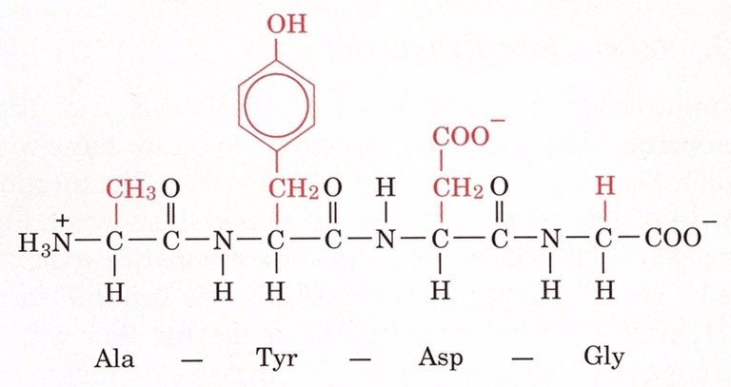
Polypeptides

Slide 5
Draw Ala-Gly-Asp

Slide 6
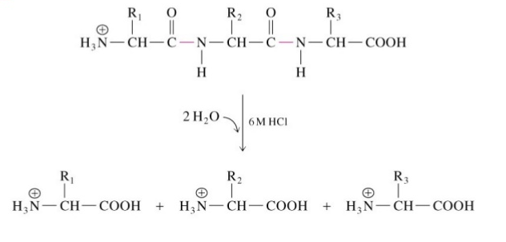
Hydrolysis Reactions
Acid Hydrolysis:

Slide 7
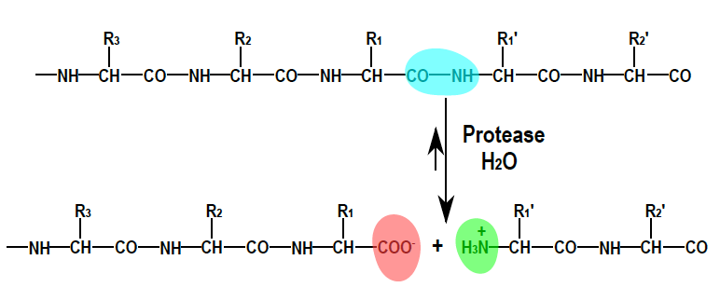
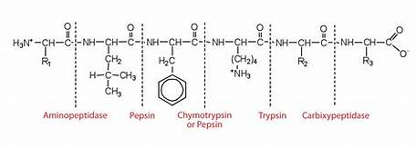
Enzymatic Hydrolysis:

Slide 8
Levels of Protein Structure
Primary: Sequence of Amino Acids
Secondary: Structures such as alpha helices and beta sheets
Tertiary: Arrangement of secondary structures
Quarternary: Arrangement of protein subunits

Slide 9
Primary Structure
Linear sequence of amino acids in a polypeptide
Alylglycylvalylserine
Ala-Gly-Val-Ser
AGVS

Slide 10
Secondary Structures
Alpha helices, beta sheets, turns
Stabilized by hydrogen bonds, disulfide bonds, hydrophobic interactions

Slide 11
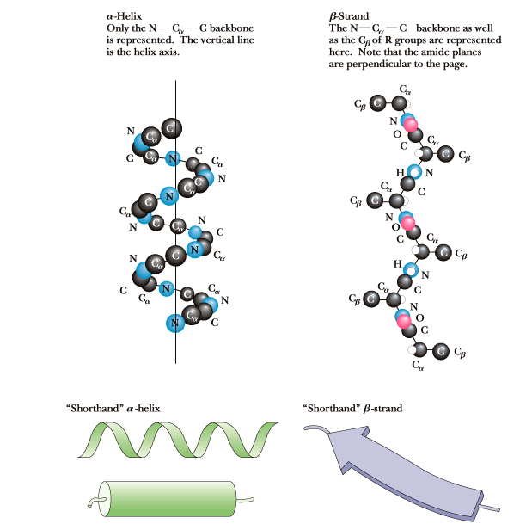
Secondary Structures

Slide 12
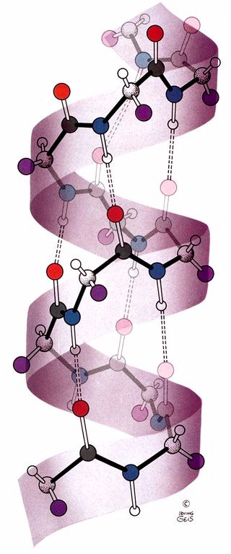
α -Helices
Right handed helix
Hydrogen bonding between amine H’s and carbonyl lone pairs of the backbone.

Slide 13
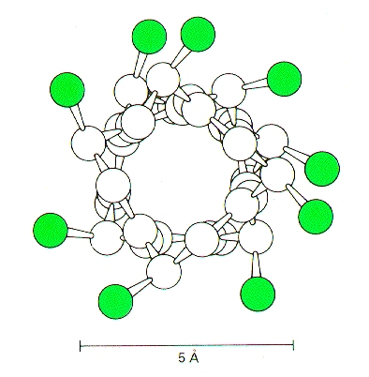
Alpha Helix Top View
R groups point outward (green).
The inside is filled, backbone atoms have Van Der Waals interactions with one another.

Slide 14
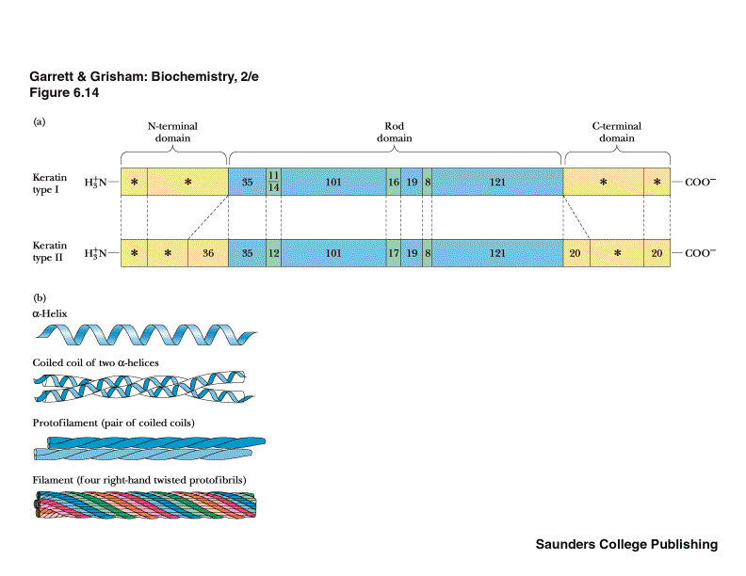
Structure of α-keratin
Right-handed
Left-handed
Found in hair, wool, nails, claws, quills,horns, hooves, and the outer layer of skin.

Slide 15
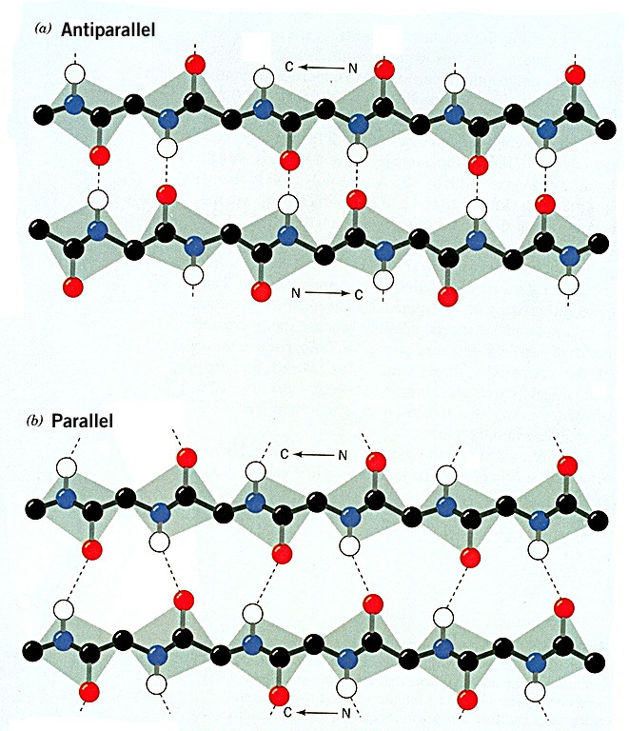
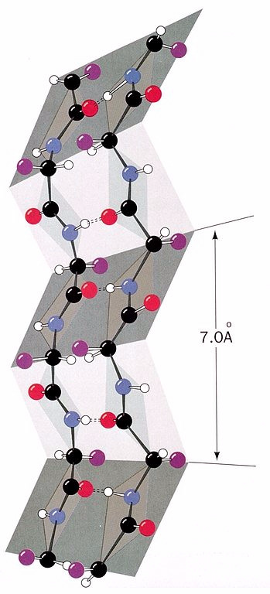
Pleated β sheets

Slide 16
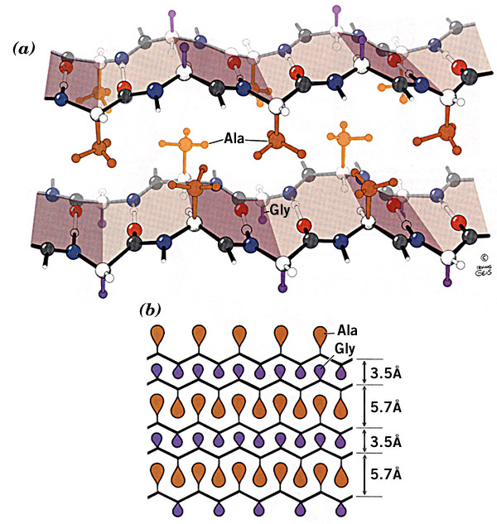
Structure of Silk Fibroin

Slide 17
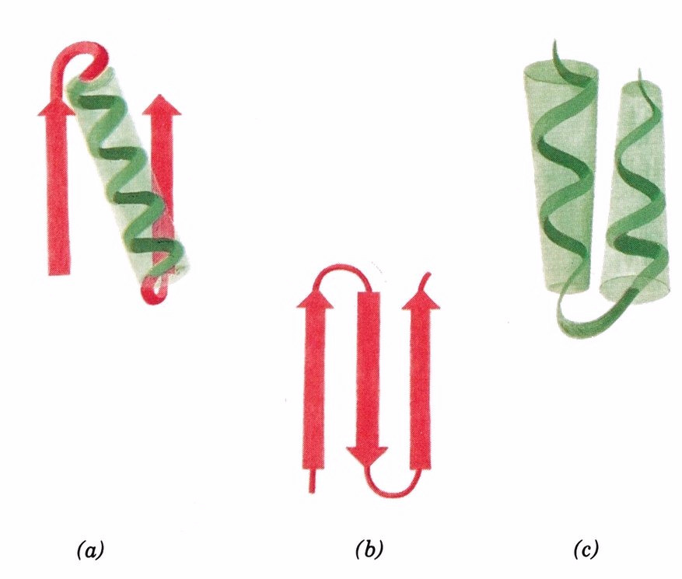
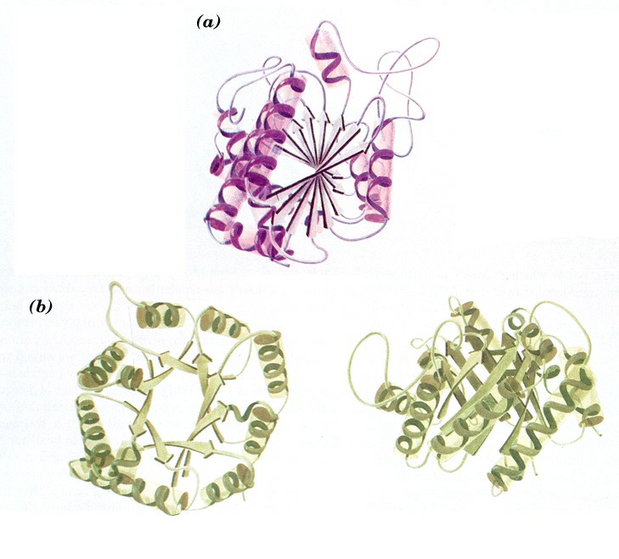
Tertiary Structures
a) beta-alpha-beta b) beta sheets c) alpha-alpha
a) and b) beta barrels

Slide 18
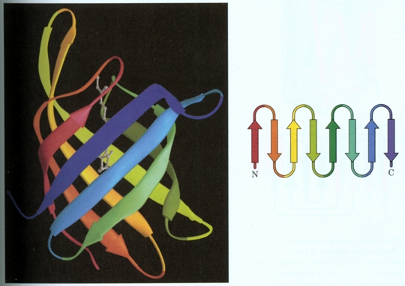
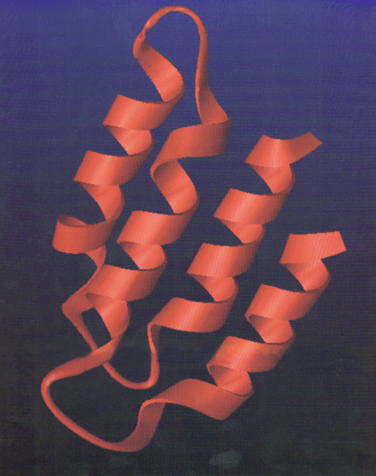
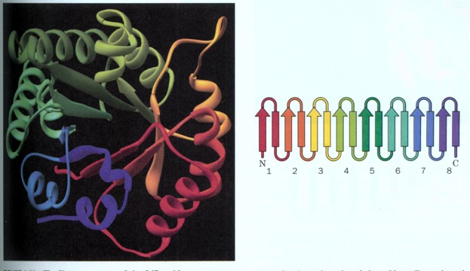
Helical Bundles
Beta Barrel
Alpha Beta Barrel

Slide 19
Quaternary Protein Structure
Many proteins are made from multiple polypeptide strands, each strand is a subunit
Subunits are labelled as α,β,γ,δ etc.
Each of these subunits has a tertiary structure
The arrangement of the subunits is the quaternary structure

Slide 20
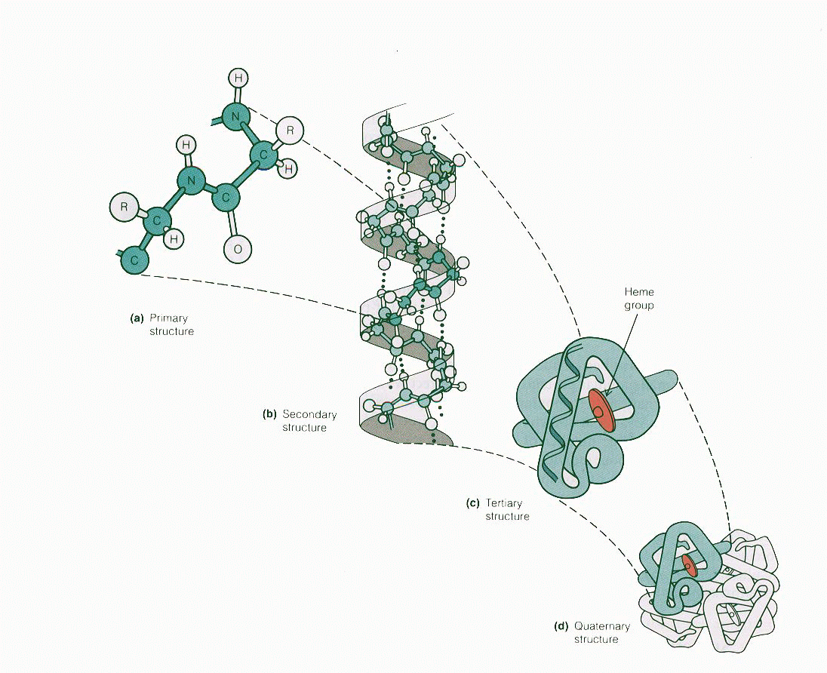

Slide 21
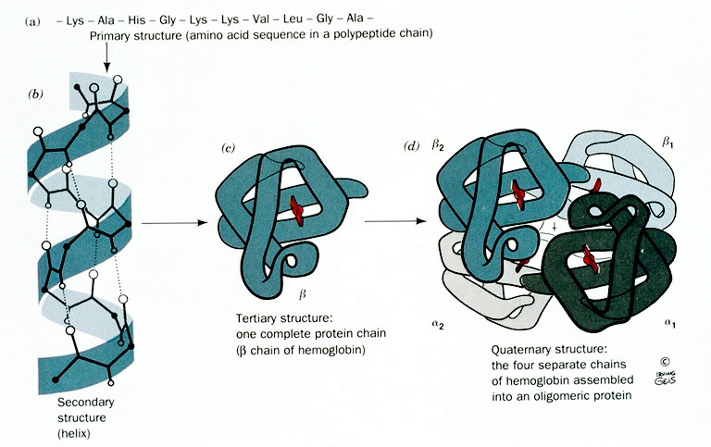
Hemoglobin

Slide 22
Denaturation
Destruction of the organized three dimensional structure
Heating
Detergents
Organic Solvents
Change in pH
Oxidation/Reduction of disulfide bonds

Slide 23
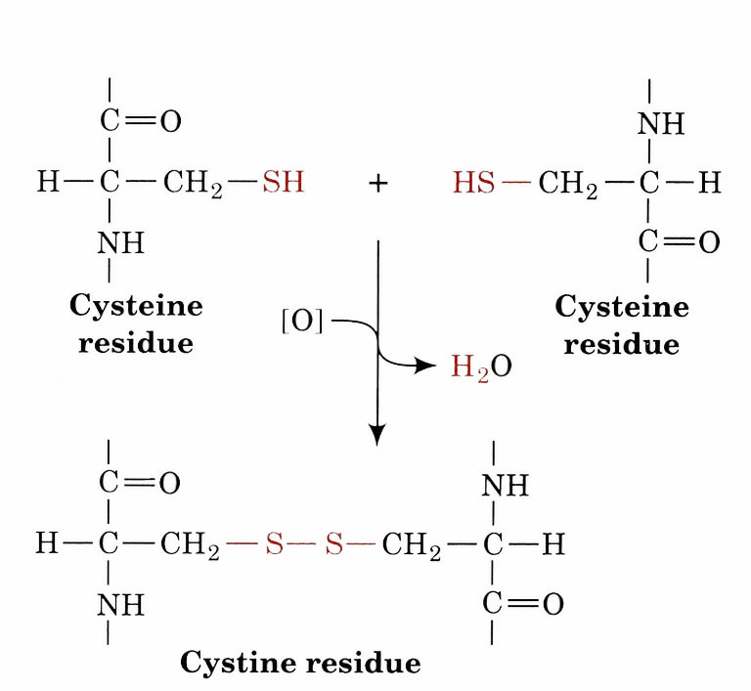
Disulfide Bonds

Slide 24
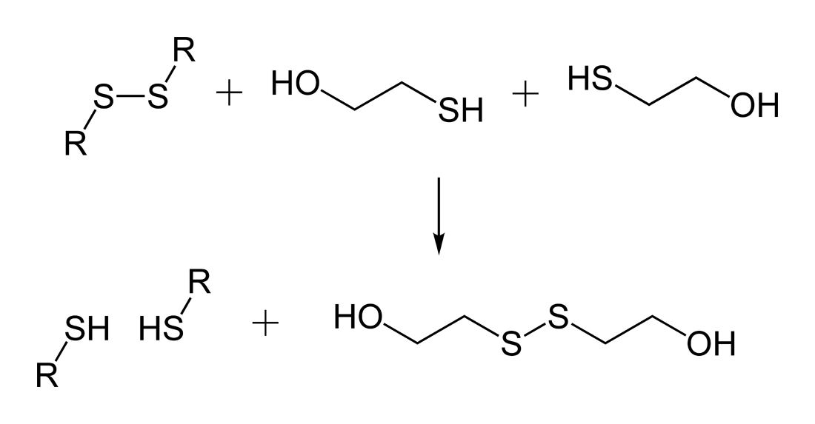
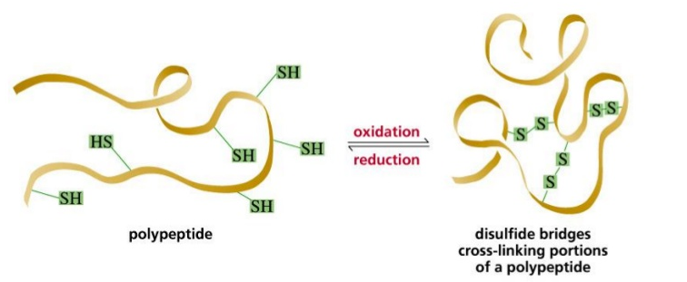
Cleaving disulfide bonds

