Slide 1
Nucleic Acids

Slide 2
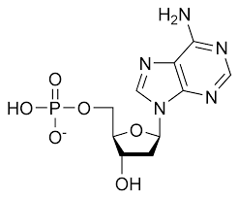
Nucleotide Bases
Building Blocks for DNA and RNA
5 Common bases: A, T, C, G, and U
DNA: A, G, C, T
RNA: A, G, C, U
A nucleotide is composed of three pieces:
Base
Sugar
Phosphate

Slide 3
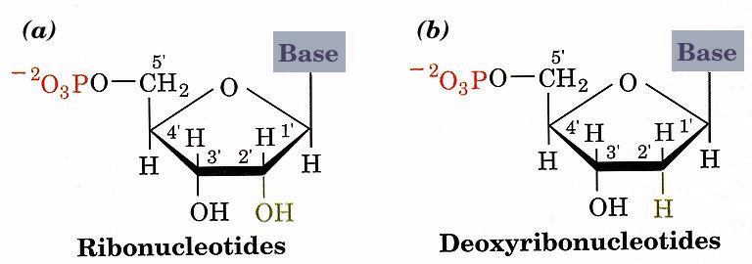
RNA uses the bases A, U, G, and C
DNA uses the bases A, T, G, and C

Slide 4
Pyrimidine Bases

Slide 5
Purine Bases

Slide 6
Nucleosides
A Base + A Sugar
  RNA uses ribose,
  DNA uses deoxyribose
Adenine becomes Adenosine
Guanine becomes Guanosine
Cytosine becomes Cytidine
Uracil becomes Uridine
Thymine becomes Deoxythymidine

Slide 7
Nucleotides
A Nucleoside + a Phosphate

Slide 8
AMP, ADP, and ATP

Slide 9
Phosphodiester Bonds

Slide 10
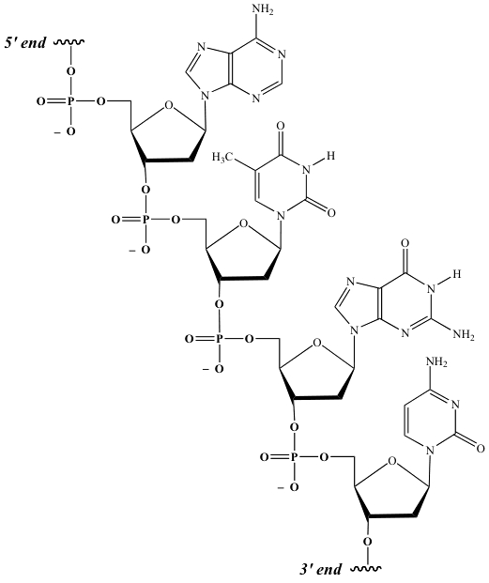
Nucleic Acids - DNA

Slide 11
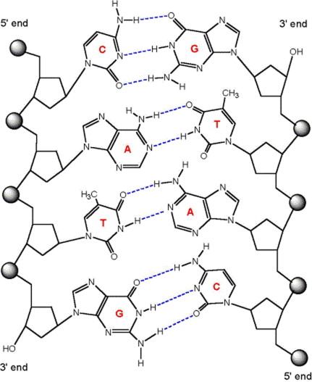
Chargaff’s Rules:
[A] = [T]
[G] = [C]

Slide 12
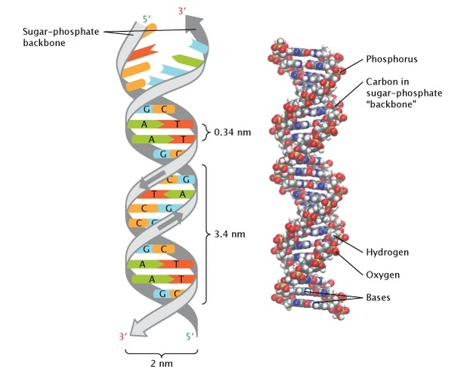

Slide 13
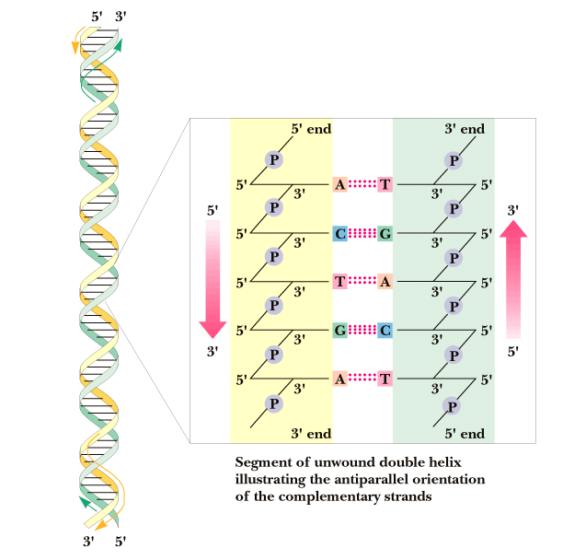
DNA is usually found as two of these polymer strands associated with one another in a double stranded helix.
Strands are:
1. Complementary
2. Antiparallel

Slide 14
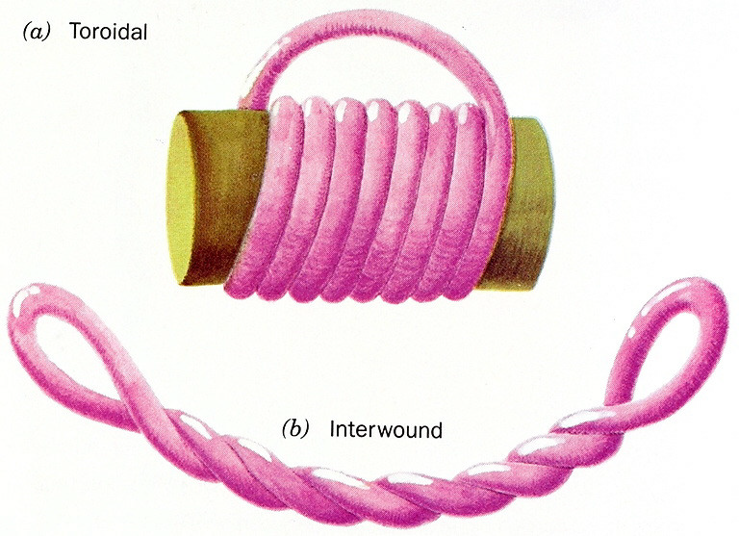
Supercoiling
Extra twists are added to DNA molecules to create supercoiling.
Supercoiling can be a) toroidal or b) interwound
Chrosomal DNA is then wound around proteins called histones for storage.

Slide 15
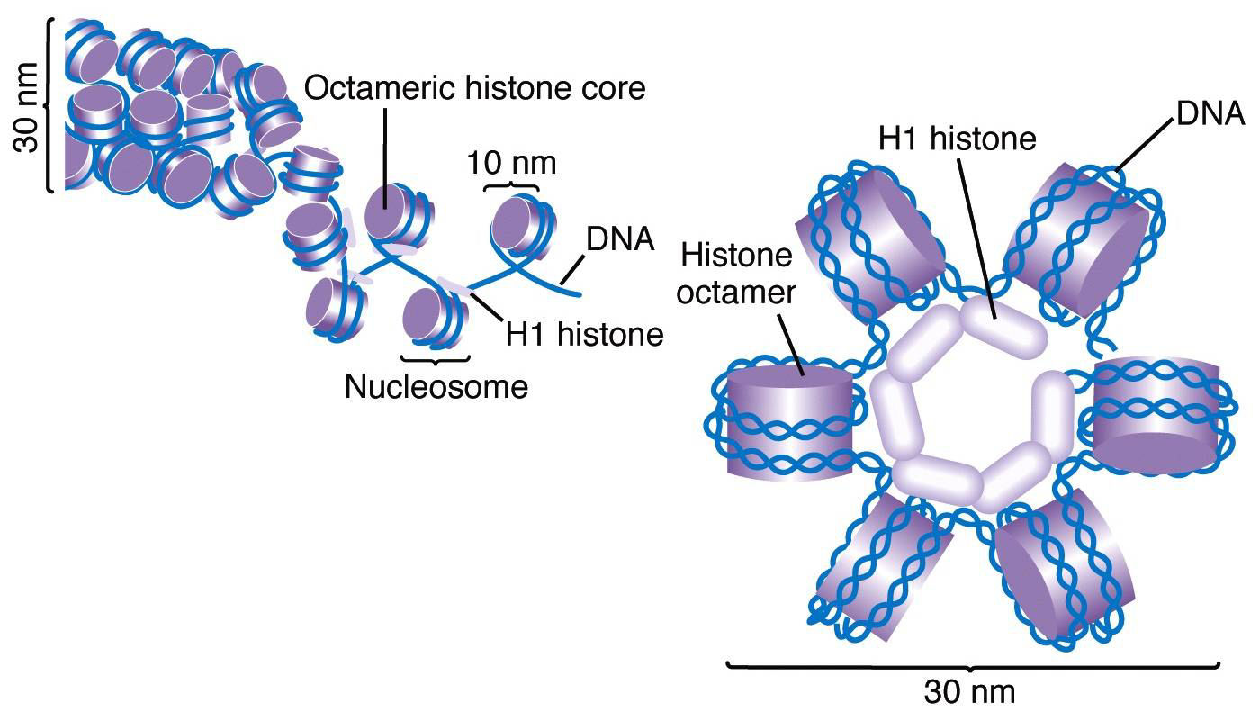

Slide 16
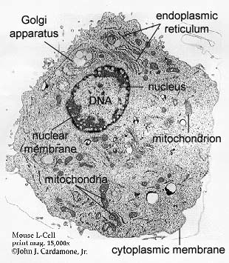
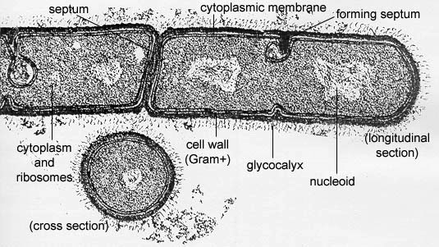
Notes:
Eukaryotic cell

