Slide 1
Translation

Slide 2
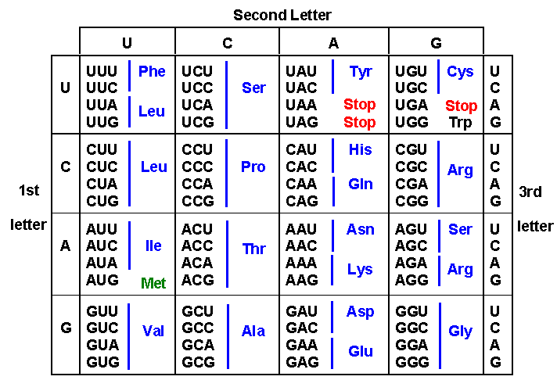

Slide 3
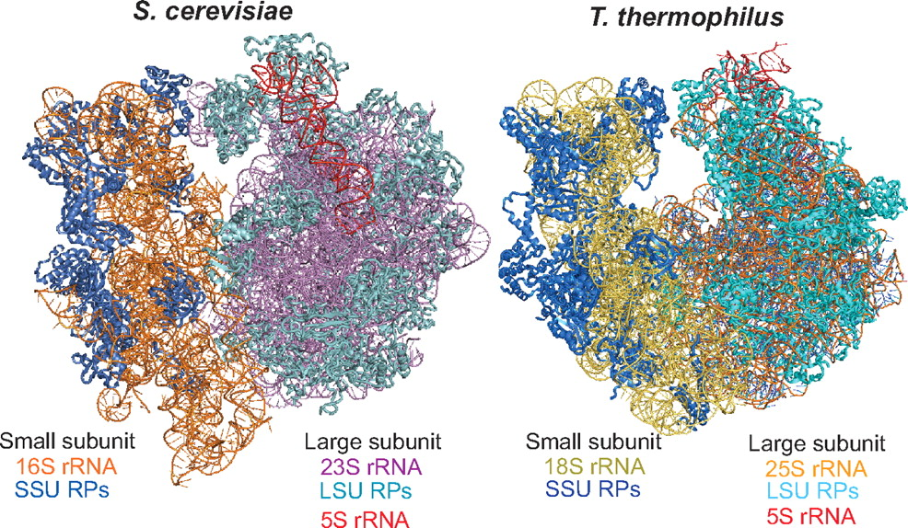
Ribosomes

Slide 4
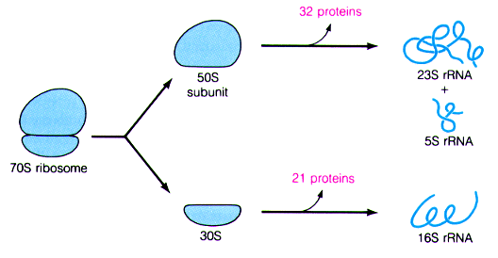

Slide 5
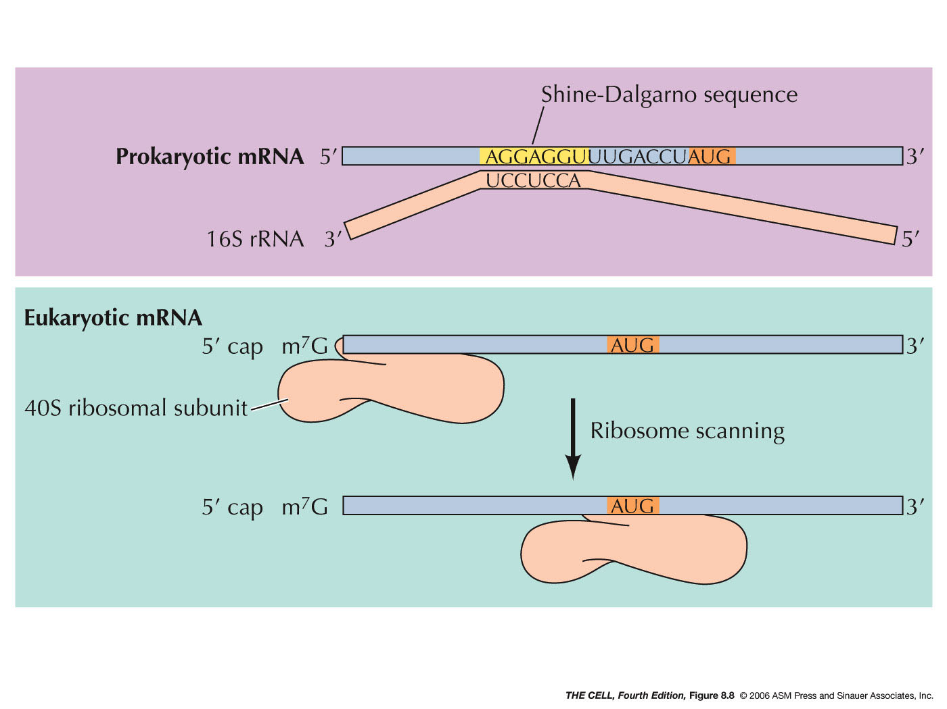
Initiation

Slide 6
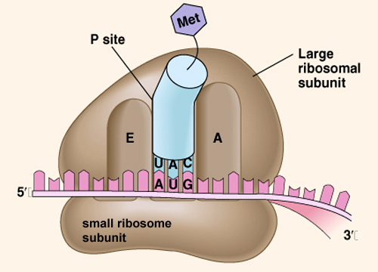

Slide 7
Elongation
E P A
E P A
E P A
E P A

Slide 8
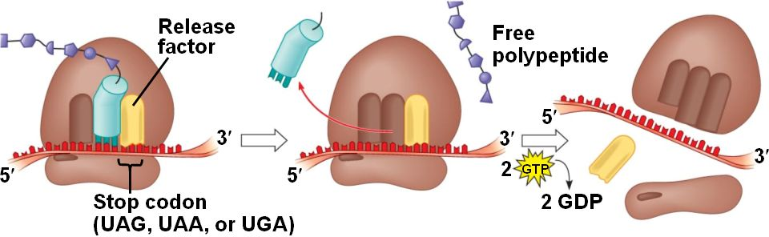
Termination

Slide 9
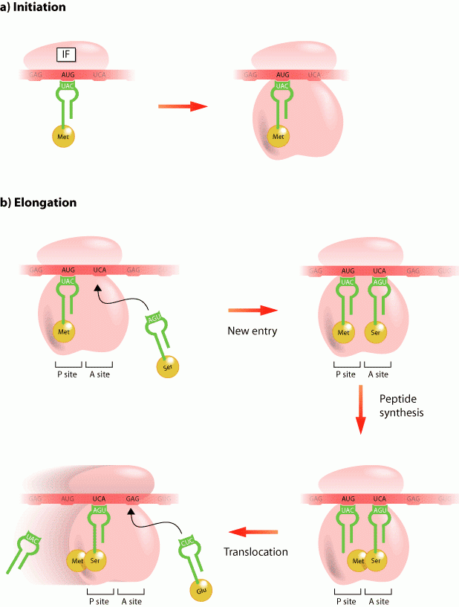
Binding of the next AA to the ribosome is inhibited by tetracyclines and aminoglycoside

Slide 10
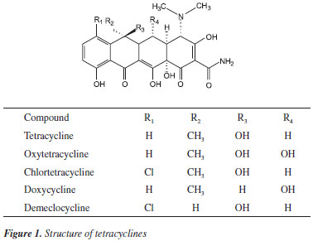
Tetracycline

Slide 11
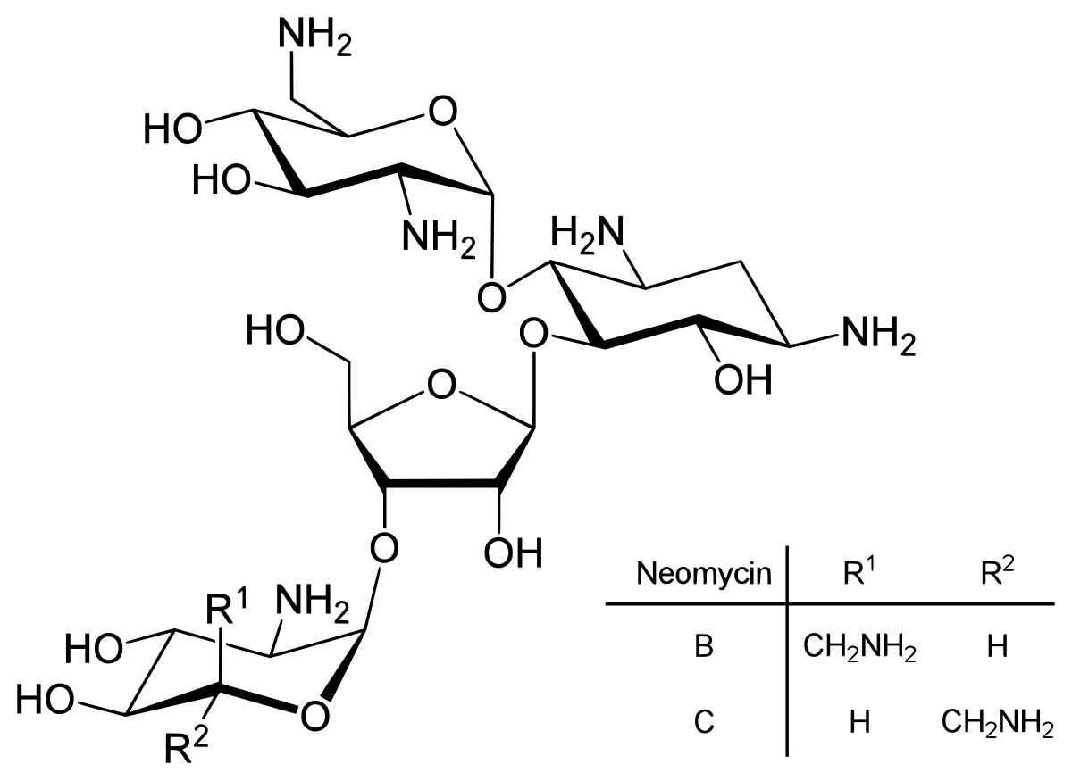

Slide 12
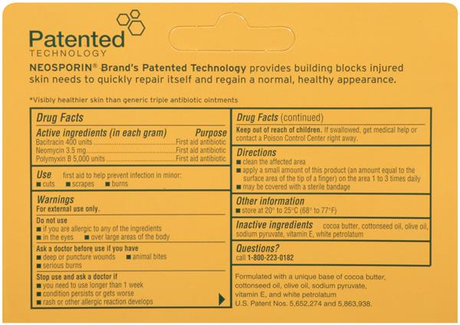
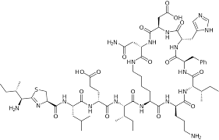
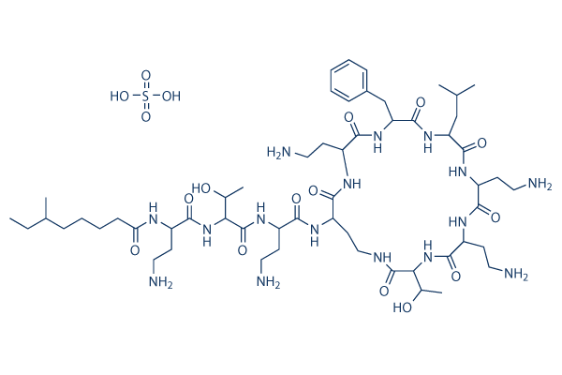
Bacitracin
Bacitracin
Polymyxin B

Slide 13
Formation of the new peptide bond by peptide synthetase is inhibited by chlorampenicol

Slide 14
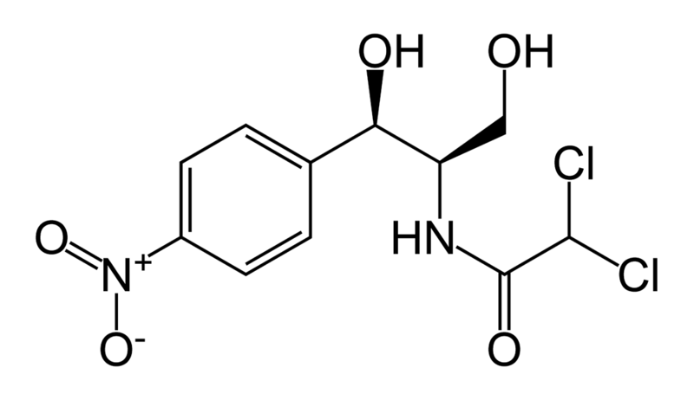
Notes:
50S ribosomal subunit

Slide 15
Translocation of the ribosome is inhibited by macrolides

Slide 16
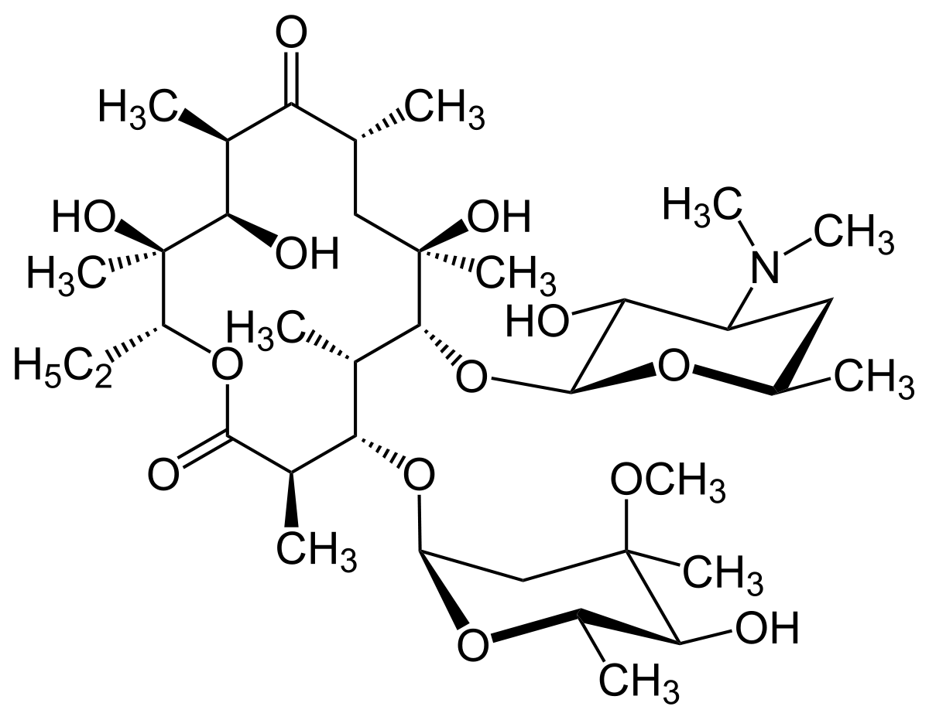
Macrolides

Slide 17
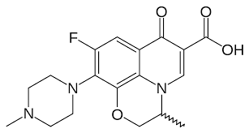
Antibiotics that interfere with DNA replication
Quinolones and Fluoroquinolones

