Slide 1
Glycolysis and Kreb’s Cycle

Slide 2
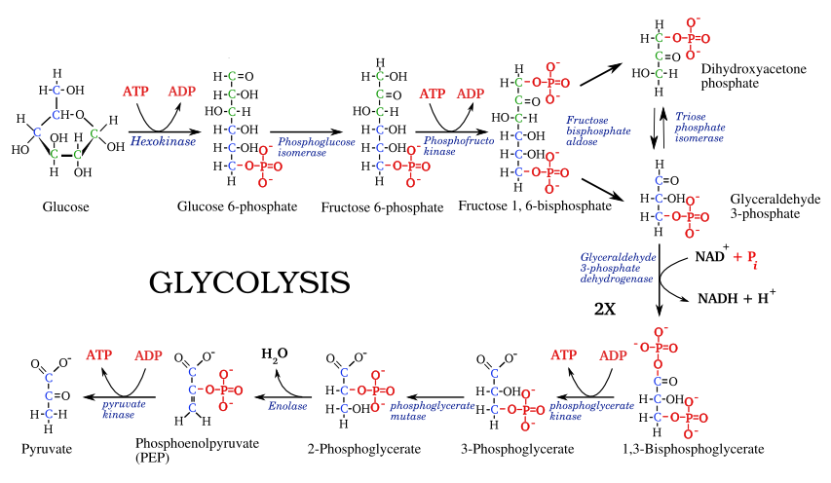
Notes:
Phase One:
Priming phase
Energy requiring (Uses 2 ATP)
Converts glucose to DHAP and GAP
Phase Two:
Energy yielding (Makes 4 ATP and 2 NADH)
Converts DHAP and GAP to Pyruvate

Slide 3
Things to Do with Pyruvate
Make lactate (lactic acid) to use in gluconeogenesis
Make ethanol (fermentation)
Make acetyl CoA for the Kreb’s cycle

Slide 4
Lactate Dehydrogenase
Notes:
•Lactate dehydrogenase makes lactate from
pyruvate.
•This occurs under conditions where the cells
are anaerobic and need to
1. Make more NADH to keep glycolysis going.
2. Need more glucose to keep glycolysis going.

Slide 5
Alcohol Dehydrogenase
Notes:
Some microorganisms convert pyruvate to ethanol in a process called alcoholic fermentation.
Uses the enzyme pyruvate decarboxylase which requires thiamine as a cofactor.

Slide 6
Pyruvate Dehydrogenase
Notes:
Under aerobic conditions the pyruvate is converted to Acetyl CoA to be used in the Kreb’s Cycle.
Uses thiamine as a cofactor
Thiamine deficiency = Beri Beri

Slide 7
Gluconeogenesis
Essentially we go through glycolysis in reverse using some of the same enzymes.
Different enzymes are used in 3 steps:
Glycolysis Gluconeogenesis
Hexokinase Glucose-6-Phosphatase
Phosphofructokinase Fructose-1,6-Bisphosphatase
Pyruvate kinase Phosphoenolpyruvate carboxykinase and pyruvate carboxylase

Slide 8
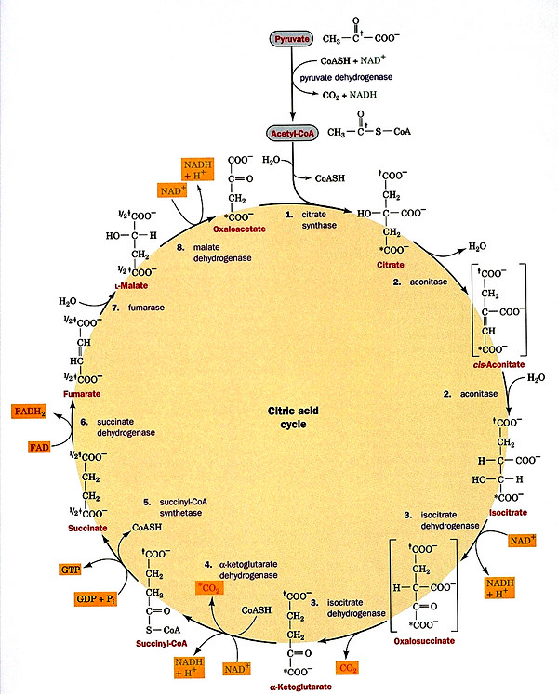
Kreb’s Cycle
Notes:
•Also called the Tricarboxylic
Acid Cycle (TCA cycle)
•Utilizes compounds provided
by metabolism of :
Carbohydrates,
Lipids, and
Amino Acids

Slide 9
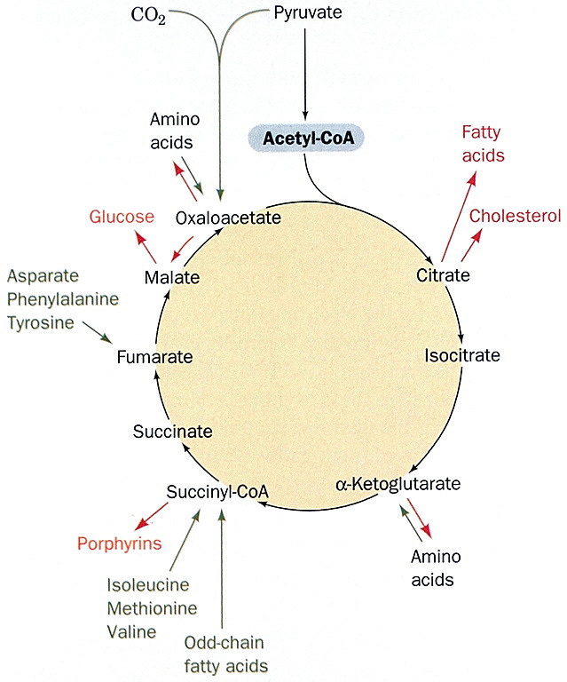
The Kreb’s Cycle is amphibolic

Slide 10
Summary of Kreb’s Cycle
Acetyl CoA + 3NAD⁺ + GDP + Pi + FAD
yields
2CO₂ + 3NADH + GTP + FADH₂

