Slide 1
Beta Oxidation of Fatty Acids

Slide 2
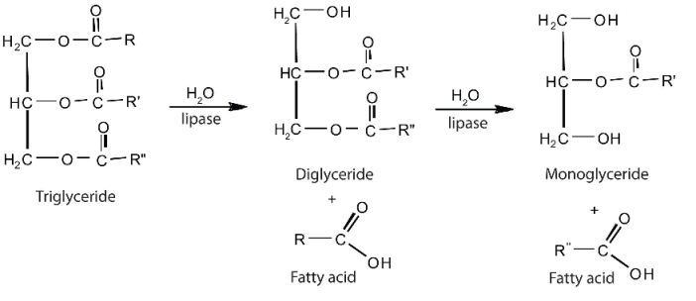

Slide 3
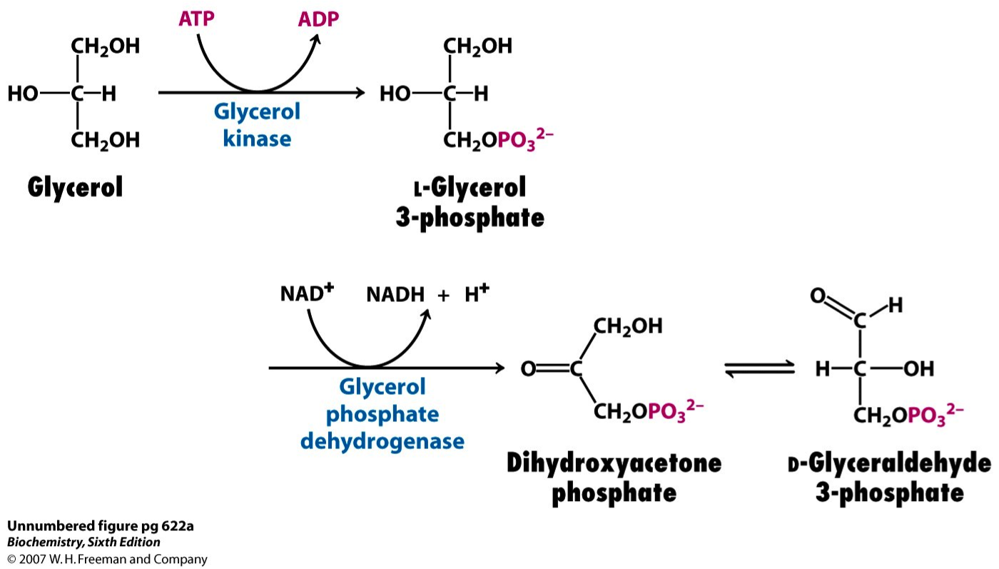
Glycerol Metabolism

Slide 4
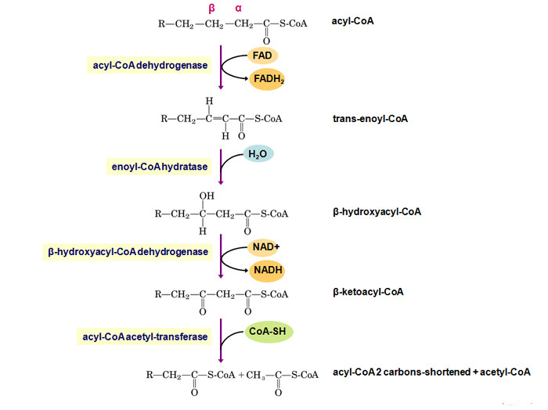
Steps of Beta Oxidation

Slide 5
