Slide 1
Properties of Organic Molecules

Slide 2
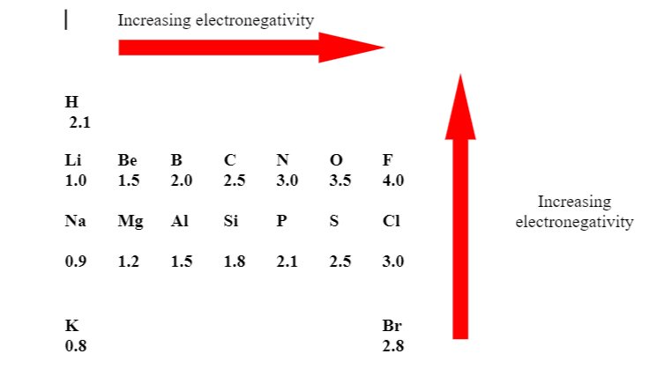
Intermolecular Forces

Slide 4
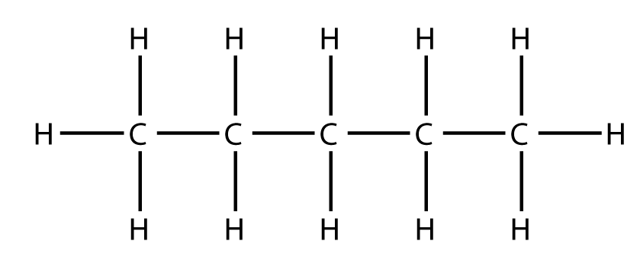
Polarity

Slide 5
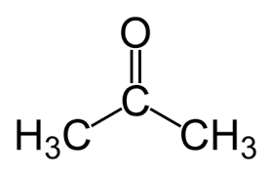
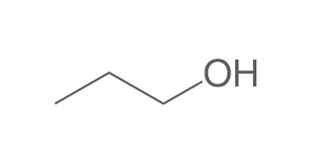

Slide 6
Boiling Points (and Melting Points)

Slide 7
Which would have the highest boiling point?
Which would have the highest melting point?

Slide 8
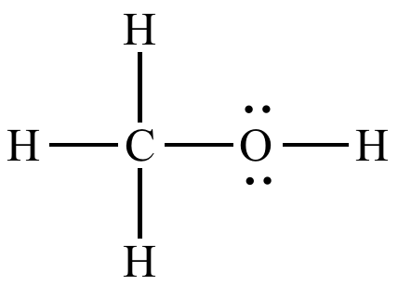
Solubility

Slide 9
Solute | Polar Solvent | Nonpolar Solvent
Ionic Solute | Soluble | Insoluble
Polar Solute | Soluble | Insoluble
Nonpolar Solute | Insoluble | Soluble

Slide 10
