Slide 1
Properties of Alkanes

Slide 2
Polarity and Solubility

Slide 3
Intermolecular Interactions

Slide 4
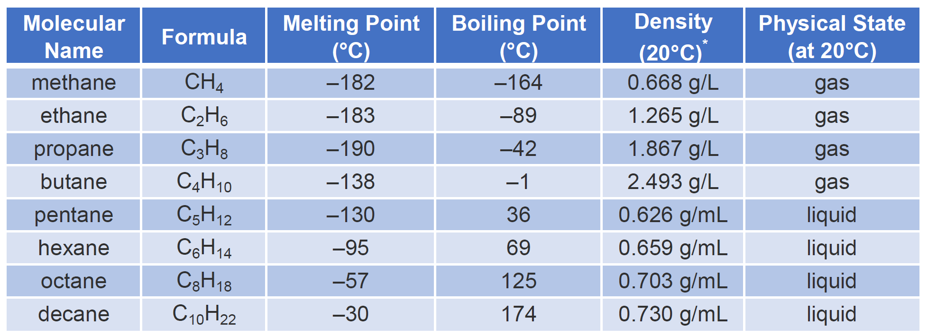
Physical Properties
Polarity
Solubility

