Slide 1
Cycloalkanes

Slide 2
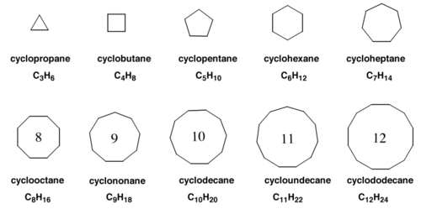
Cycloalkanes

Slide 3
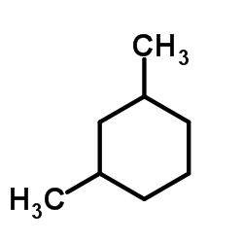

Slide 4
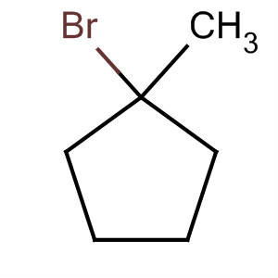

Slide 5
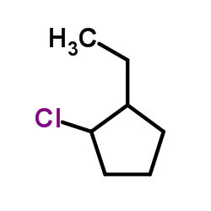

Slide 6


Slide 7


Slide 8
