Slide 1
Receptors
Stereochemistry

Slide 2
Stereochemistry
Enantiomers
Diastereomers

Slide 3
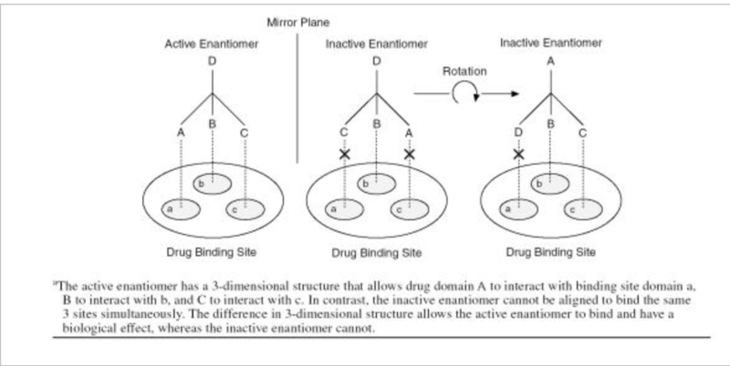

Slide 4
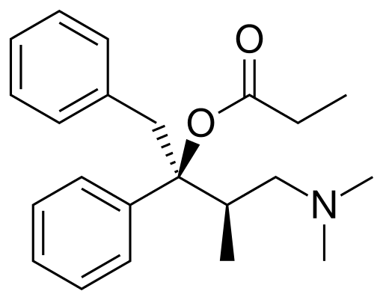
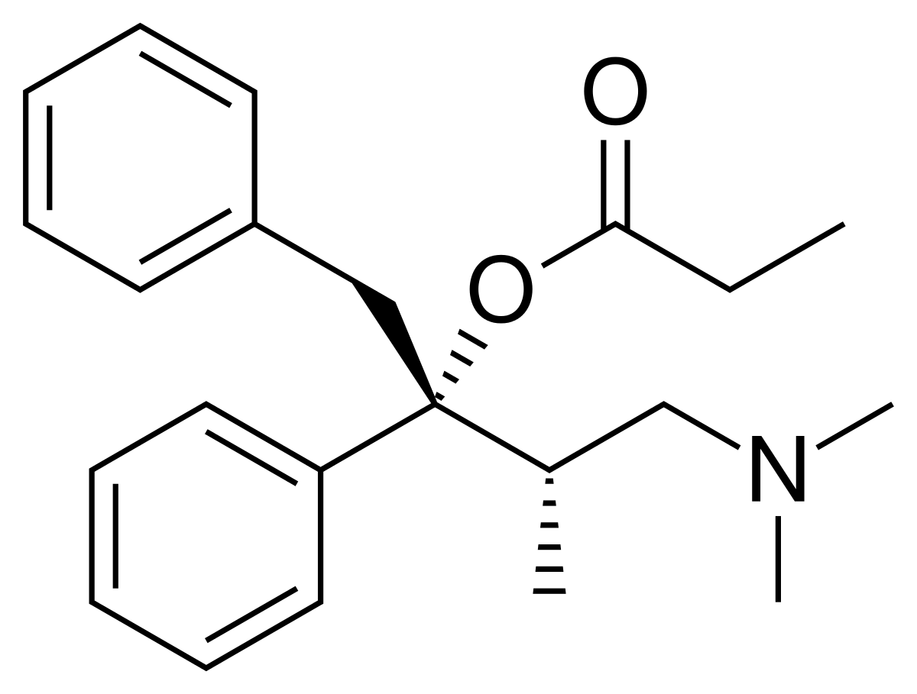
Dextropropoxyphene
Levropropoxyphene

Slide 5
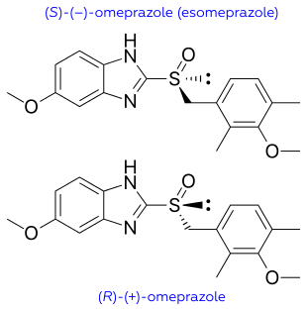

Slide 6
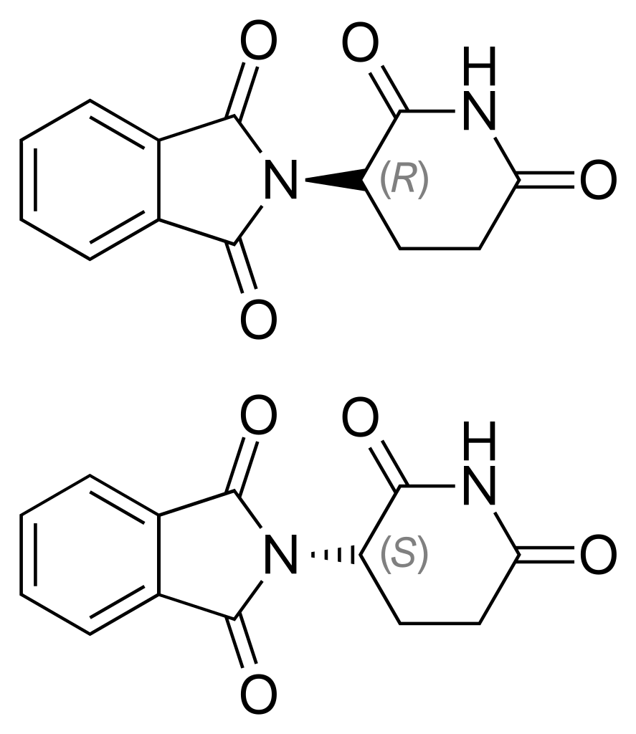
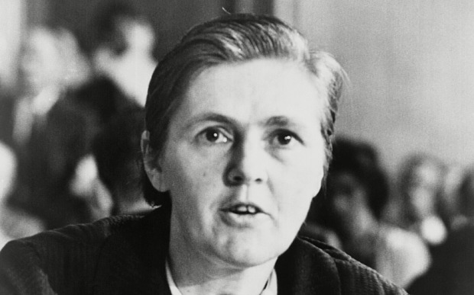

Slide 7
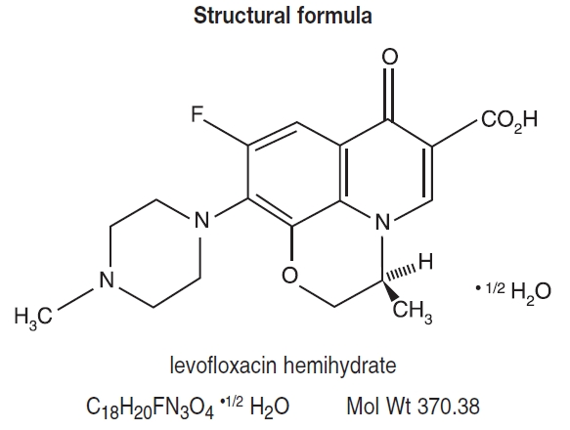

Slide 8
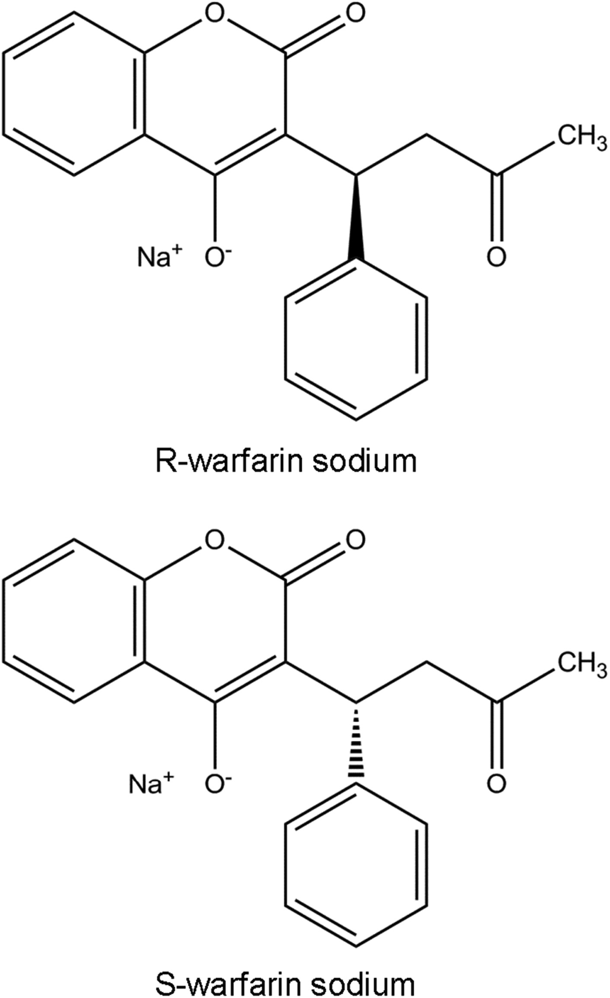

Slide 9
Eutomer
Distomer
Eudismic Index

Slide 10
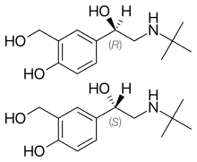
Notes:
albuterol

Slide 11
Comments on binding of ligands and drugs to receptors:

