Slide 1
Acetylcholine Receptors

Slide 2
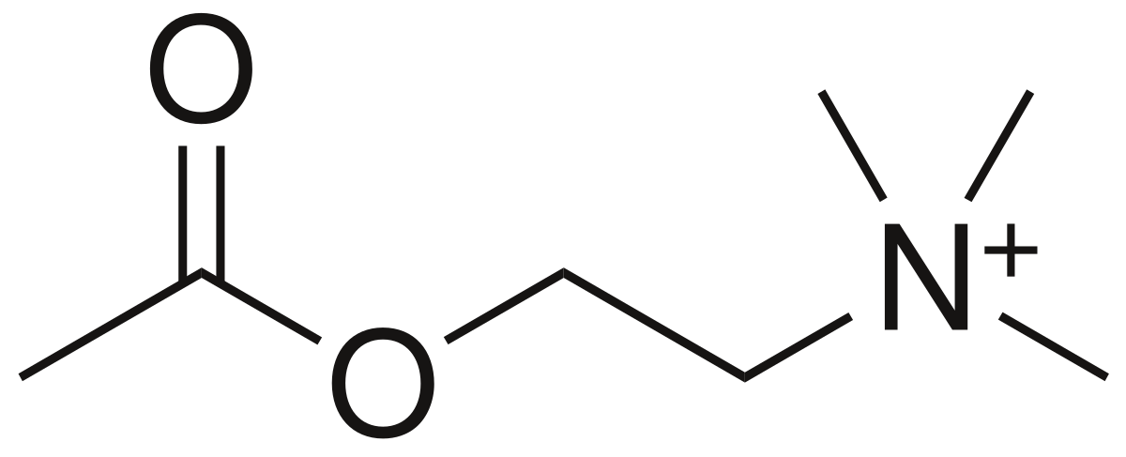

Slide 3
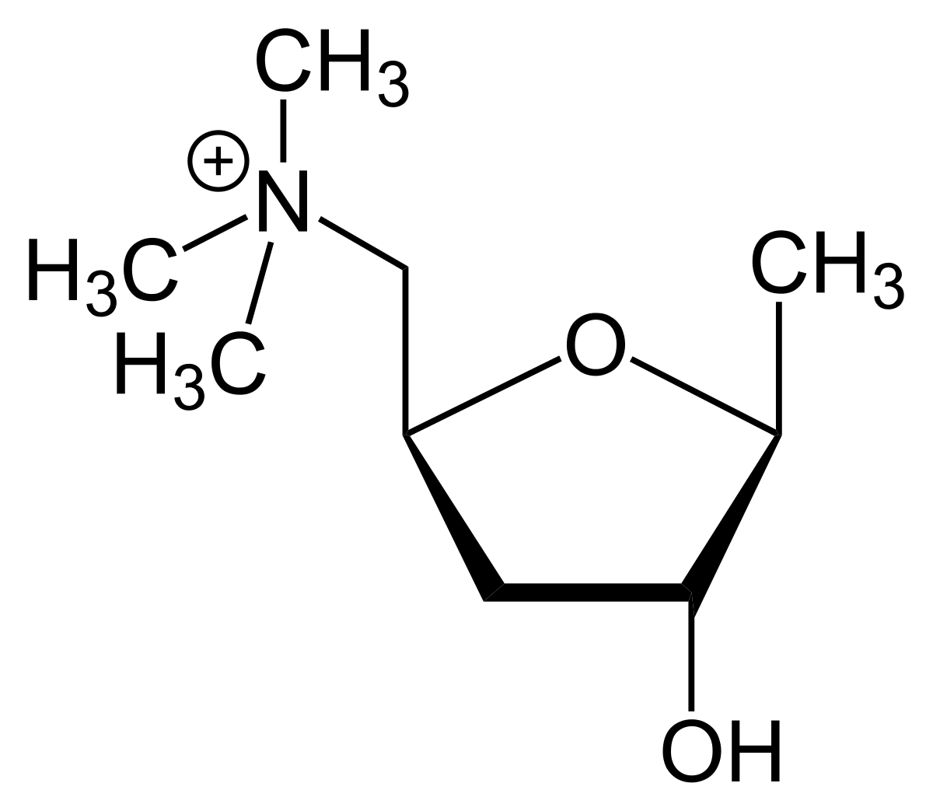
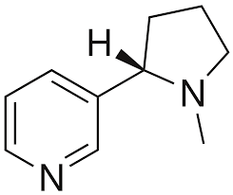
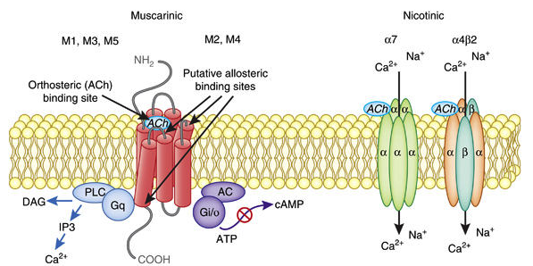

Slide 4
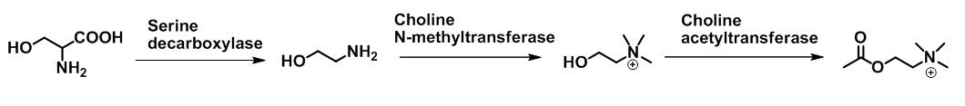

Slide 5
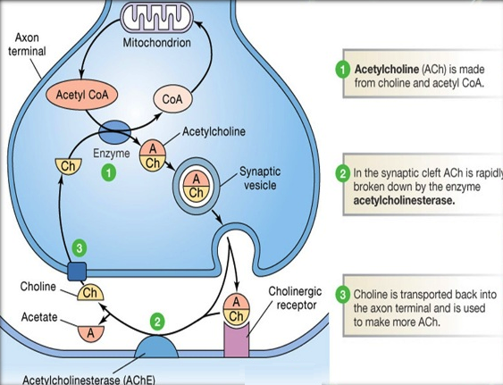

Slide 6


Slide 7
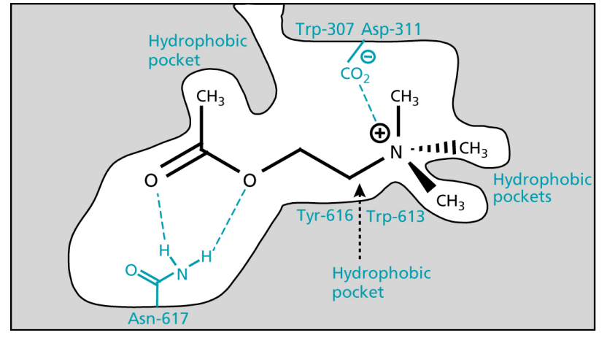

Slide 8
Direct Cholinergics

Slide 10
Muscarinic Receptors
M₁ ganglia; gastric glands; CNS
M₂ cardiac muscle
M₃ smooth muscle; endocrine glands

Slide 11
Agonists
Antagonists
M₁
M₂
M₃

Slide 12
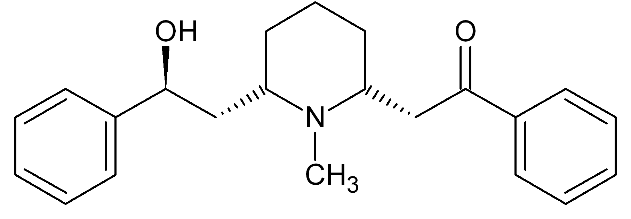
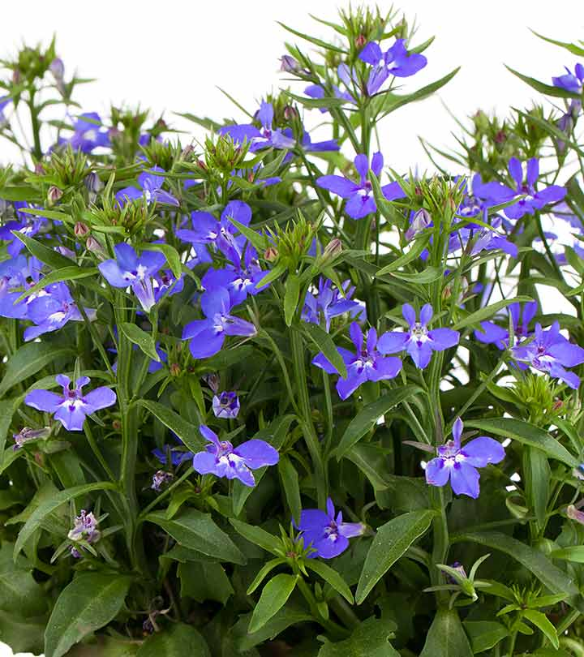
Nicotinic Receptors
N_{N} Autonomic ganglia
N_{M} Skeletal muscle

Slide 13
General AChR Antagonists

Slide 15
Amino alcohol ethers

Slide 16
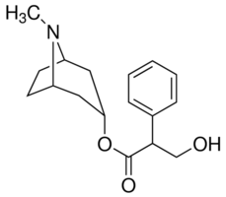
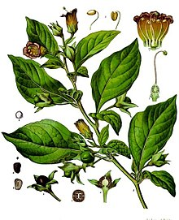
AChR Antagonists

Slide 17
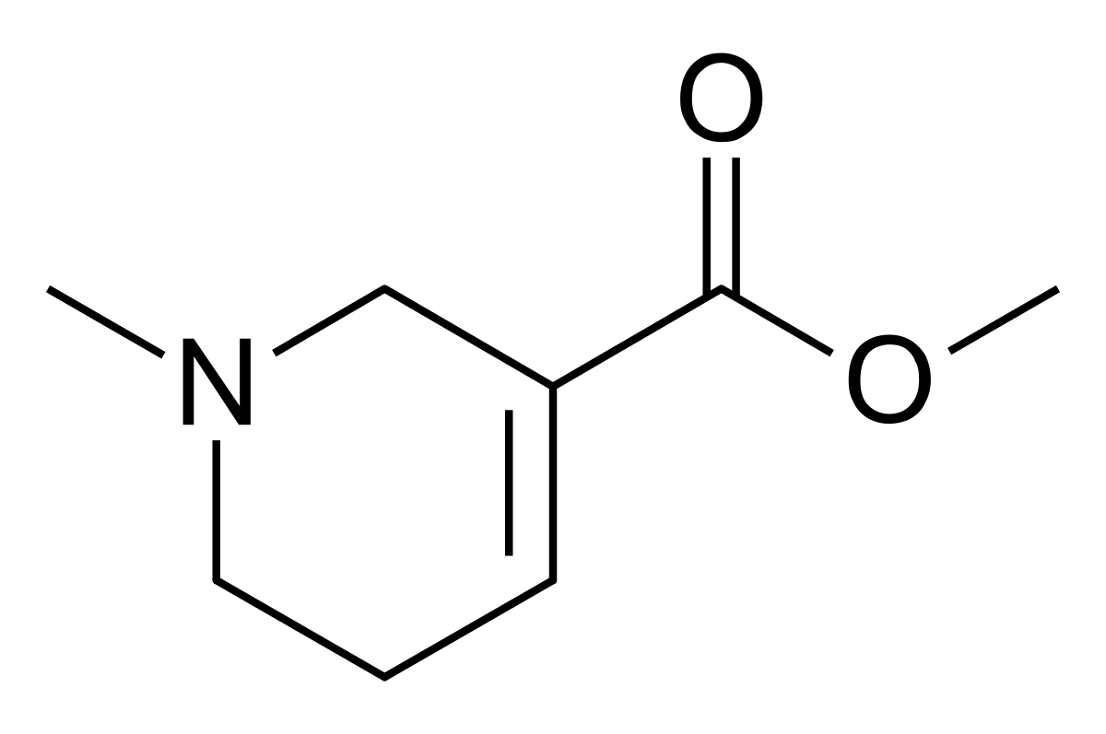
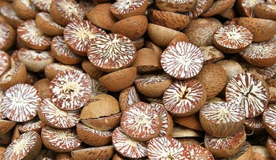
AChR Antagonists

Slide 18
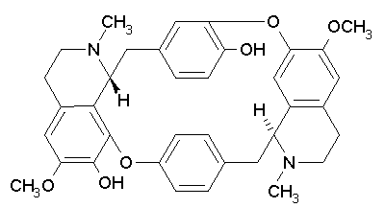
AChR Antagonists
Curare

Slide 19
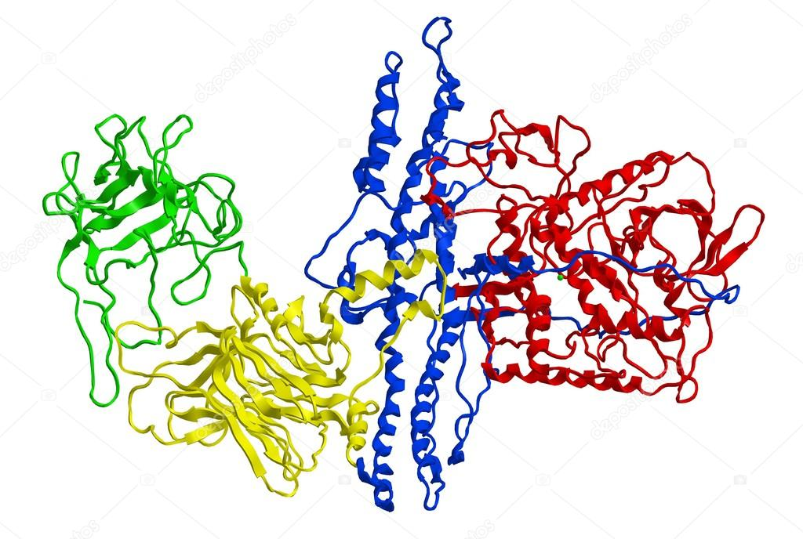
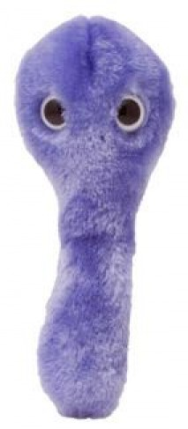
AChR Antagonists

Slide 20
AChR Antagonists

Slide 21
AChR Antagonists

Slide 22
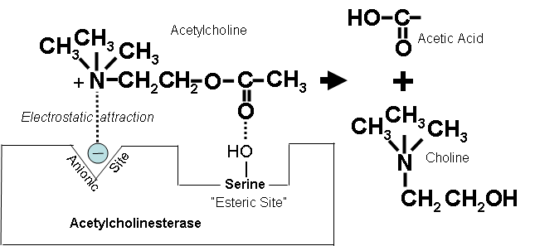
Indirect Cholinergics

Slide 23
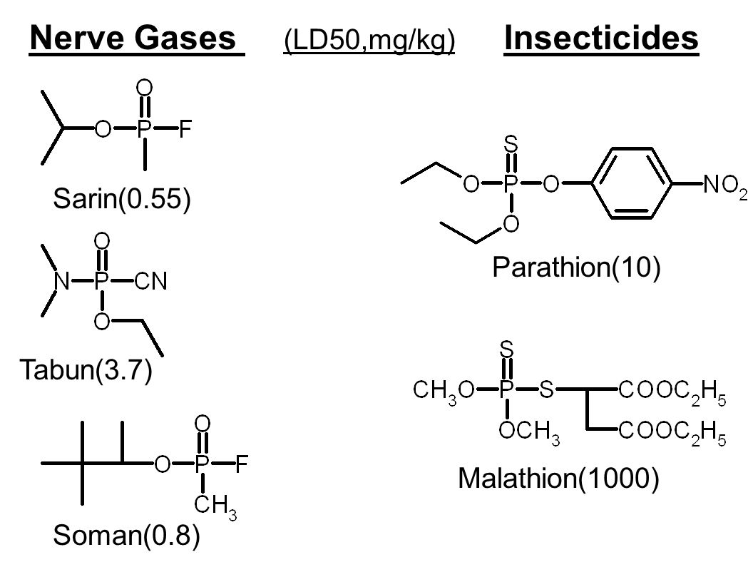

Slide 24
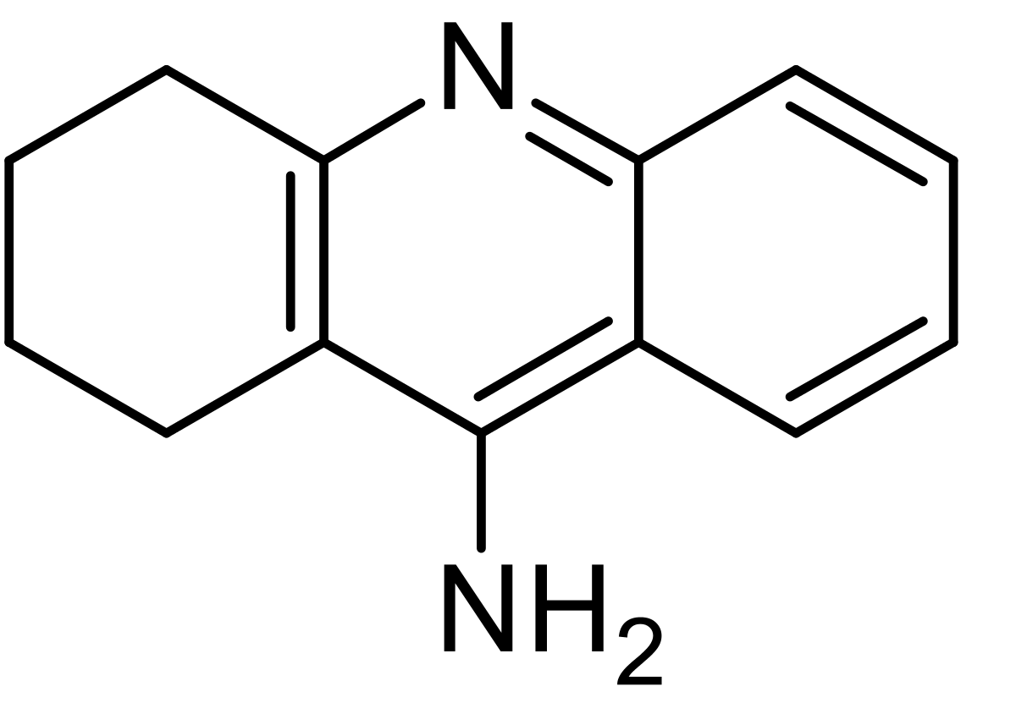
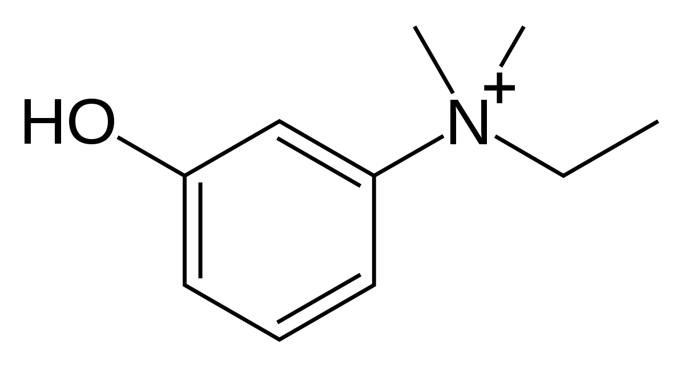
Tacrine
Edrophonium

Slide 25
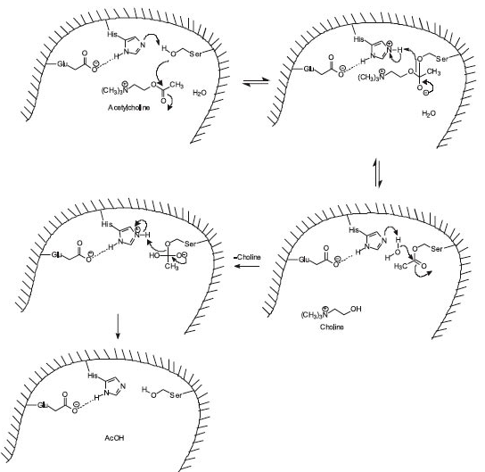
Notes:
http://www.scielo.br/img/revistas/jbchs/v20n3/a03fig04.jpg

Slide 26
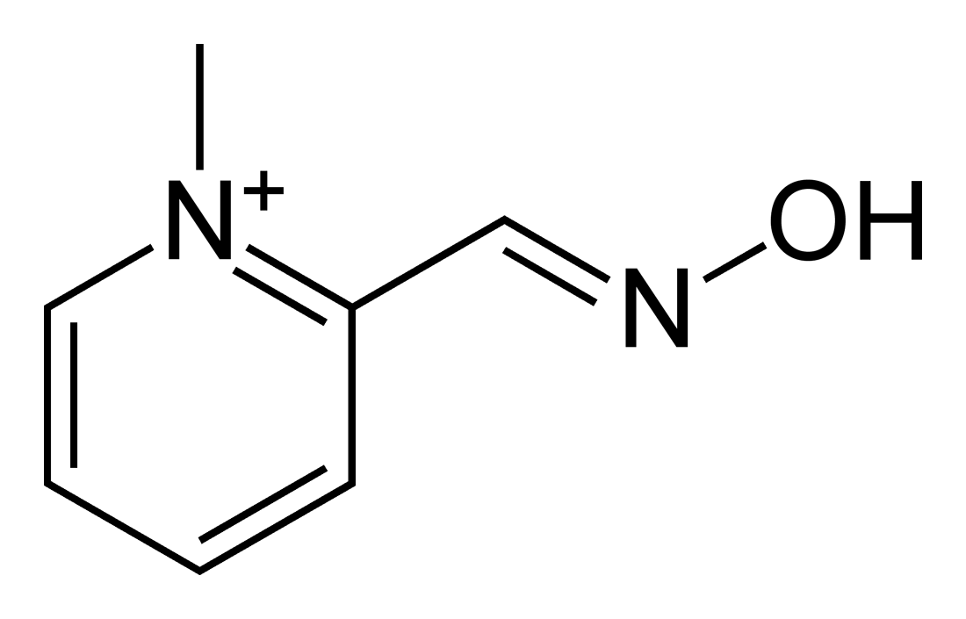

Slide 27
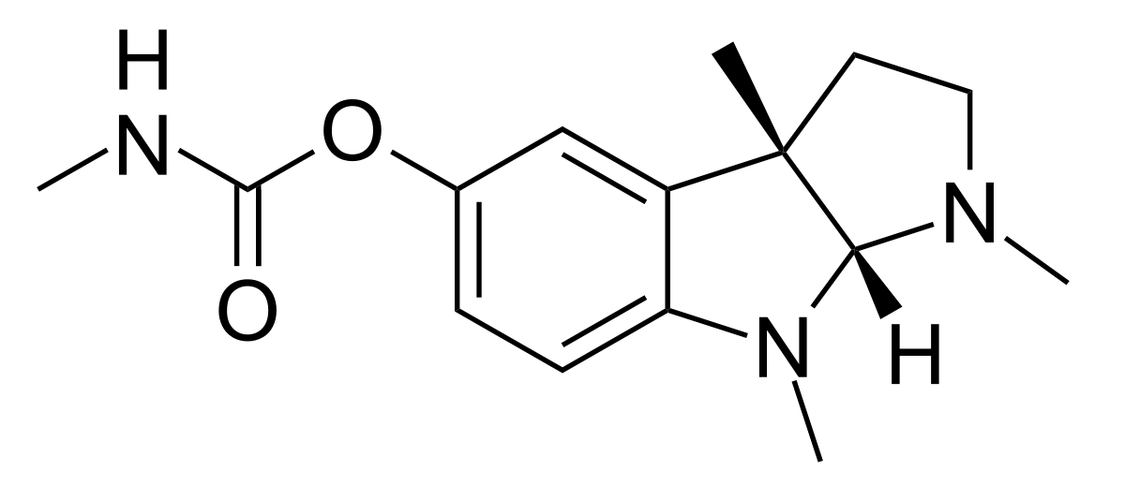
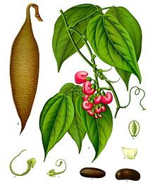
Reversible AChEI

Slide 28
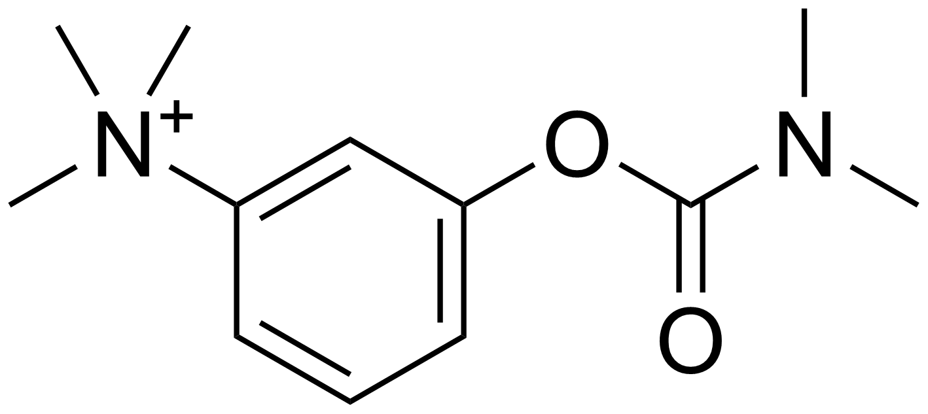

Slide 29
Myasthenia Gravis

