Slide 1
Antipsychotics

Slide 2
Psychosis

Slide 3
Schizophrenia
Dopamine Hypothesis : Schizophrenia is the result of increased DA neurotransmission
Positive Symptoms : delusions, hallucinations, thought disorder, emotional disturbances
Negative Symptoms : lack of motivation, social isolation, lessened speech

Slide 4
Antipsychotics (Neuroleptics)
Neuroleptics: cause sedation, are anxiolytic, are antiemetic

Slide 5
Phenothiazines
Thioxanthenes
Butyrophenones

Slide 6
Phenothiazine

Slide 10
R1 R2
Thorazine
Triflpromazine
Perphenazine
Fluphenazine
Trifluoperazine

Slide 11
Chlorprothixene
Thiothixene

Slide 12
Butyrophenones

Slide 13
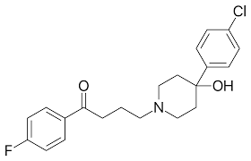
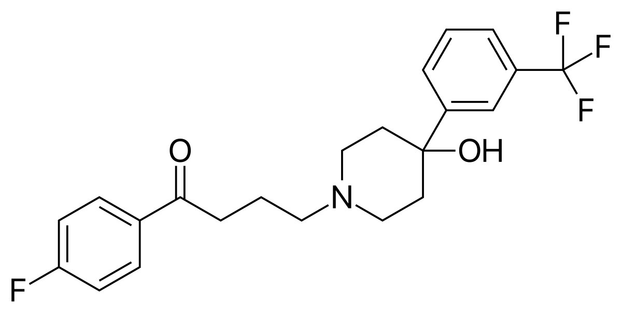
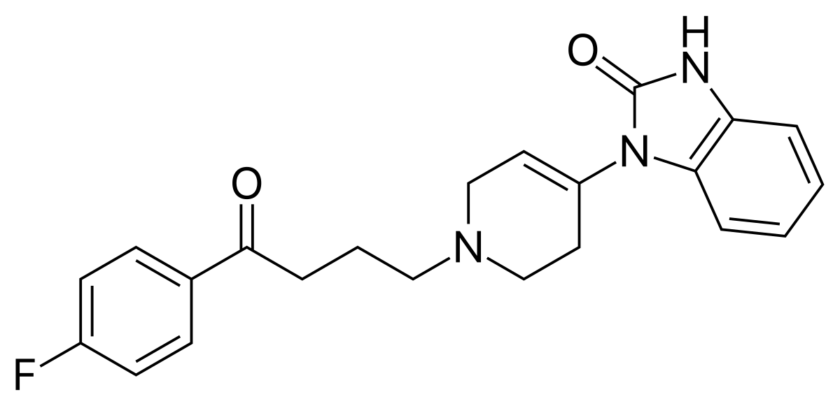

Slide 14
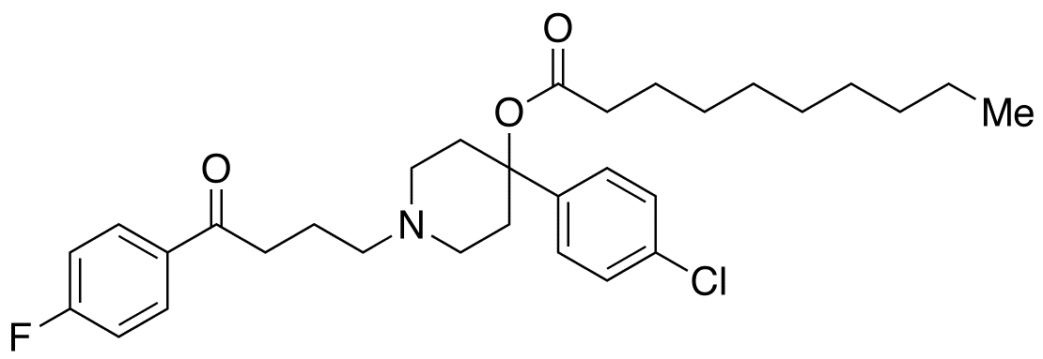
Haloperidol decanoate
Depot Drugs

Slide 15
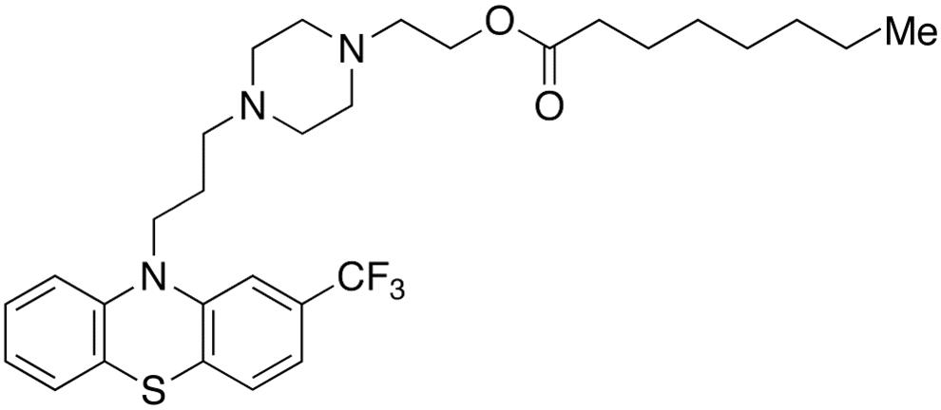

Slide 16
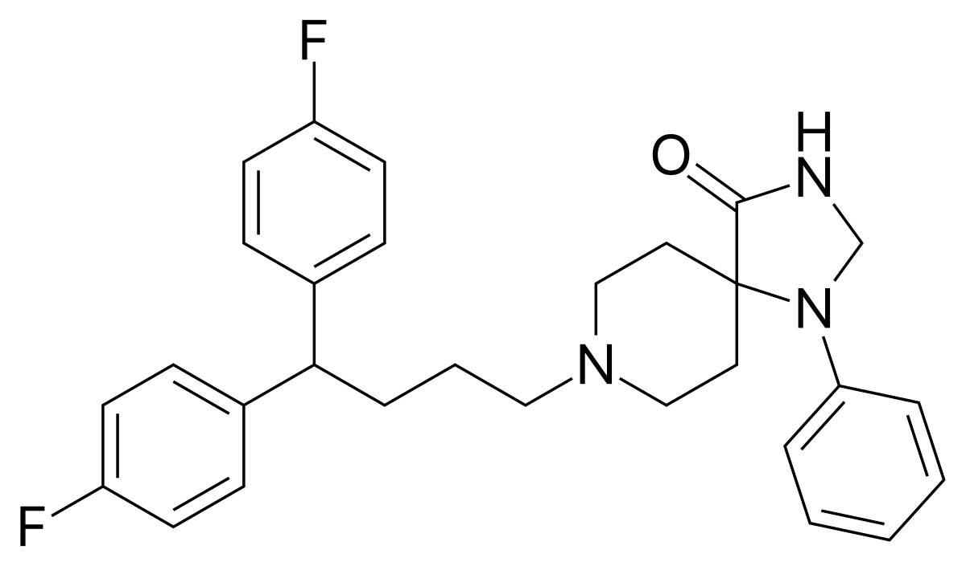
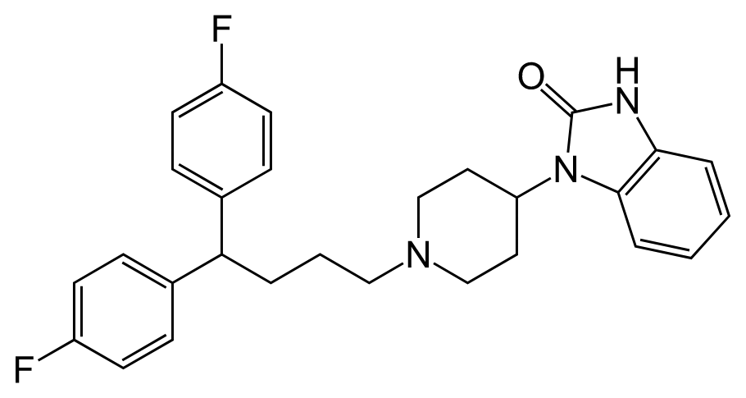
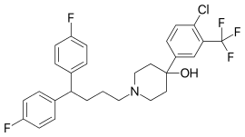
Diphenylbutylpiperidines

Slide 17
Neuroleptic Side Effects
Sedation, hypotension, sexual dysfunction
GI problems, bladder problems, cardiac side effects, opthalmic
Neuroleptic Malignant Syndrome

Slide 18
Long term neuroleptic use may result in
Parkinsonian Syndrome
Akathisia
Tardive Dyskinesia

Slide 20
Atypical Antipsychotics (2nd generation)

Slide 21
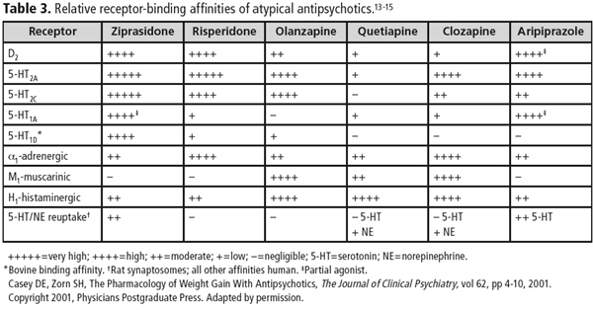
Atypical antipsychotics
Side effects related to binding at other receptors…..
Dizziness
Sedation
Increased appetite/weight gain

Slide 22
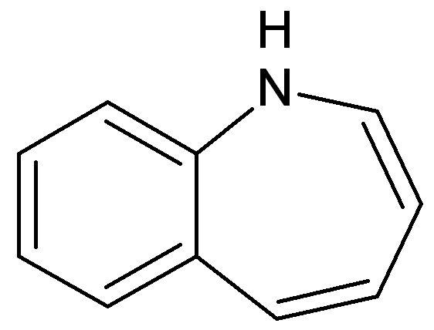
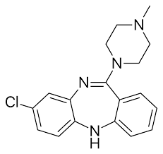
Notes:
Clozapine

Slide 23
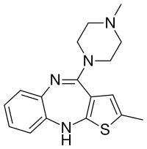
Notes:
zyprexa

Slide 24
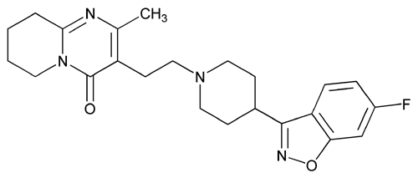
Notes:
risperdal

Slide 25
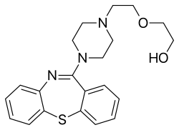

Slide 26
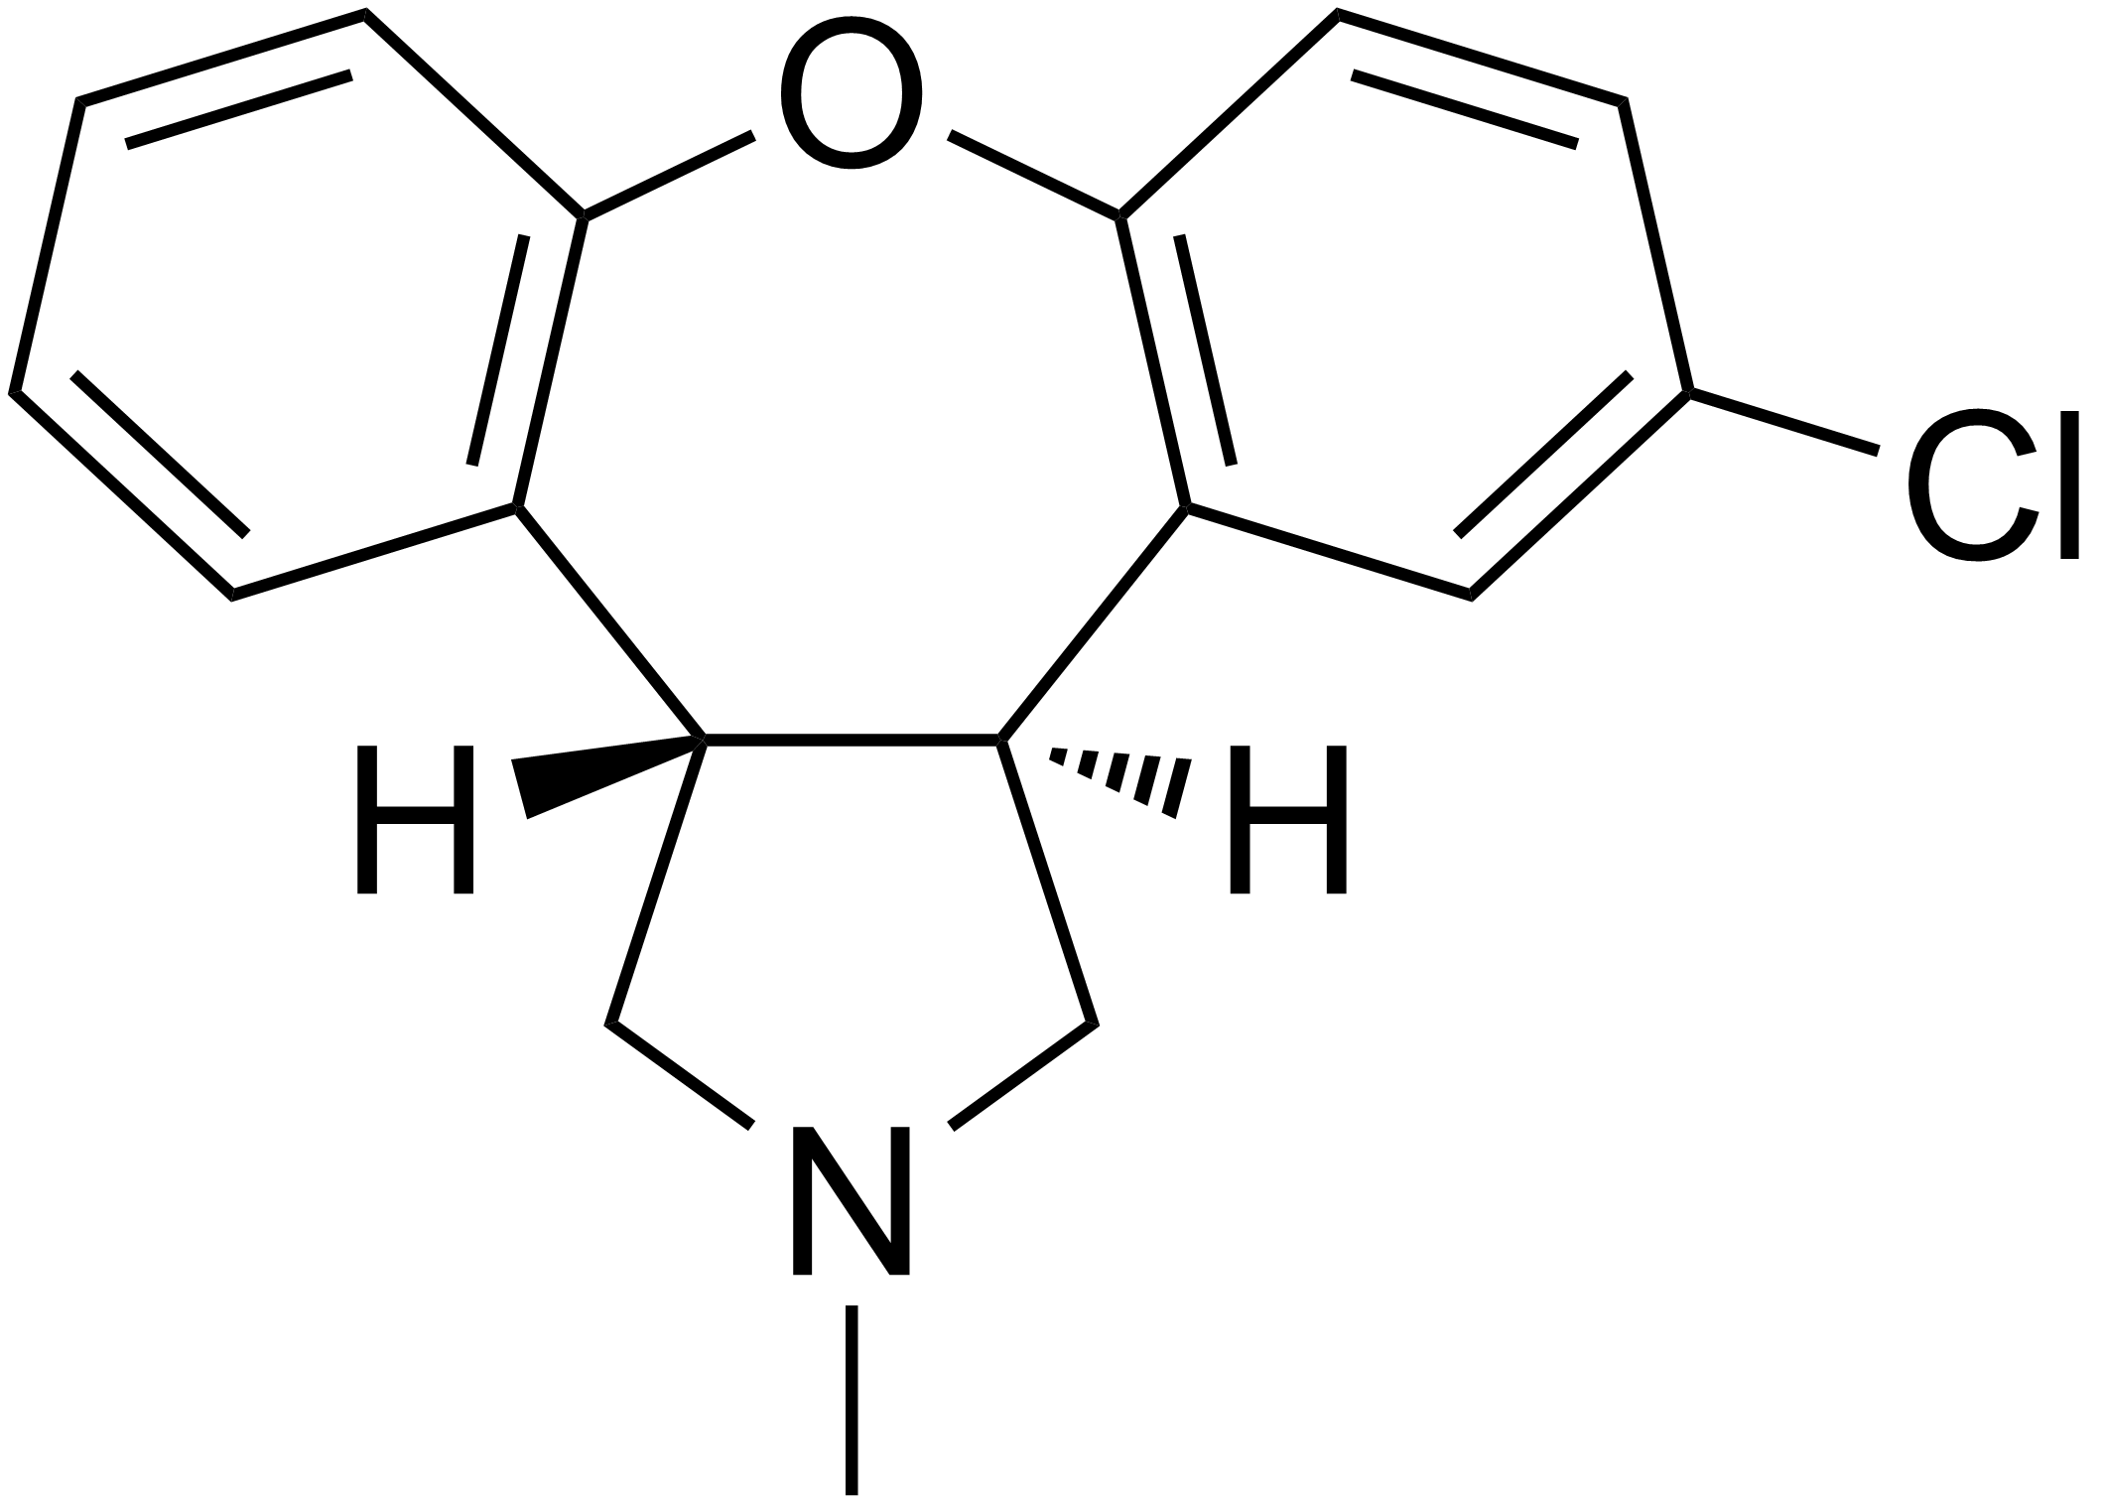
Notes:
Asenapine

Slide 27
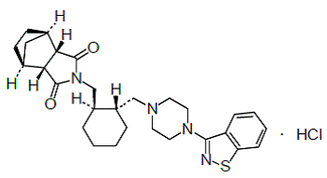
Latuda

Slide 28
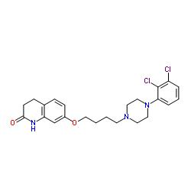
Notes:
Aripiprazole

Slide 30
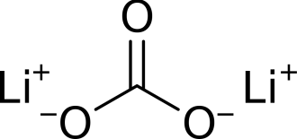
Lithium Salts

