Slide 1
Anxiolytics

Slide 2
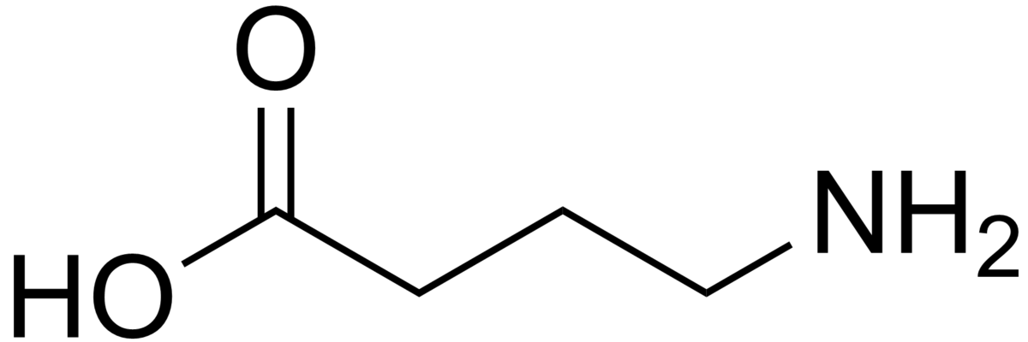
GABA
Low [GABA] is associated with anxiety disorders

Slide 3
GABA Receptors

Slide 4
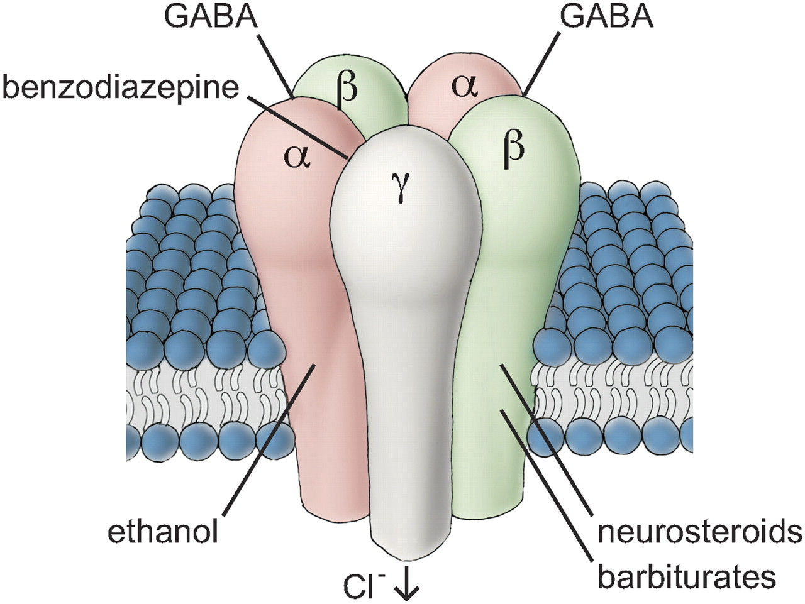
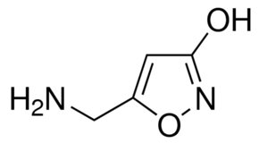

Slide 5
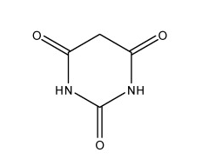
Barbiturates

Slide 6
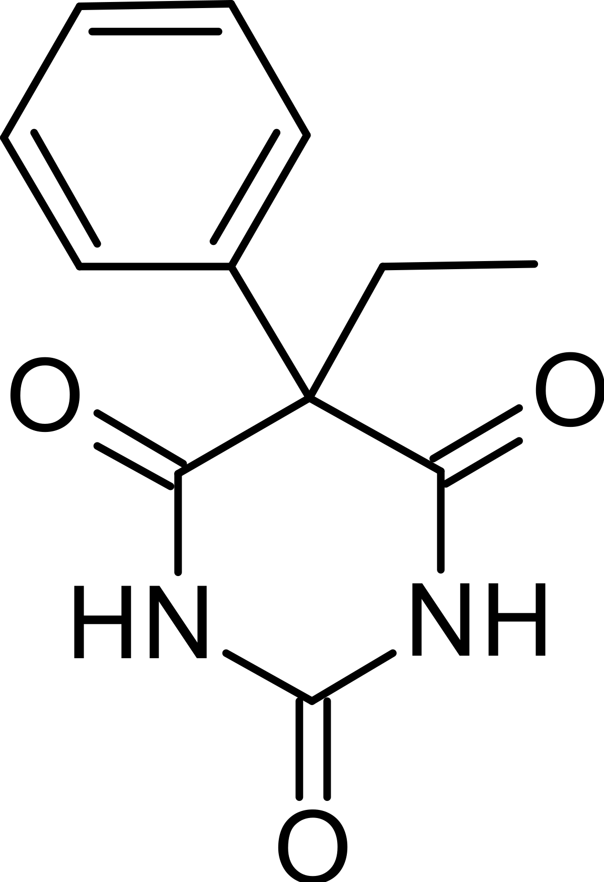
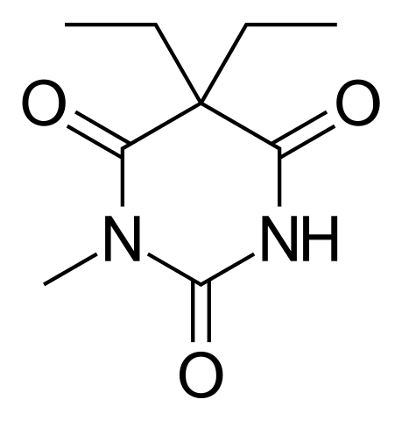
Long Lasting Barbiturates
Notes:
Phenobarbital
Methbarbital

Slide 7
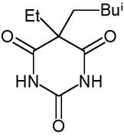
Intermediate Acting

Slide 8
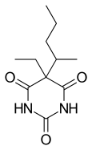
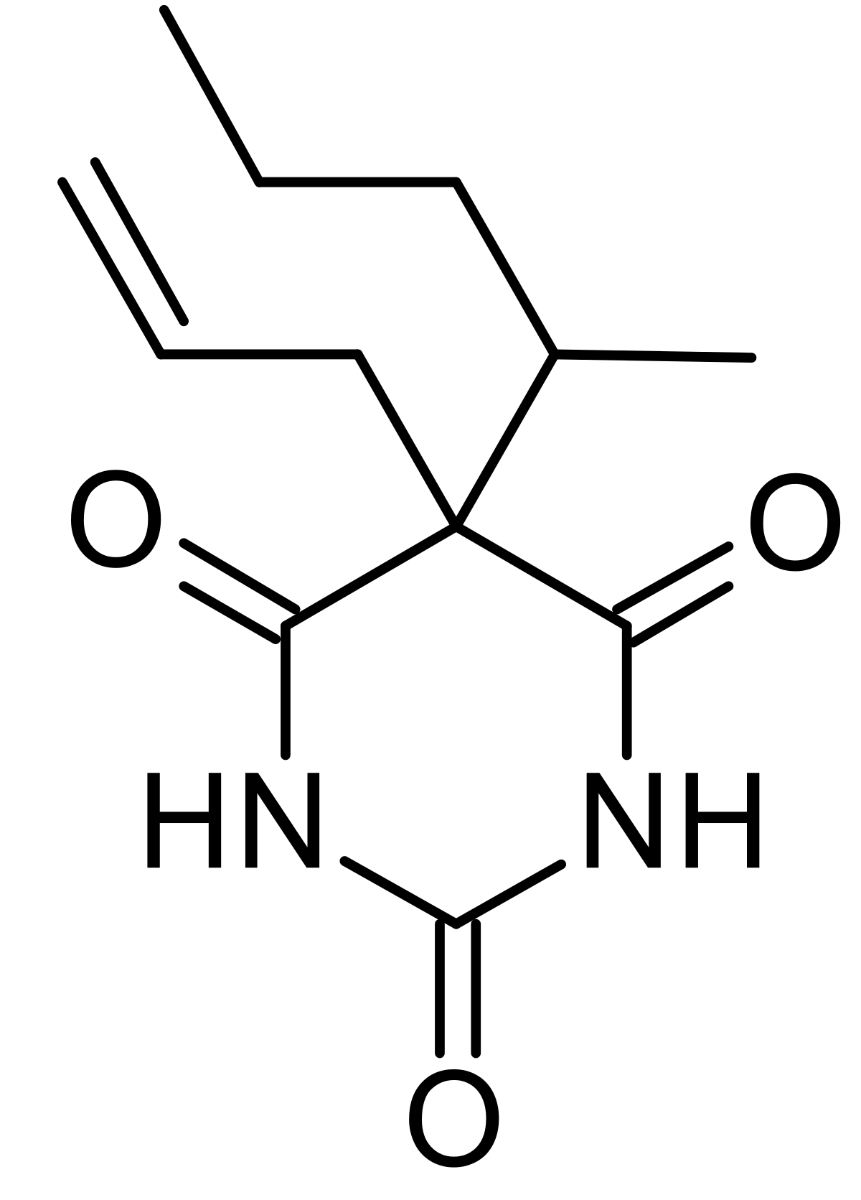
Short Acting <3 hrs

Slide 9
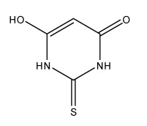
Thiobarbiturates

Slide 10
Barbiturate Synthesis (Grimaux’s Synthesis)

Slide 11
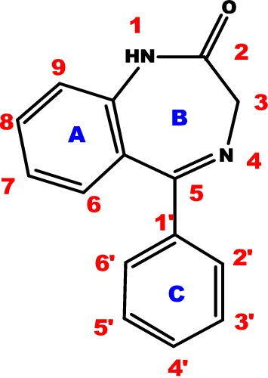
Benzodiazepines

Slide 12
Benzodiazepine Mode of Action

Slide 13
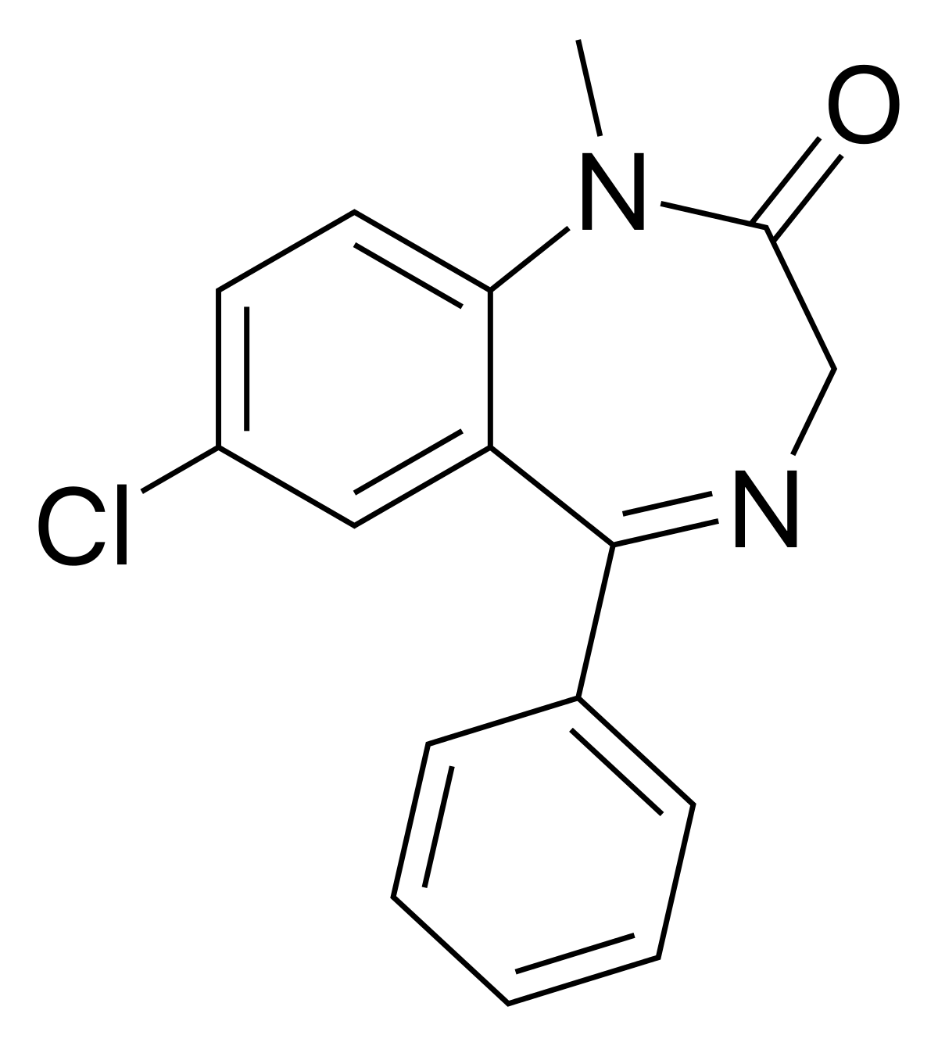
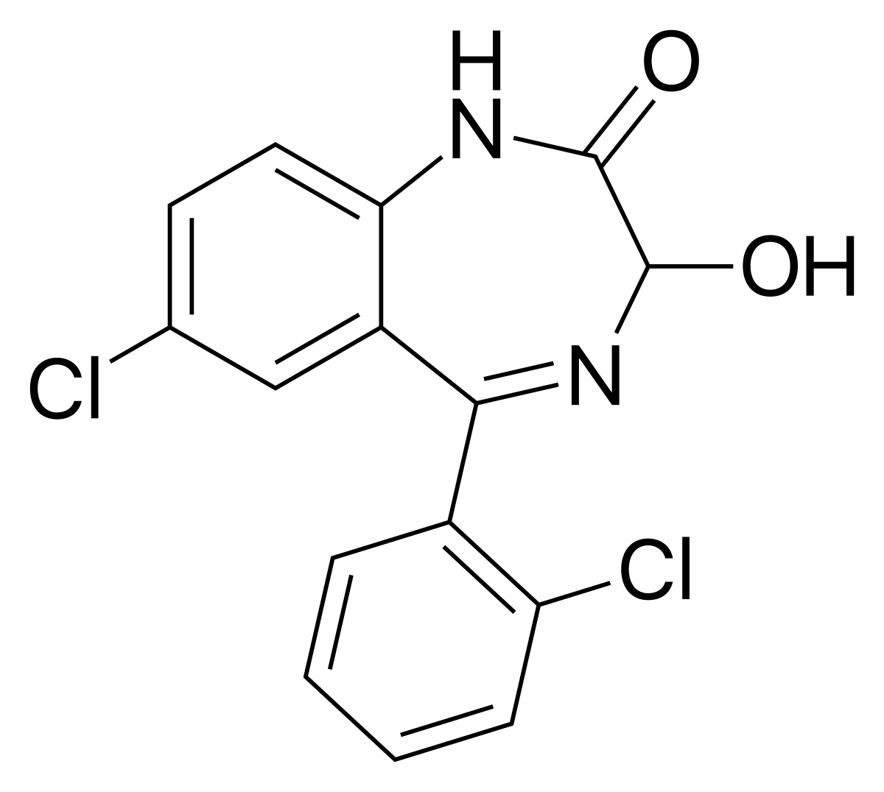
Diazepam
Lorazepam

Slide 14
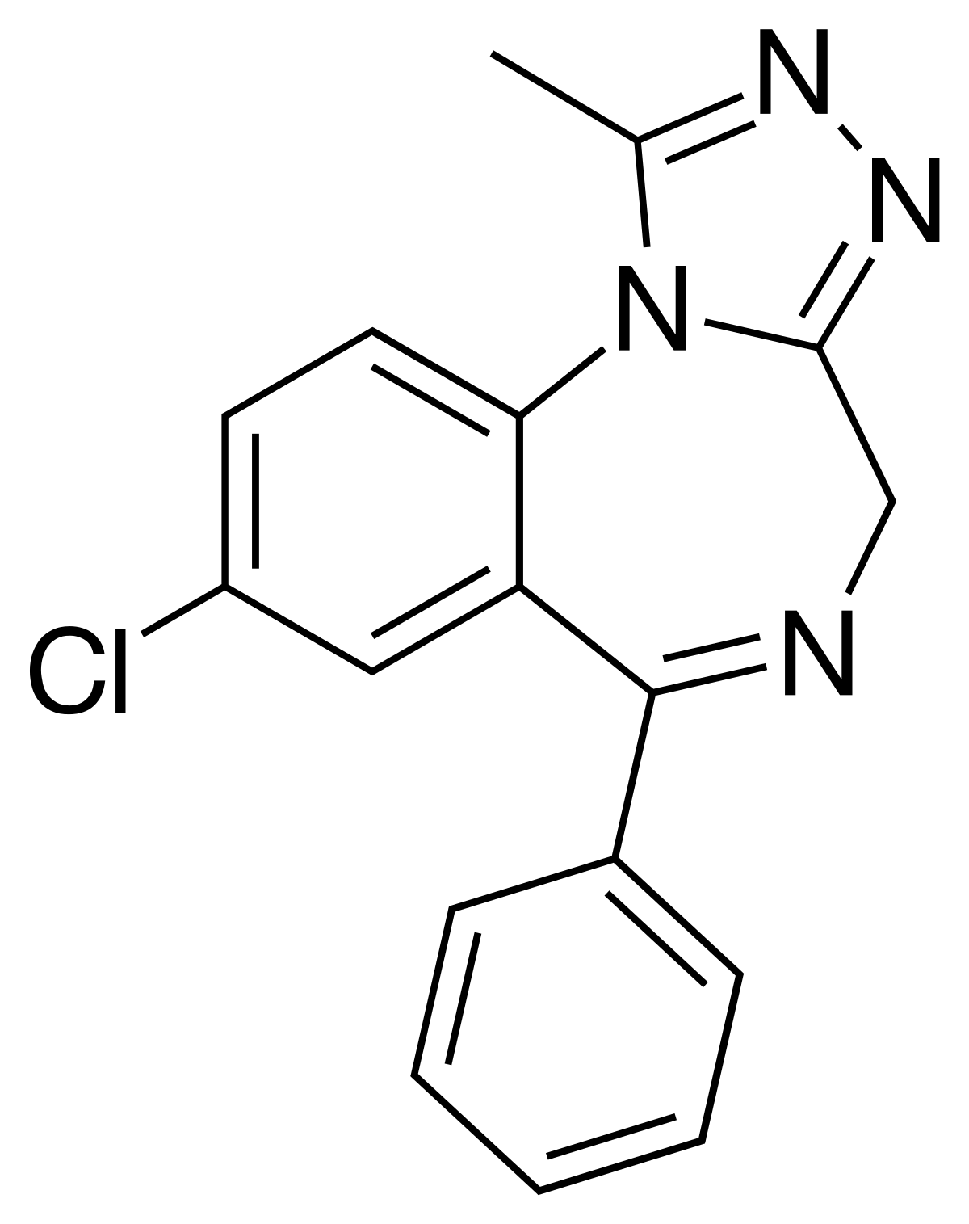
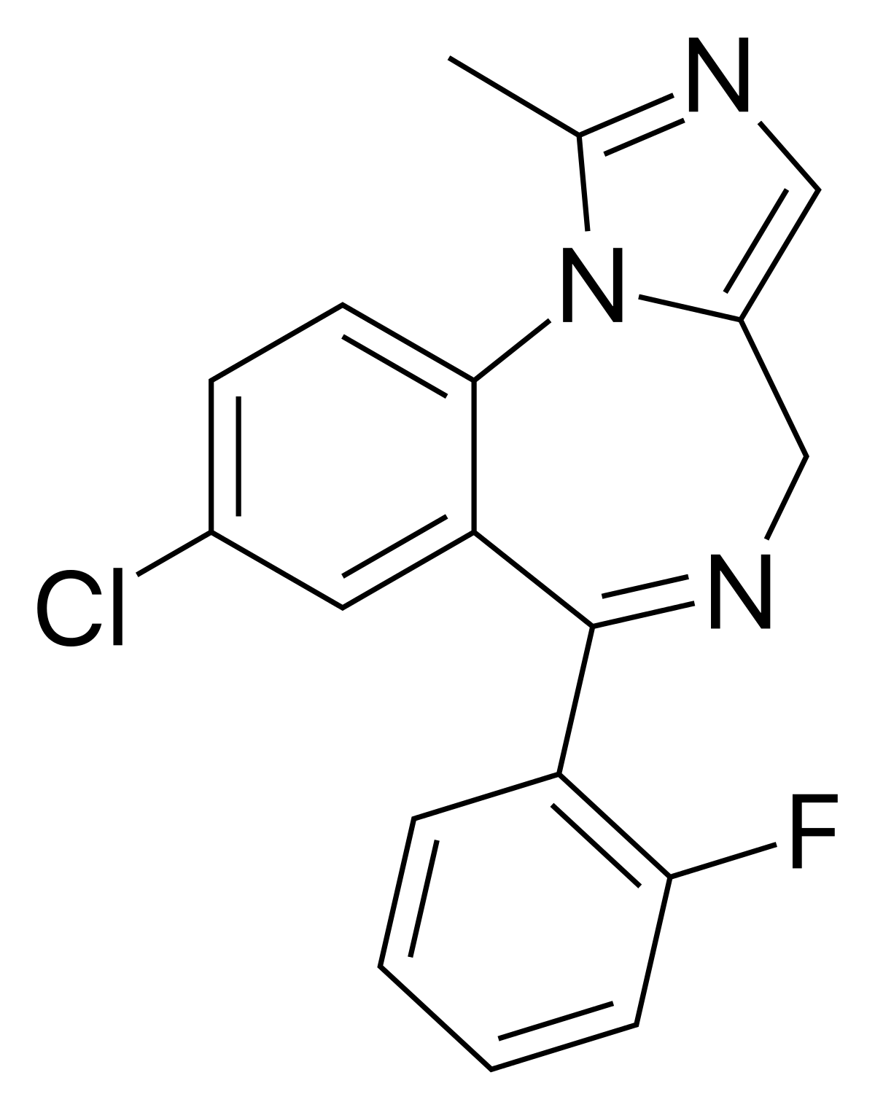
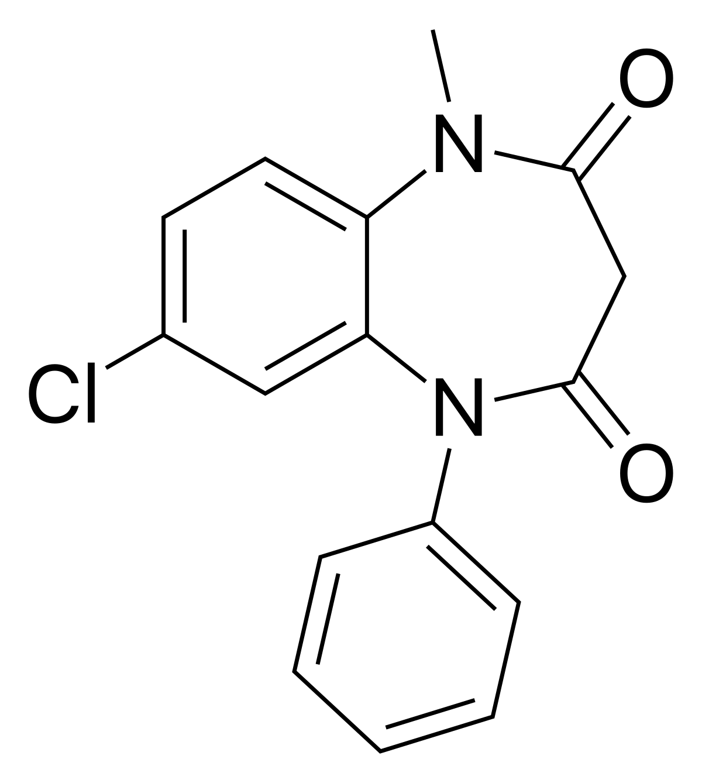
Alprazolam
Clobazam
Midazolam

Slide 15
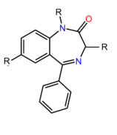
Benzodiazepine Synthesis

Slide 16
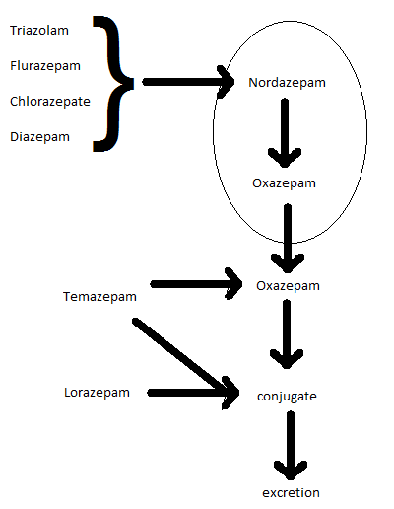

Slide 17
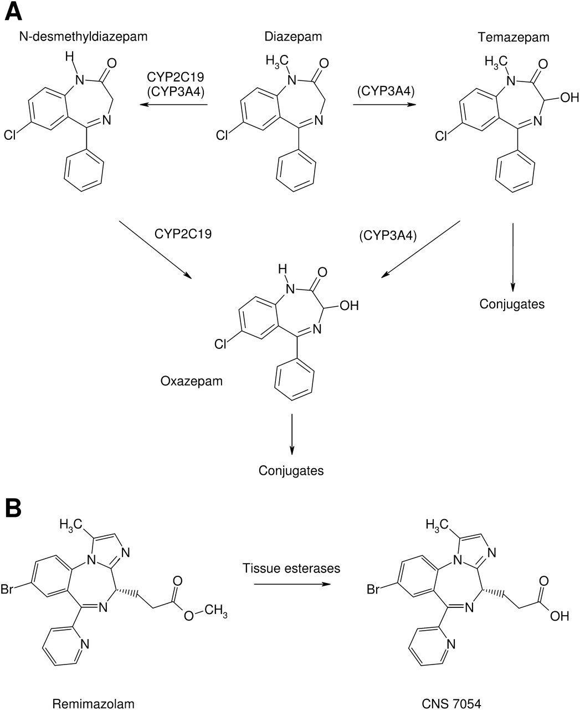

Slide 18
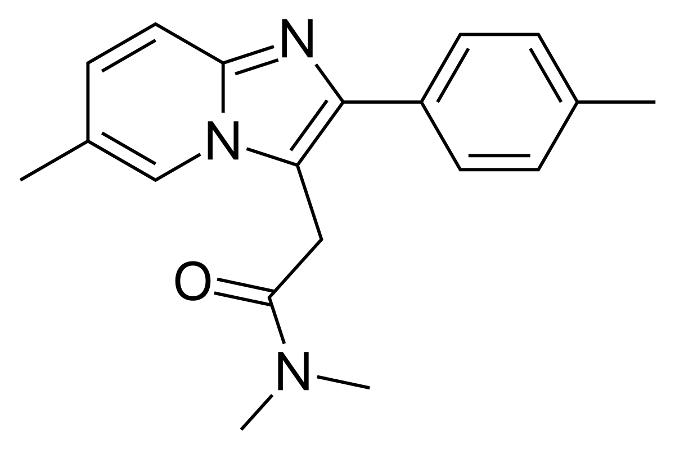
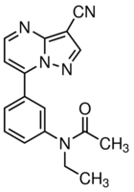
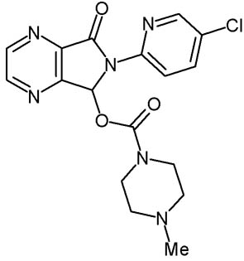
Nonbenzodiazepine GABA_{A} agonists
Zolpidem
Zaleplon
Zopiclone

Slide 19
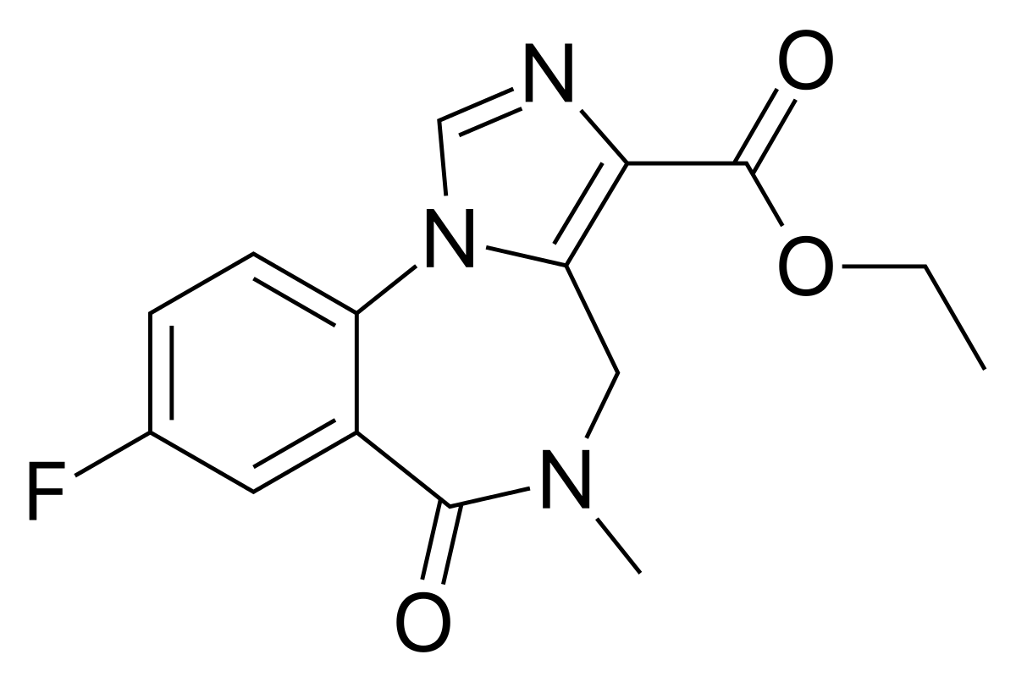
GABA Antagonist
Flumzenil

