Slide 1
Histamine Receptors

Slide 3
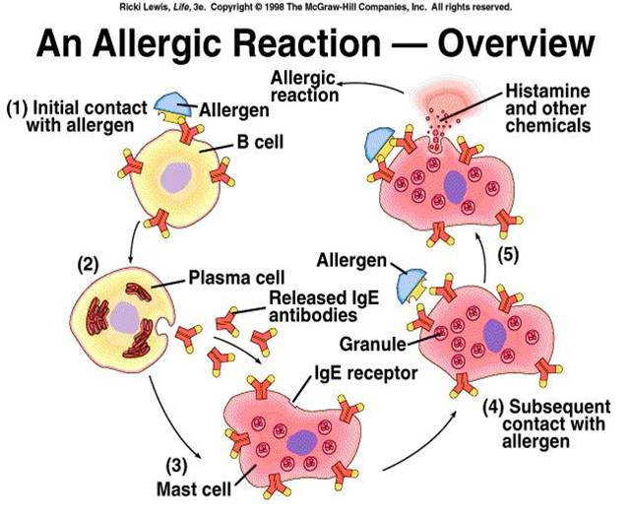

Slide 4
H1 : smooth muscle, endothelial cells
H2 : gastric cells, parietal cells
H3 : CNS
H4 : Immune Cells

Slide 5
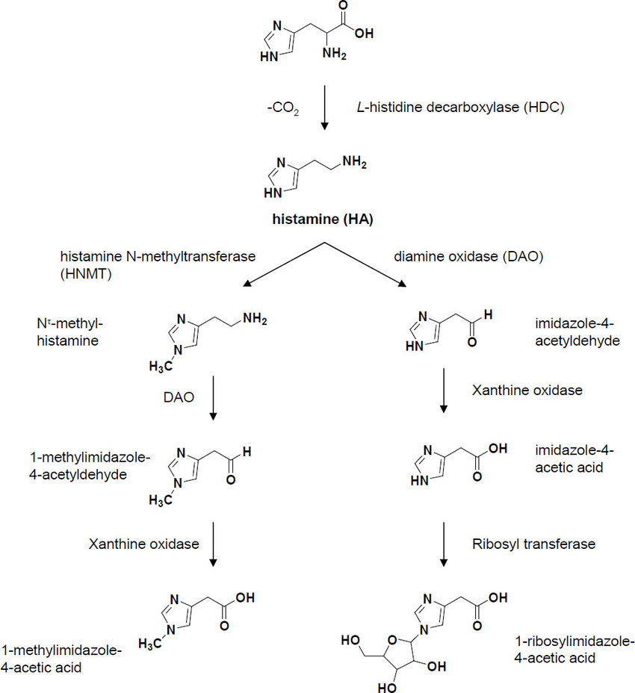
Histamine Deactivation

Slide 6
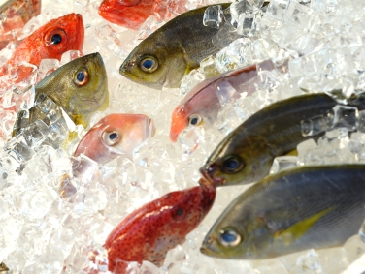
Scombroid Fish Poisoning

Slide 7
First Generation H1 Antagonists : aminoalkyl ethers (ethanolamines)

Slide 8
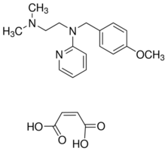
First Generation H1 Antagonists : ethylenediamines

Slide 9
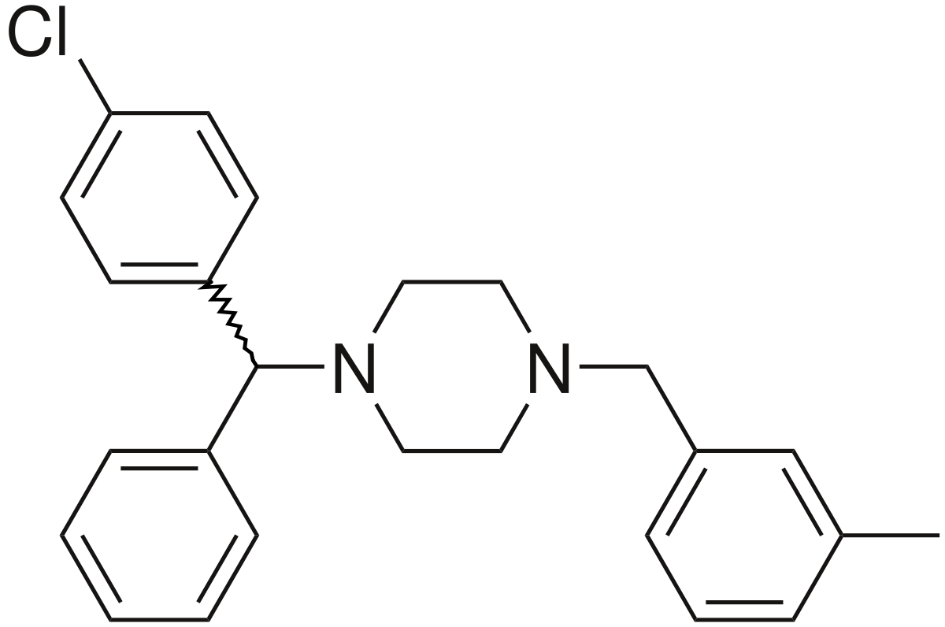
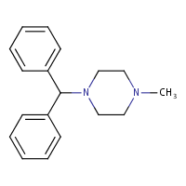
First Generation H1 Antagonists : piperazines

Slide 10
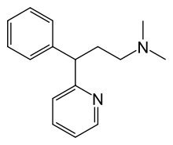
First Generation H1 Antagonists : propylamines

Slide 11
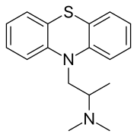
First Generation H1 Antagonists : phenothiazines

Slide 12
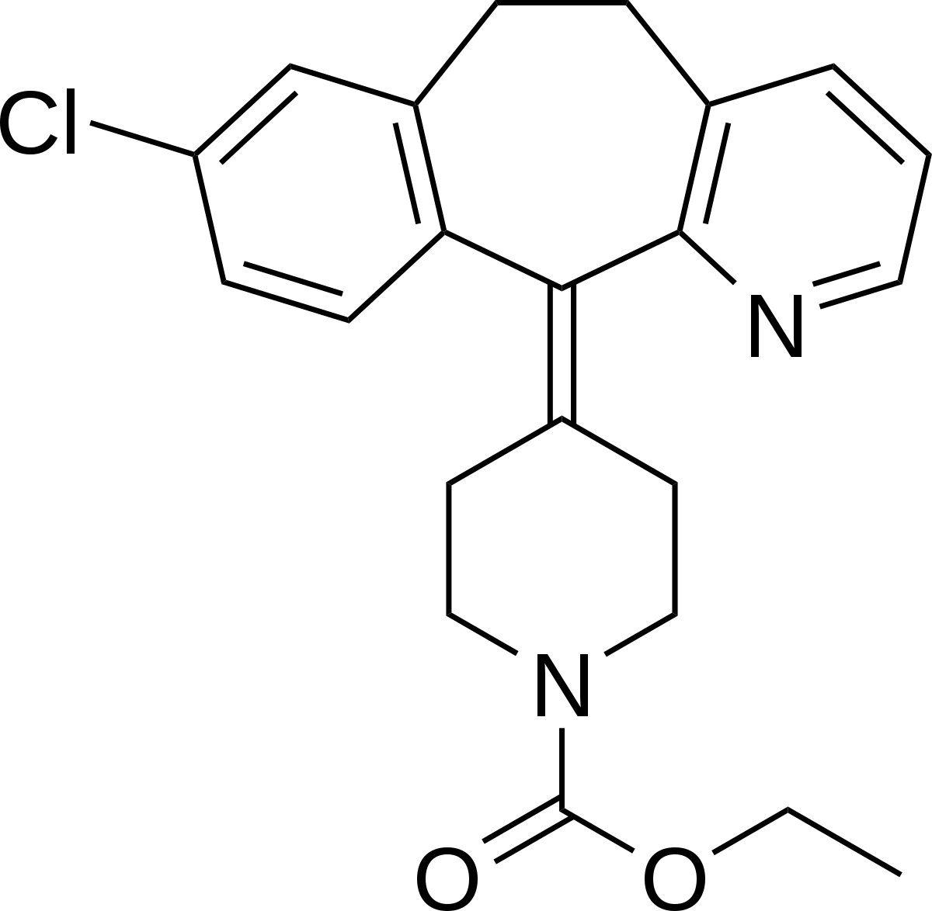
Dibenzocycloheptenes
Notes:
Loratadine

Slide 13
Second Generation H1 Antagonists

Slide 14
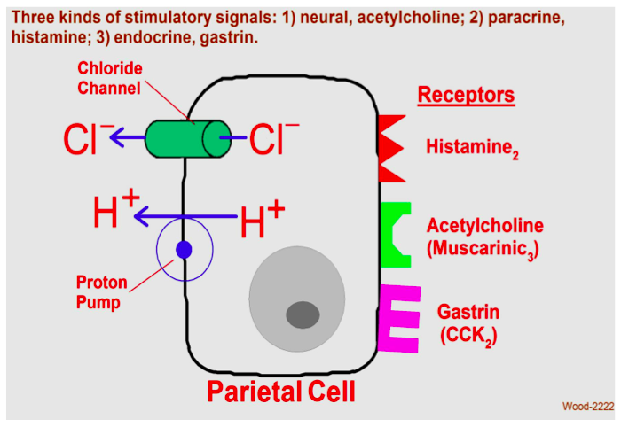

Slide 15

Treating Ulcers

Slide 16
Antacids
Antibiotics
Mucoprotectants
Anticholinergics

Slide 17
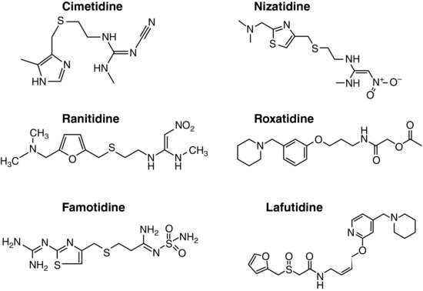
H2 Antagonists

Slide 18
Development of Cimetidine…

