Slide 1
NSAIDS

Slide 2
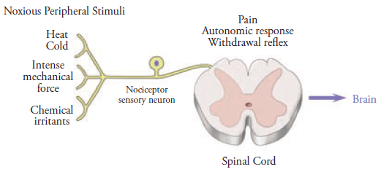
Pain Pathways

Slide 3
Epicritic pain
Proropathic pain
Neuropathic pain

Slide 4
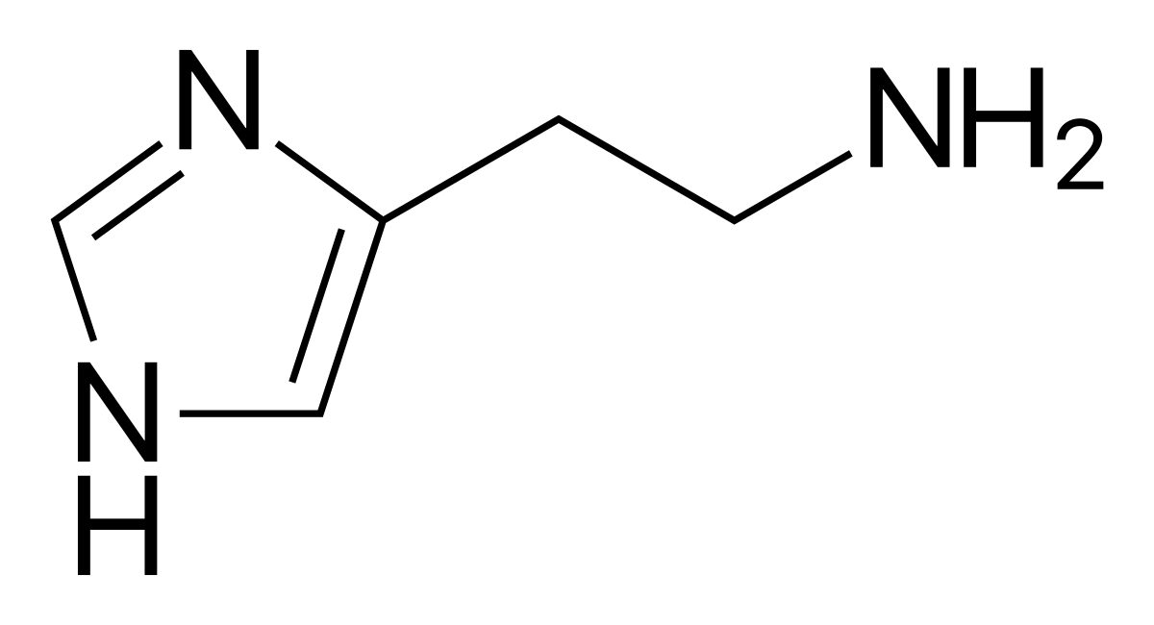
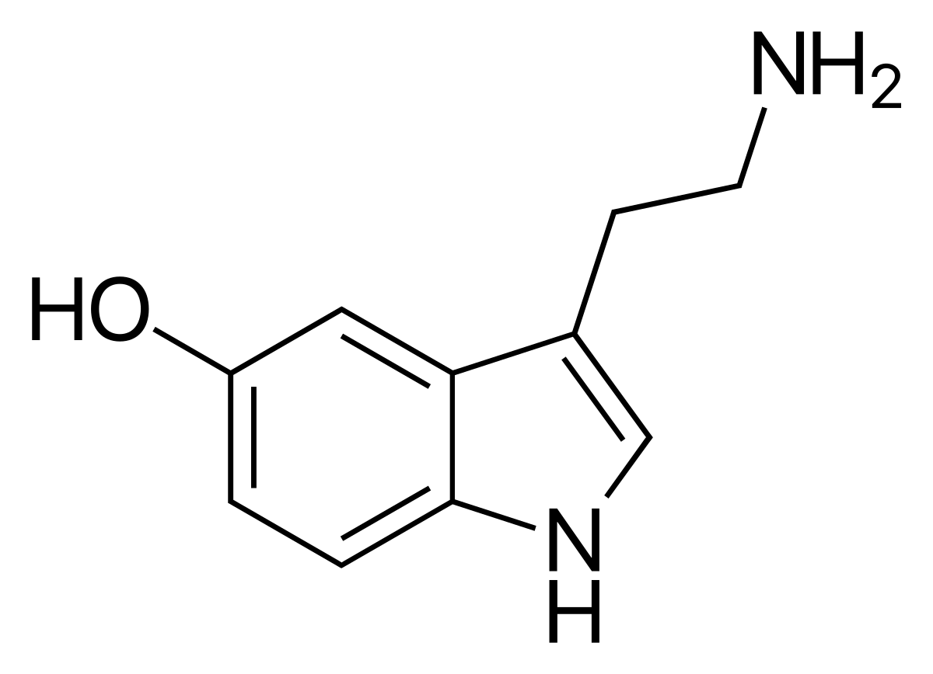
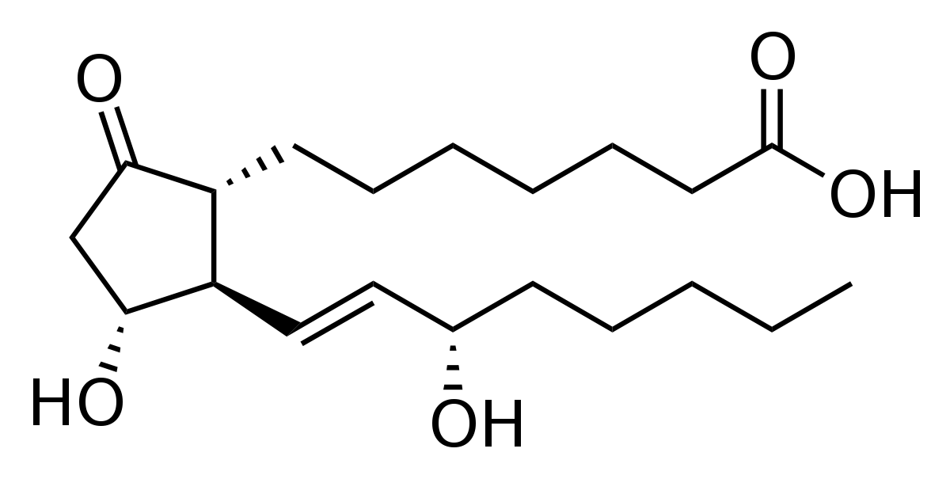
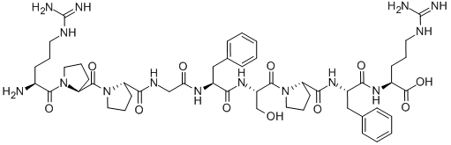
Inflammation

Slide 5
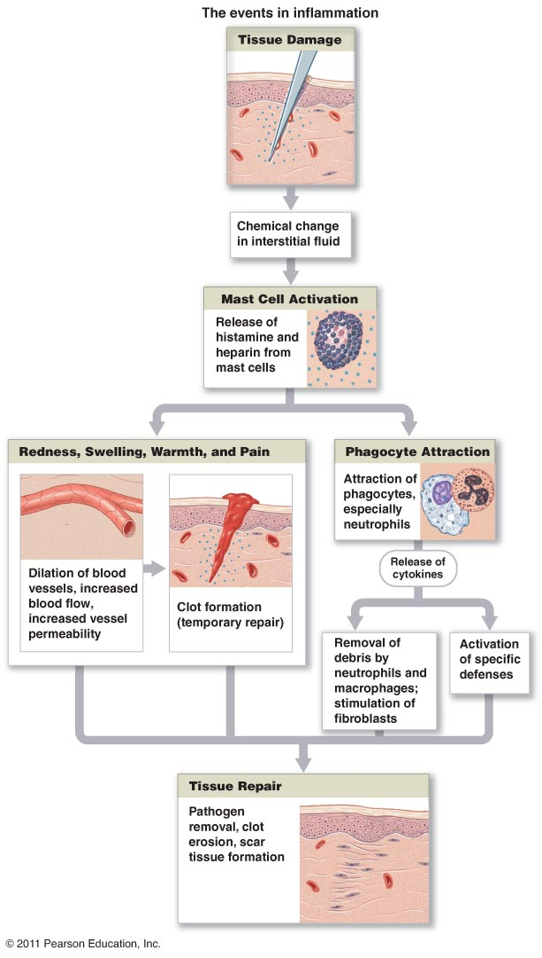

Slide 6
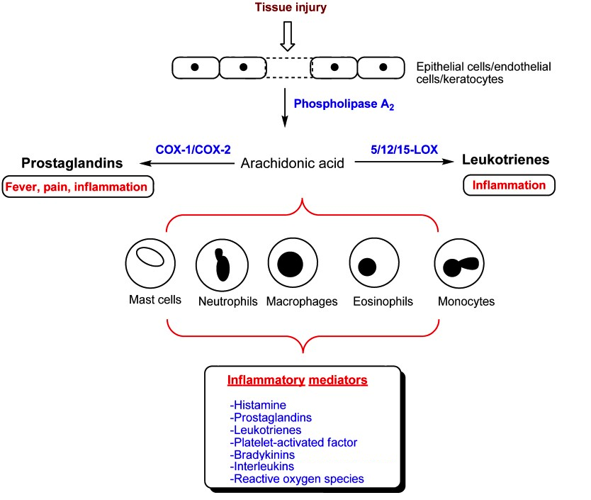

Slide 7
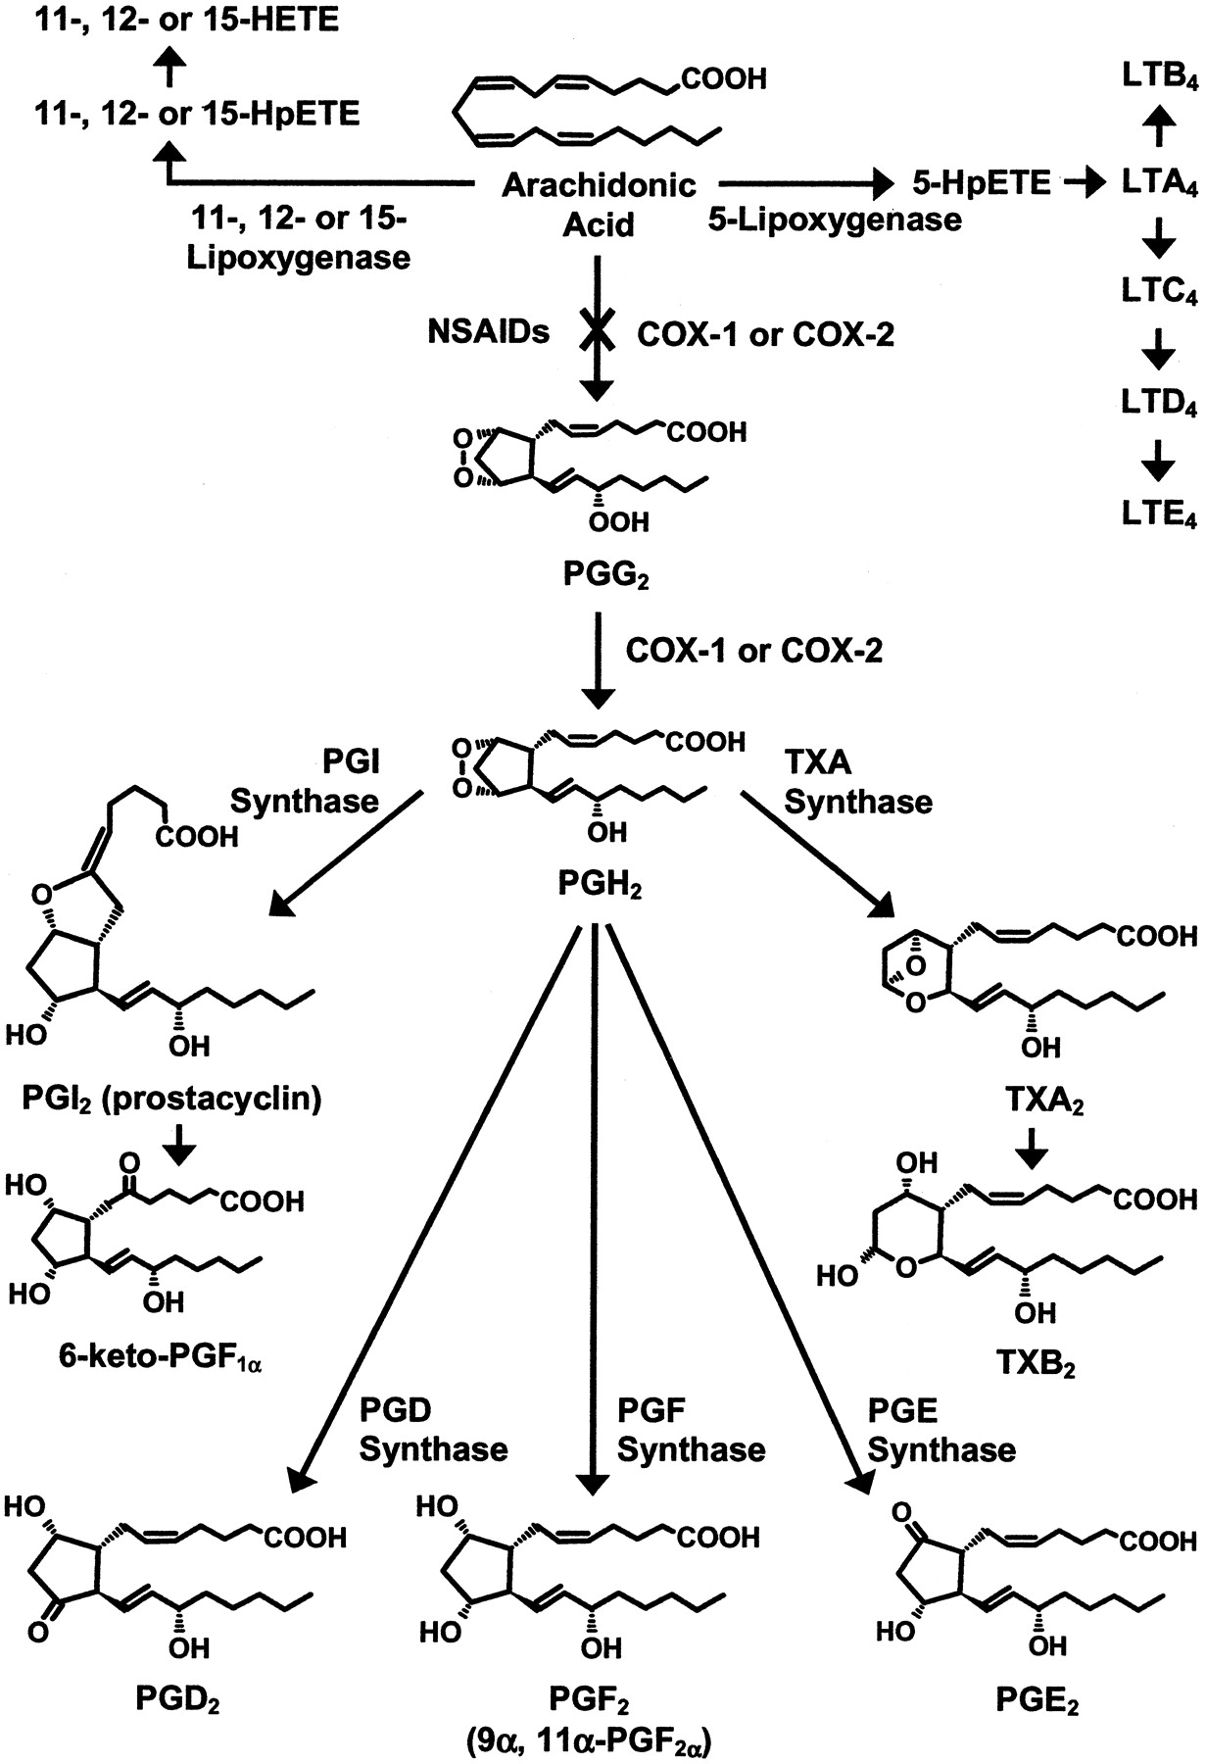

Slide 8
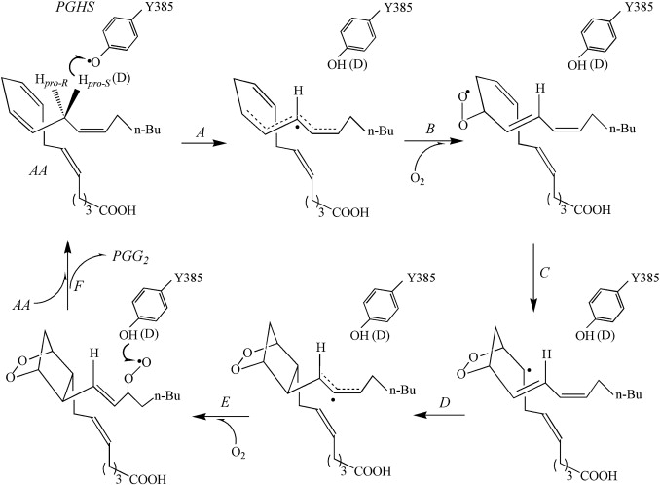
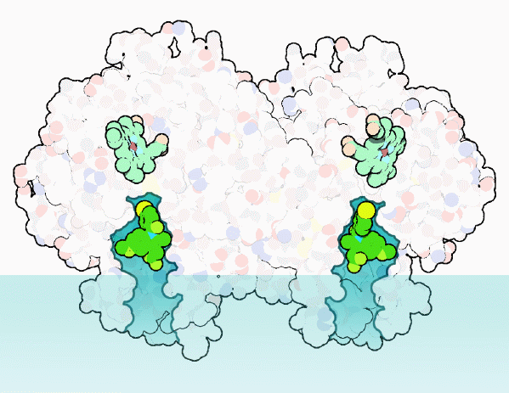
http://pdb101.rcsb.org/motm/17

Slide 9
Non Steroidal Anti Inflammatory Drug

Slide 10
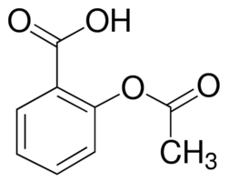
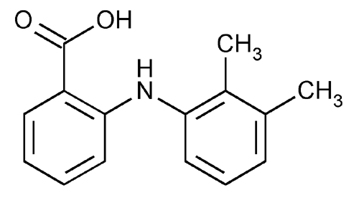

NSAID Classification (6)
Salicylate Derivatives
Arylanthranilic Acids
Arylpropionic Acids (Phenylacetic acid derivatives)

Slide 11
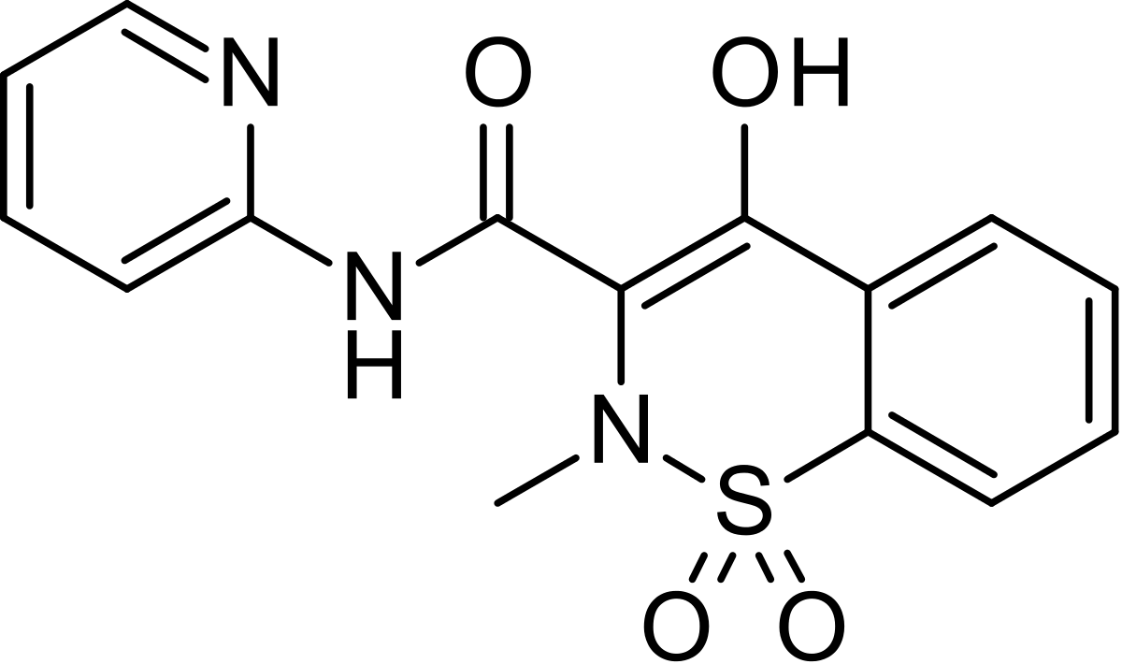
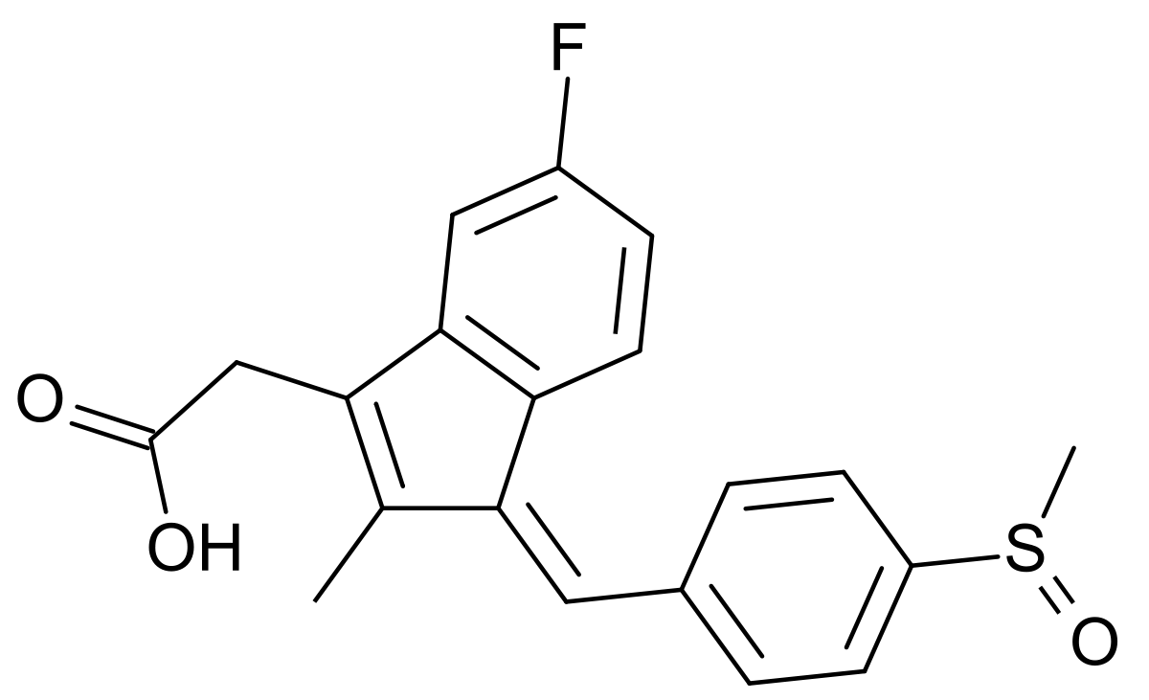
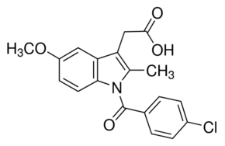
Oxicams
Indene and Indole Derivatives

Slide 12
Acetylsalicylic Acid

Slide 13
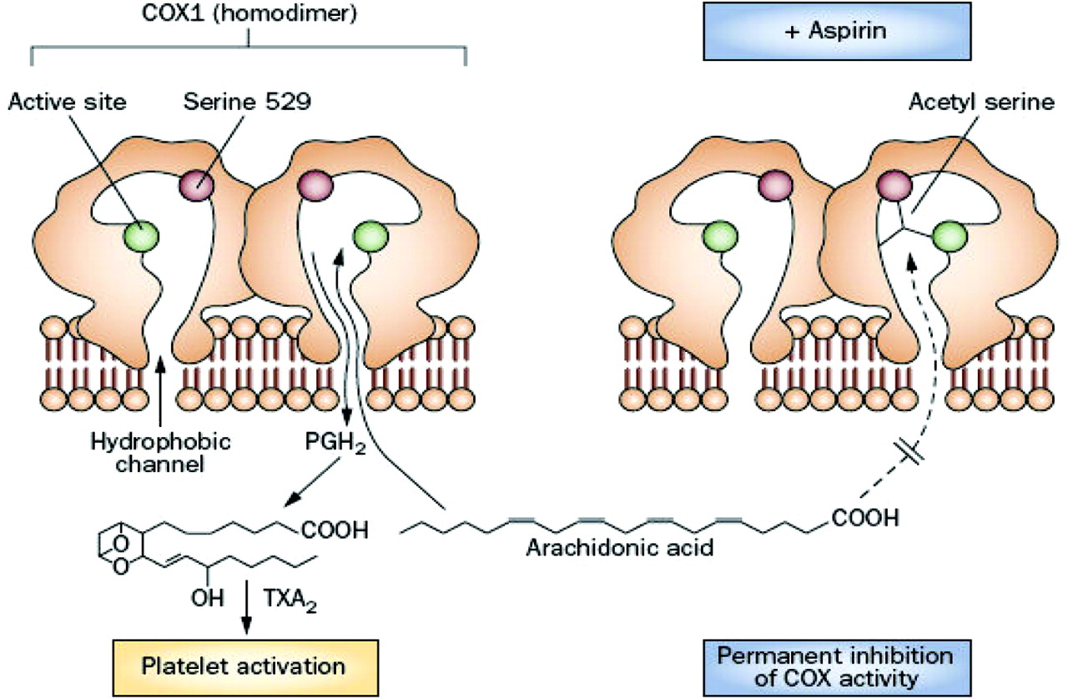
Notes:
[The modes of anti-inflammatory and analgesic actions of aspirin and salicylic acid].
[Article in Japanese]
Higuchi S, Osada Y, Shioiri Y, Tanaka N, Otomo S, Aihara H.
Abstract
The modes of anti-inflammatory and analgesic actions of aspirin and salicylic acid were investigated using some experimental animal models. Anti-inflammatory potencies of aspirin were almost equal to those of sodium salicylate in the carrageenin hind paw edema, the cotton pellet granuloma and the adjuvant arthritis tests in rats. On the other hand, in the ultra-violet ray erythema and the arachidonic acid erythema tests in guinea pigs, aspirin was more potent than sodium salicylate. Aspirin and sodium salicylate exhibited almost the same inhibitions of the rat hind paw edema induced by a mixture of carrageenin and prostaglandin E1. These results suggest that inhibition of cyclo-oxygenase by aspirin does not play any important roles for the prevention of the vascular permeability increment and the granulation in the inflamed tissue. Aspirin may exert its antiinflammatory activity mainly as salicylic acid which is not an inhibitor of prostaglandins biosynthesis in vitro. Aspirin showed about 5 times more potent analgesic action than sodium salicylate in the lameness test using adjuvant arthritic rats. Analgesic potency of aspirin was decreased to the level of sodium salicylate by injection of prostaglandin E2 into the inflamed rat paw in the adjuvant-induced lameness test. On the other hand, analgesic potency of sodium salicylate was not decreased by the same treatment. It is concluded that aspirin has two analgesic effects on the inflammatory pain, one is inhibition of prostaglandins biosynthesis by acetylation of cyclo-oxygenase and the other is an action due to salicylic acid, but the action of salicylic acid was not totally explained by the inhibition of prostaglandins synthetase.

Slide 14
Reye’s Syndrome

Slide 15
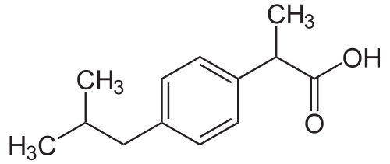
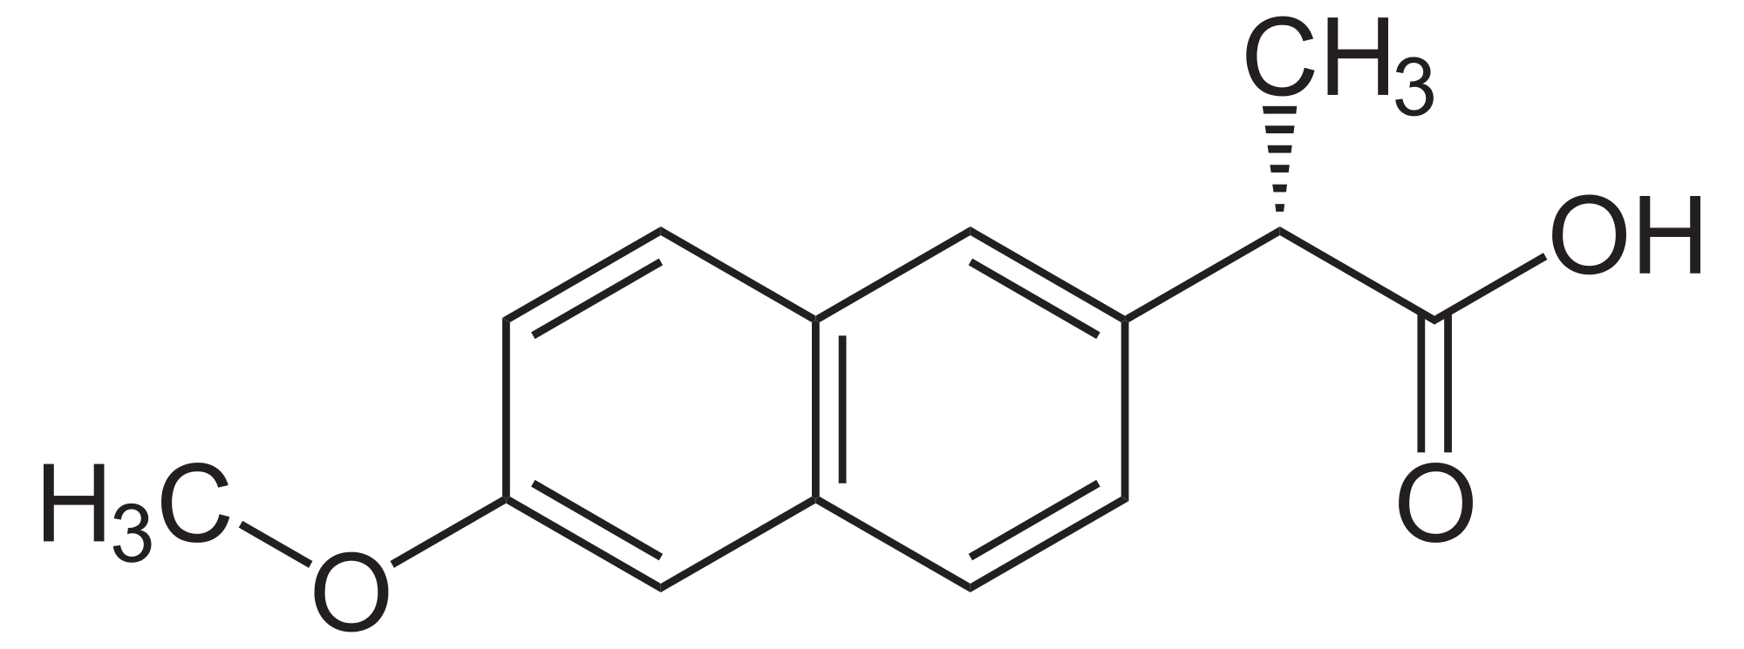
Phenylacetic Acid Derivatives

Slide 16
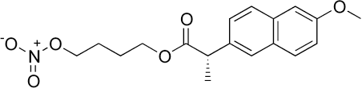
Naproxcinod

Slide 17
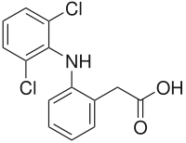
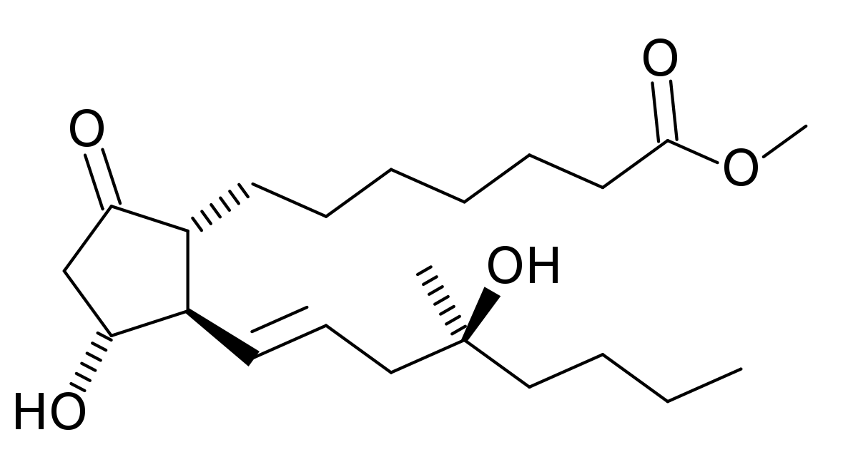

Slide 18
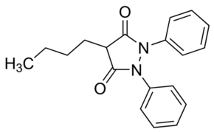
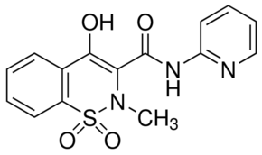
Oxicams

Slide 19
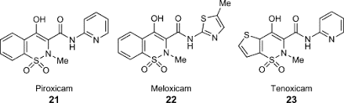

Slide 20
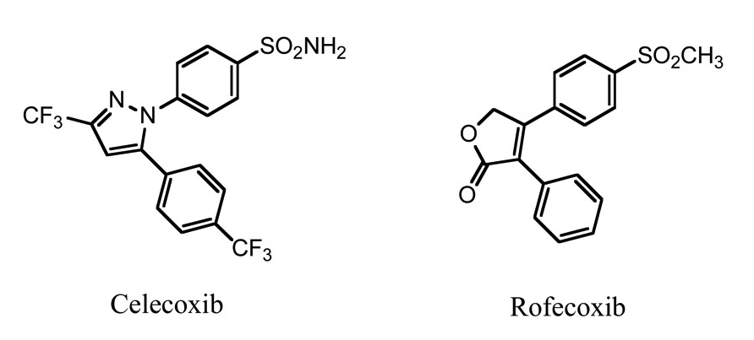

Slide 21
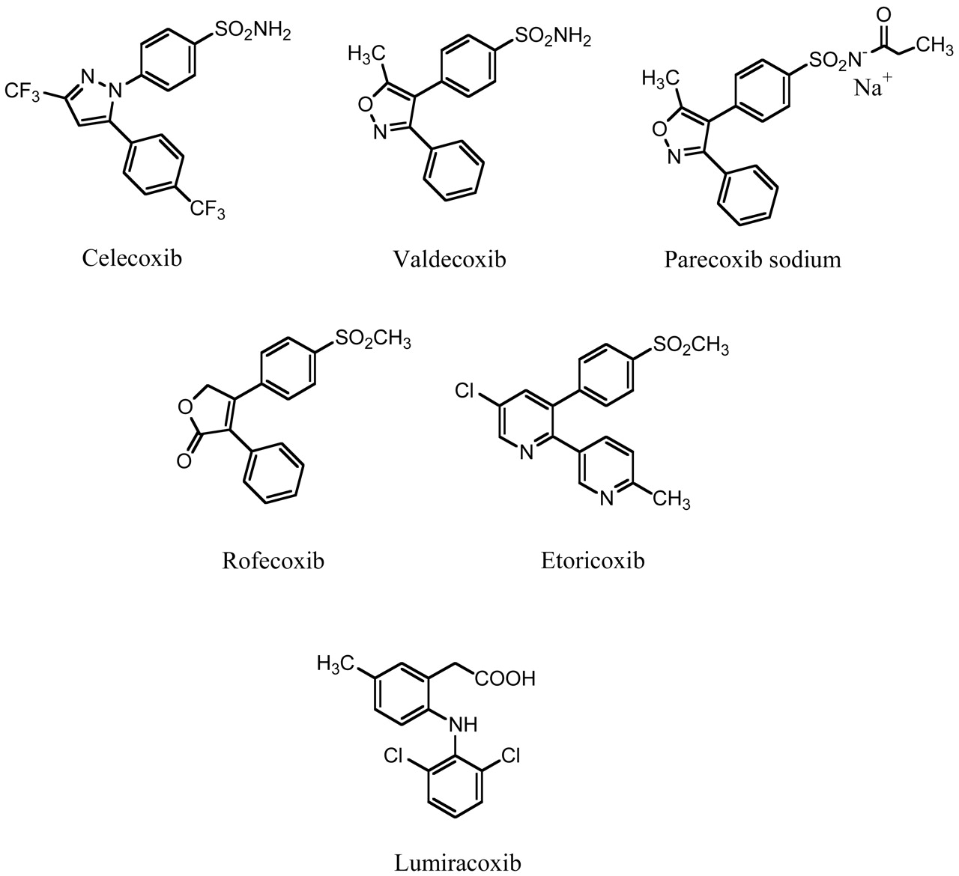

Slide 22
Selective NSAID’s
Cox -1
Cox-2

Slide 23
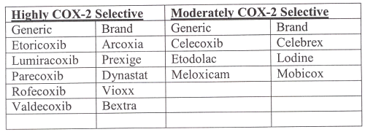

Slide 24
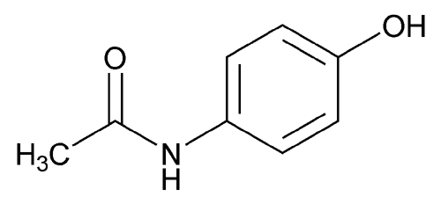
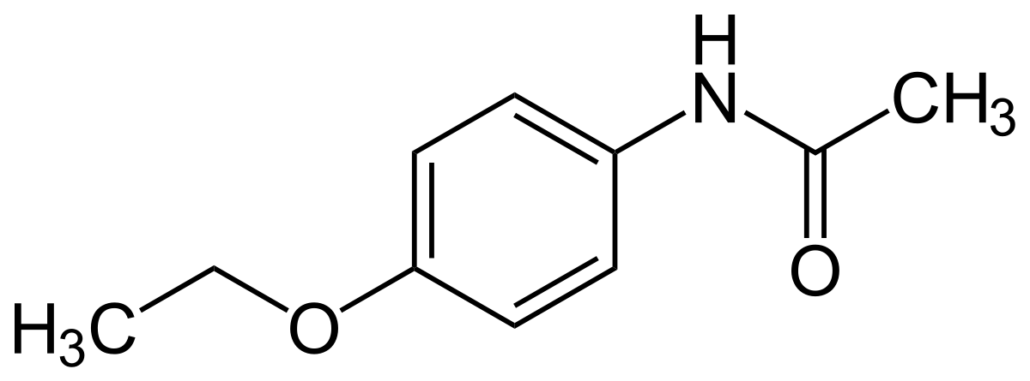
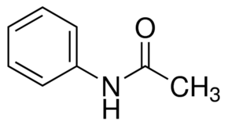
Acetominophen

Slide 27
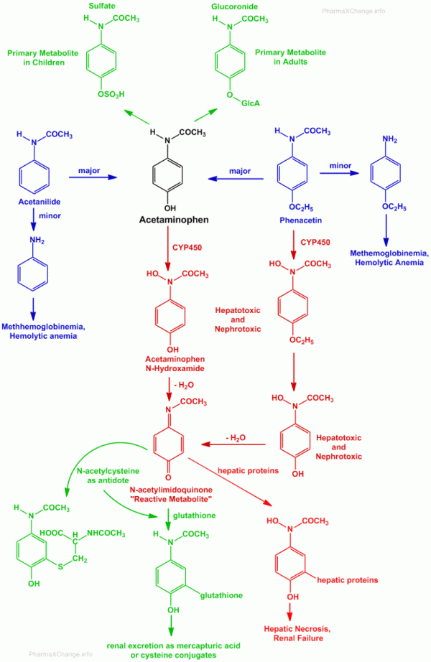

Slide 28
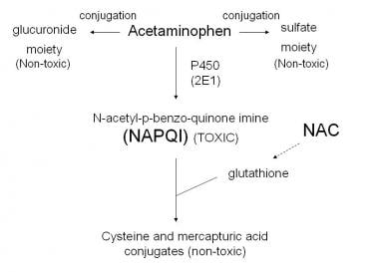

Slide 29
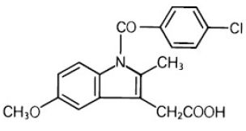
Indomethacin

Slide 30
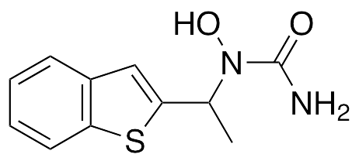
5-lipooxygenase Inhibitors

