Slide 1
Drug Sources

Slide 2
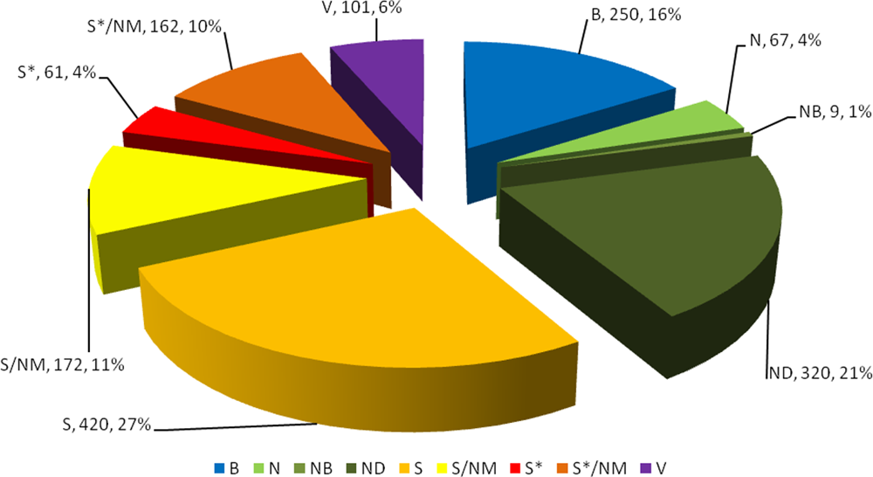
Natural Products as Sources of New Drugs from 1981 to 2014
David J. Newman*,† and Gordon M. Cragg‡
J. Nat. Prod. 2016, 79, 629−661
Sources of Drugs
Synthetic
Synthesis of natural products or mimics
Modified natural products
Biologics/Natural products
Vaccine
B Biological macromolecule
N Unaltered natural product
NB Botanical drug (defined mixture)
ND Natural product derivative
S Synthetic drug
S* Synthetic drug (NP pharmacophore)
V Vaccine
/NM Mimic of natural product, 2003
Notes:
B
N
NB
ND
S
S/NM/V

Slide 3

Goals of Drug Design
Selectivity
Selective Toxicity
Risk/Benefit Ratio
TI
ED₅₀
LD₅₀

Slide 4
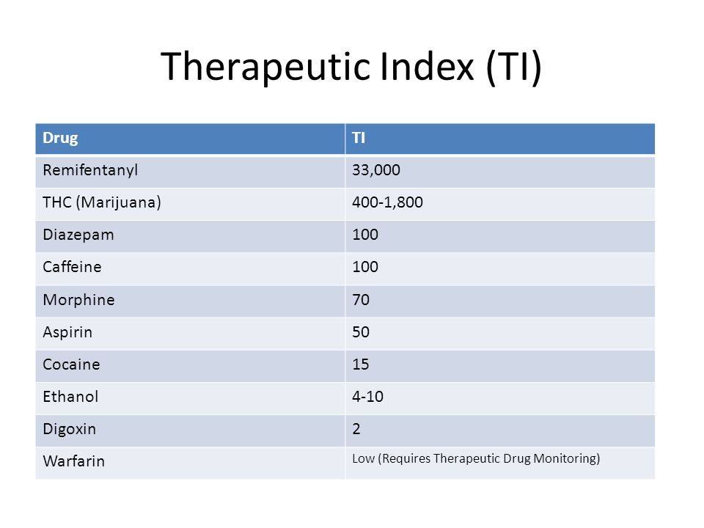

Slide 5
Controlled Time of Action
Localization/Targetting

Slide 6
Drug Design : sources of lead compounds
1. Natural Products

Slide 7
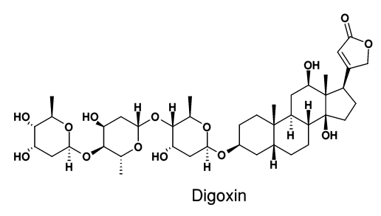
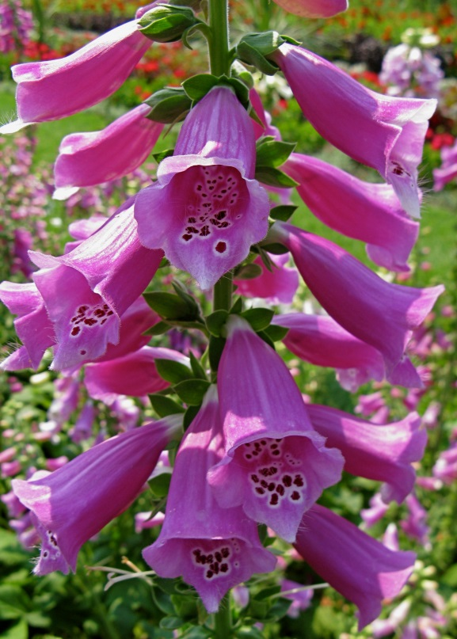
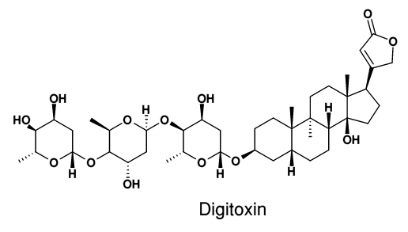

Slide 8
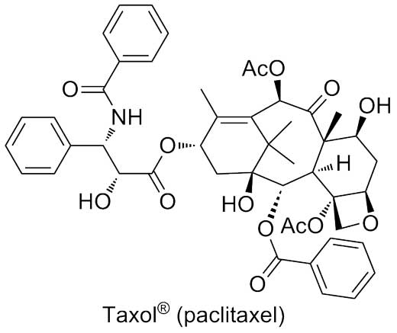
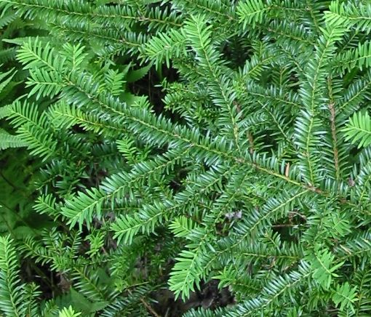

Slide 9
Drug Design : sources of lead compounds
2. Serendipity

Slide 10
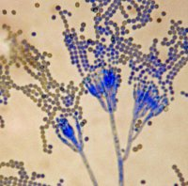
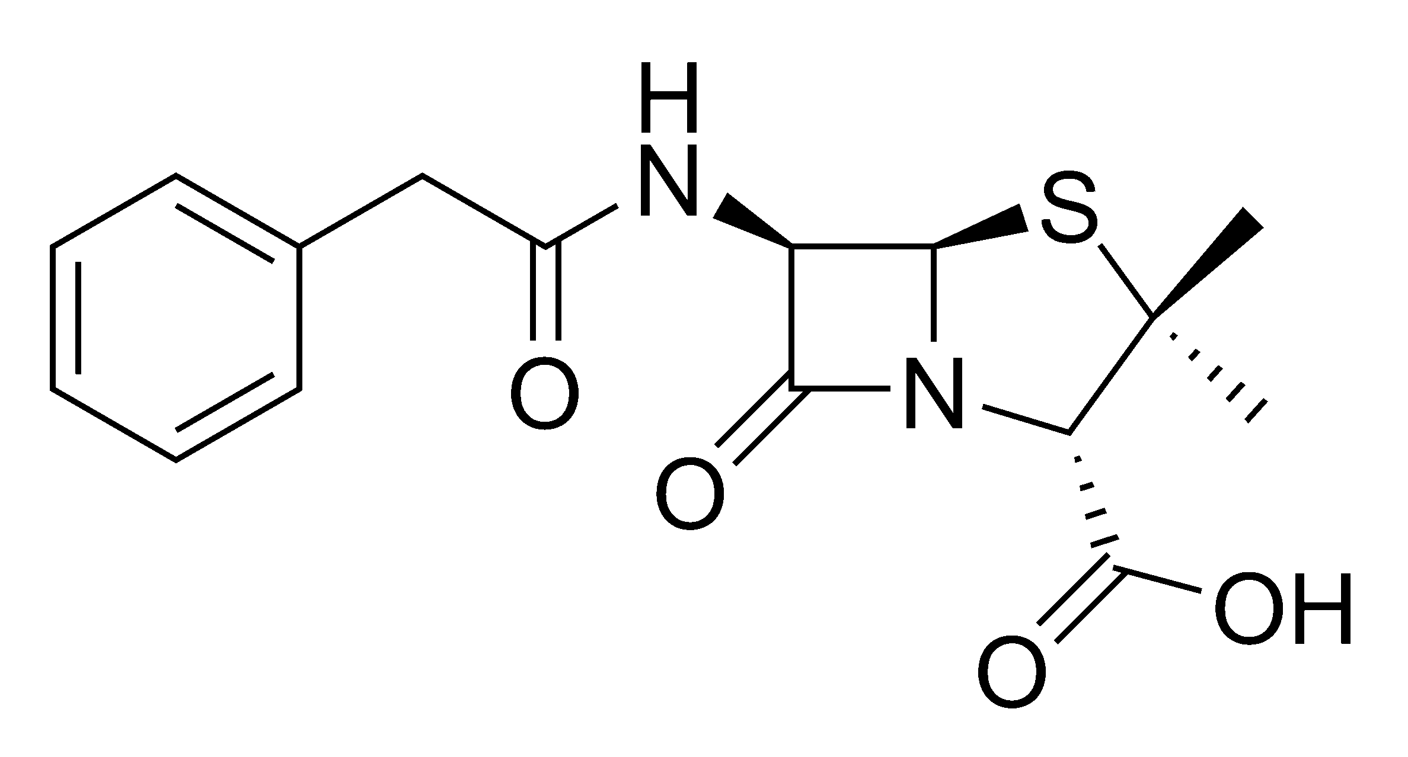
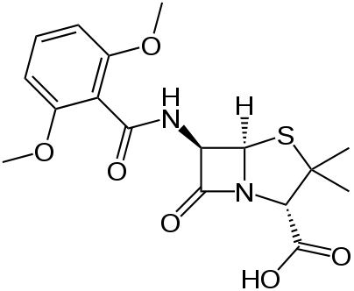
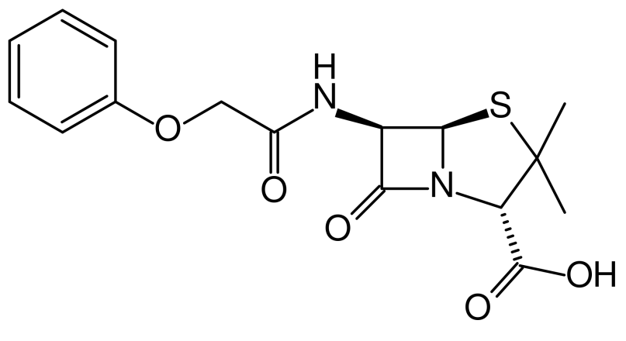
Pen G
Pen V
Methicillin

Slide 11
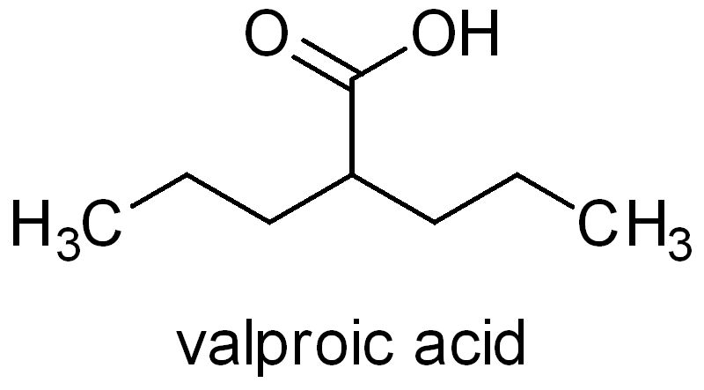
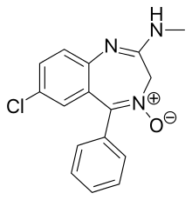
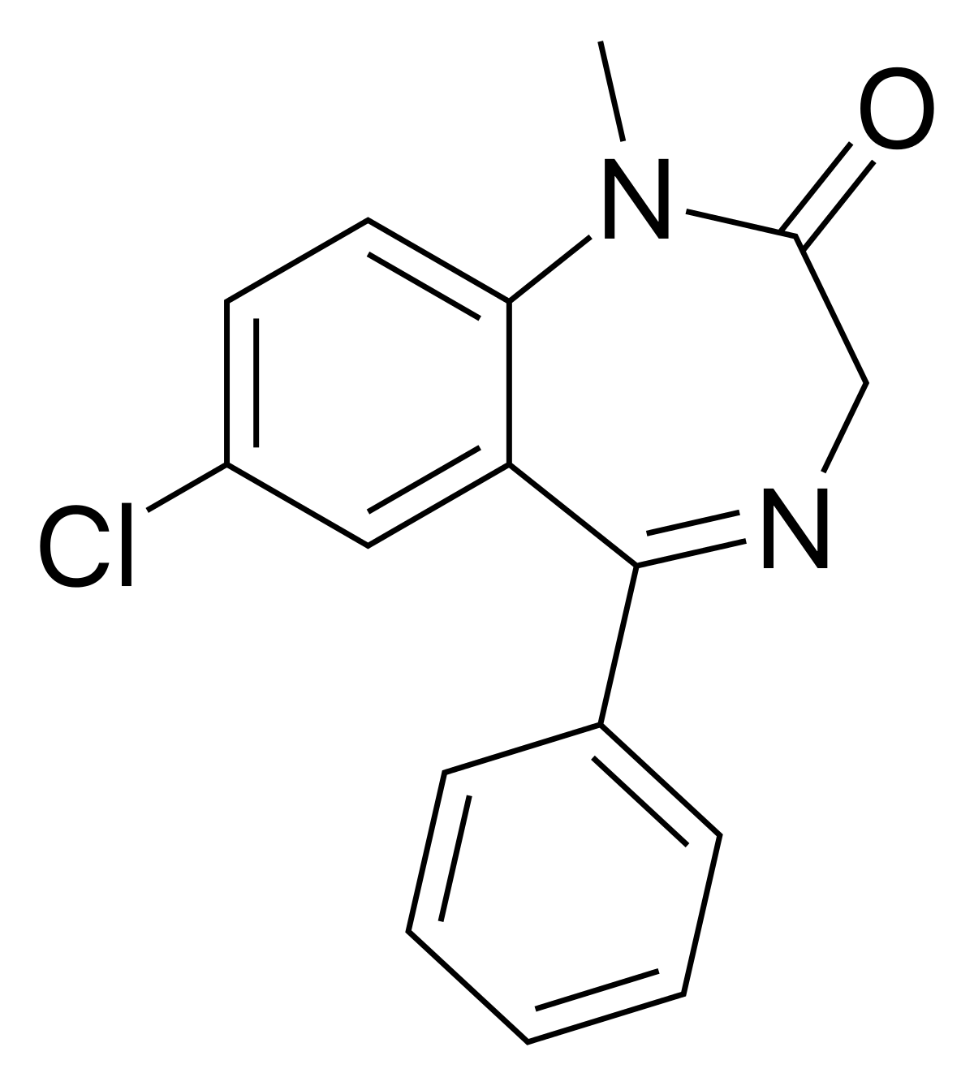
Sodium salt = depakote
chlordiazepoxide
Valium

Slide 12
Drug Design : sources of lead compounds
3. Clinical Observations

Slide 13
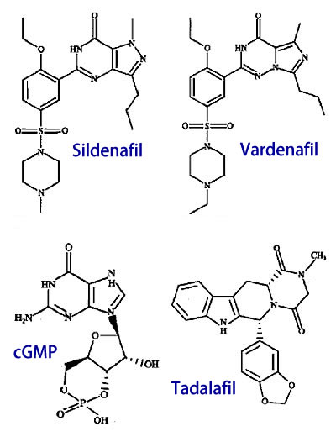

Slide 14
Drug Design : sources of lead compounds
4. Random Screening

Slide 15
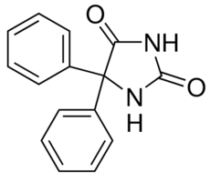
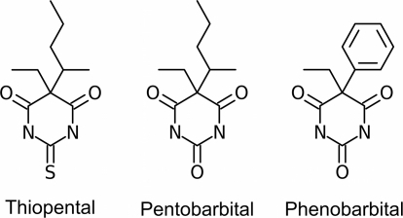
Diphenylhydantoin

Slide 16
Drug Design : sources of lead compounds
5. High Throughput Screening

Slide 17
Drug Design : sources of lead compounds
6. Rational Drug Design

Slide 18
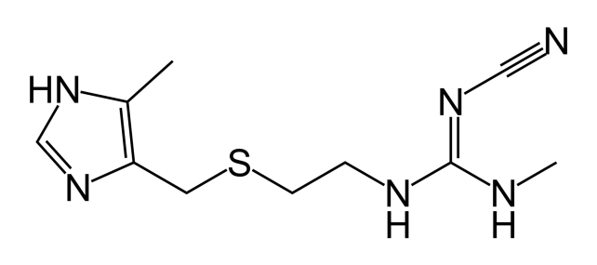
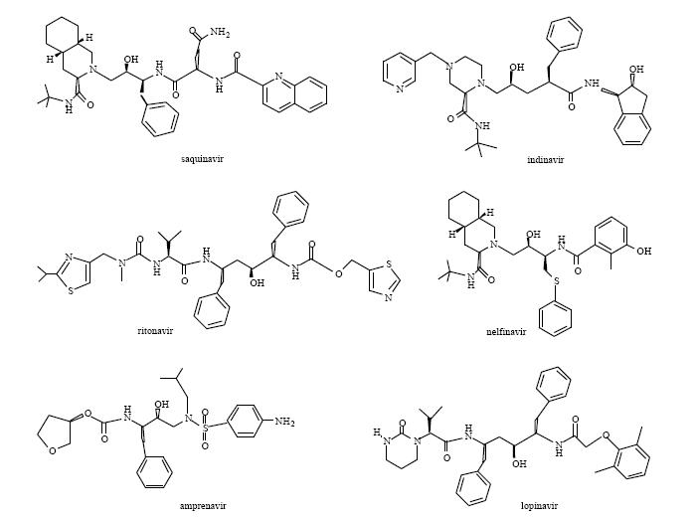
Cimetidine
HIV
Protease
Inhibitors

