Slide 1
Diuretics

Slide 3
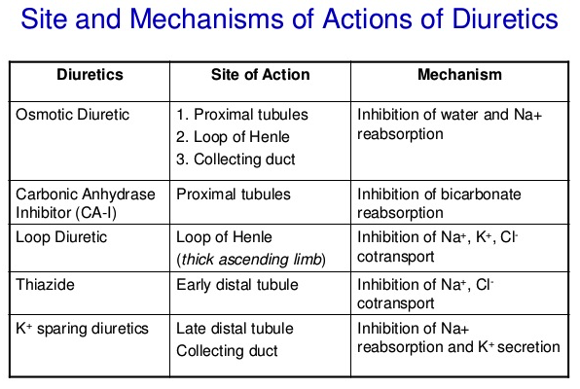
Notes:
Diuretics increase the rate of urine flow
Used for Edema and Hypertension

Slide 4
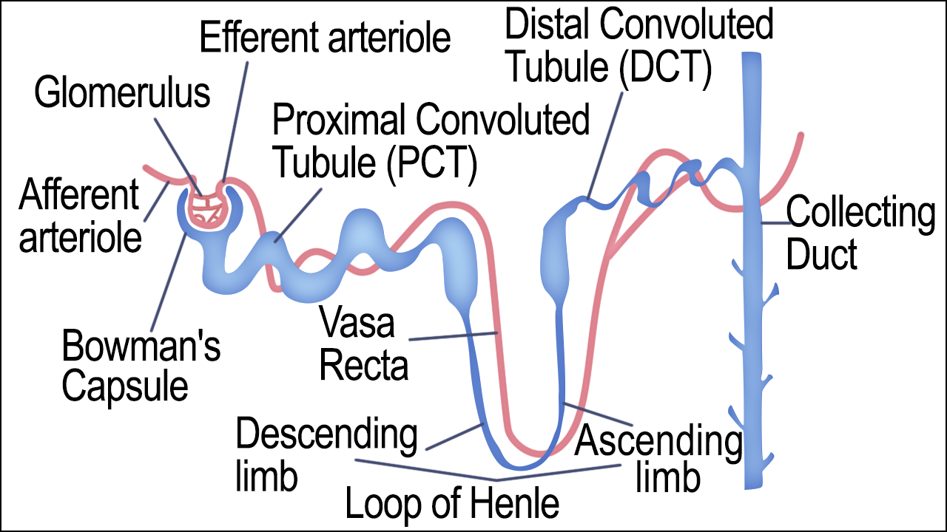

Slide 5
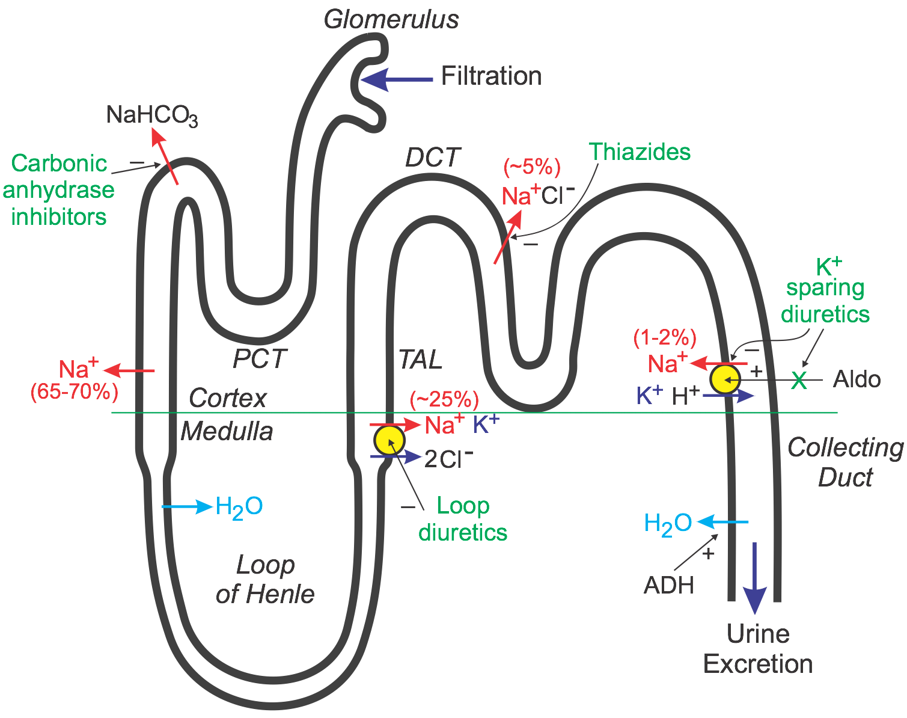

Slide 6
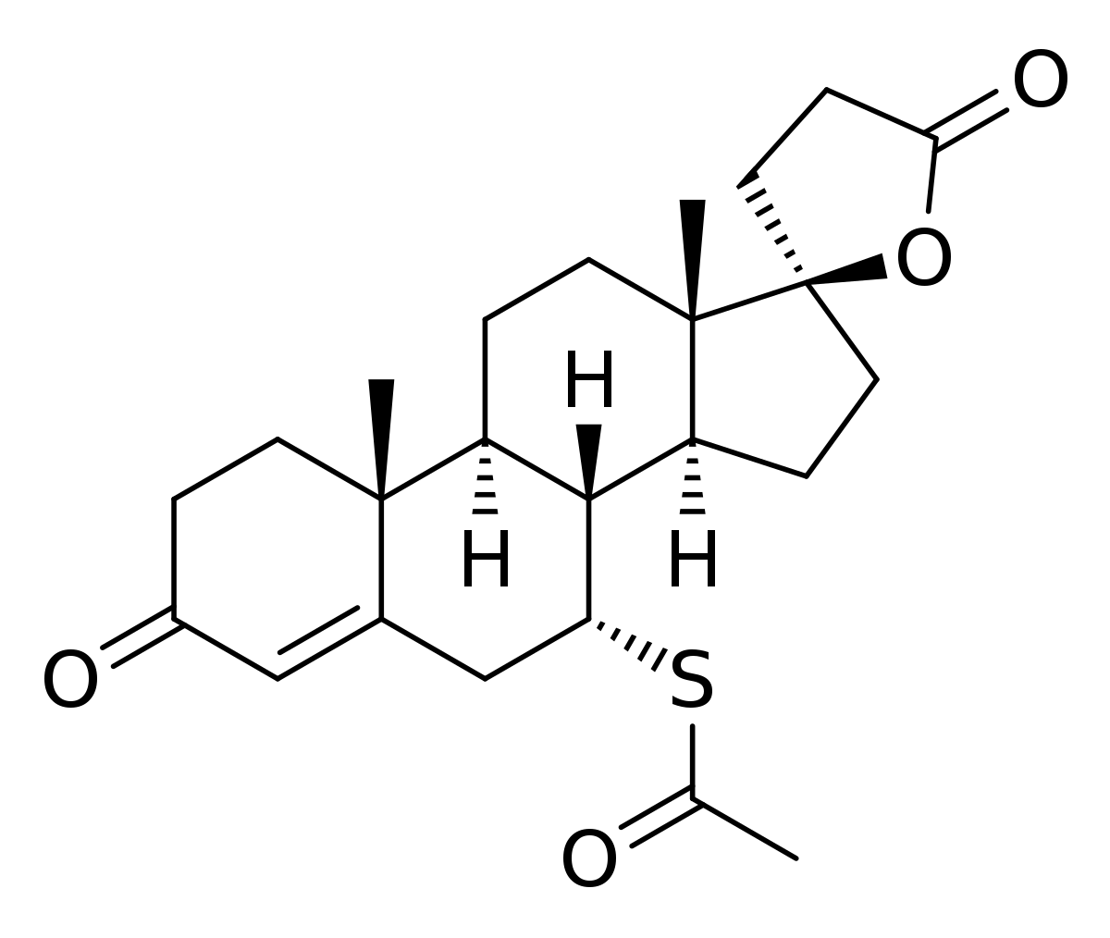
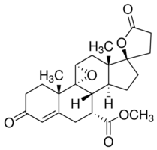
Aldosterone Antagonists
Spironolactone
Epirenone
Notes:
Diuretics, increase Na+ excretion and K+ retention
Mineralocorticoid receptor
binds aldosterone and cortisol, in target cells there is a dehydrogenase that converts C-OH to C=O
so it doesn’t compete for binding
In the kidneys
1. increases resorption of Na+ 2. increases resorption of H2O 3. increases excretion of K+
Stimulates transcription of a gene for Na+/K+ ATPase and for Na+ pumps

Slide 7
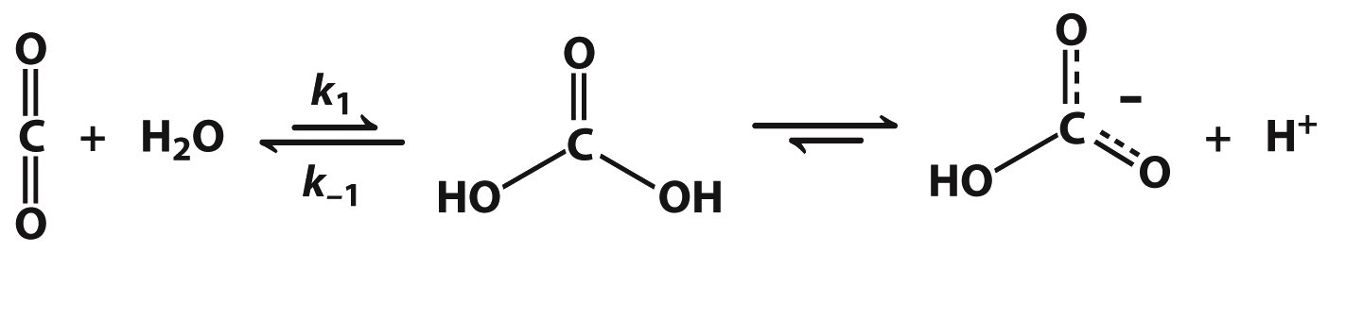
Carbonic Anhydrase Inhibitors

Slide 8
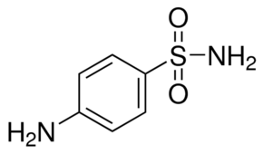
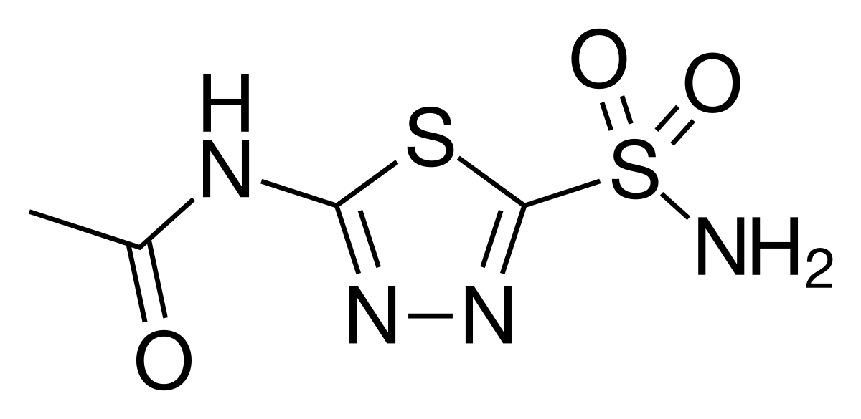

Slide 9
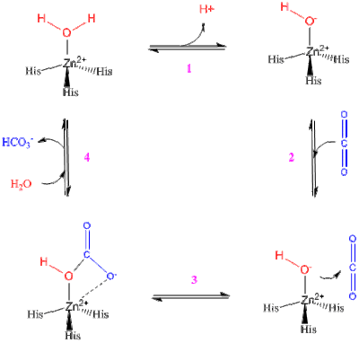

Slide 10
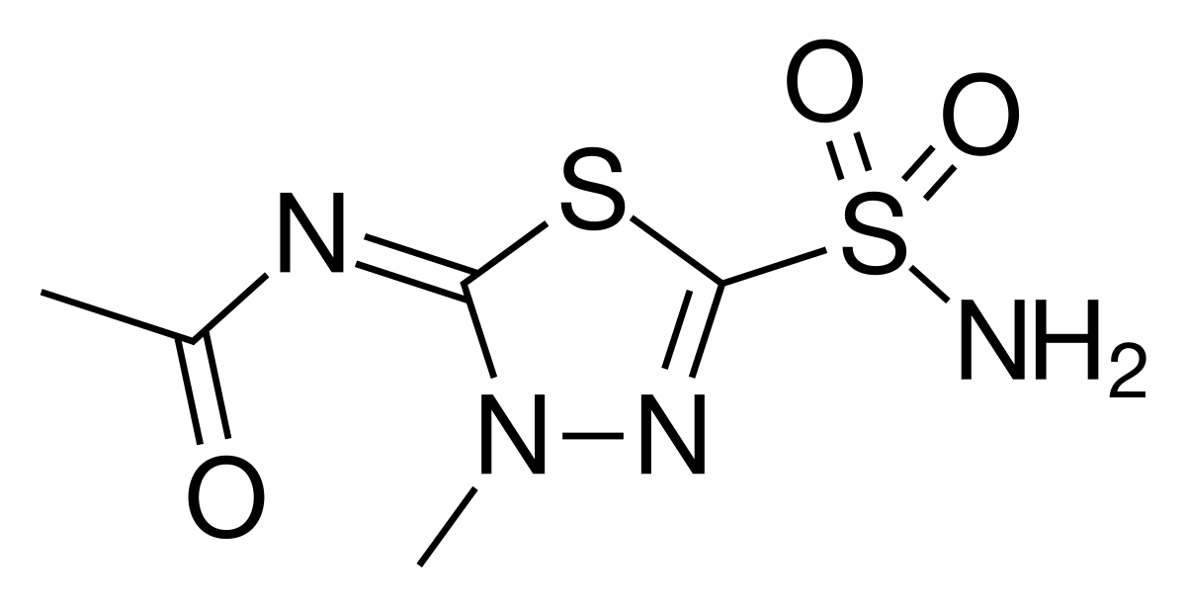
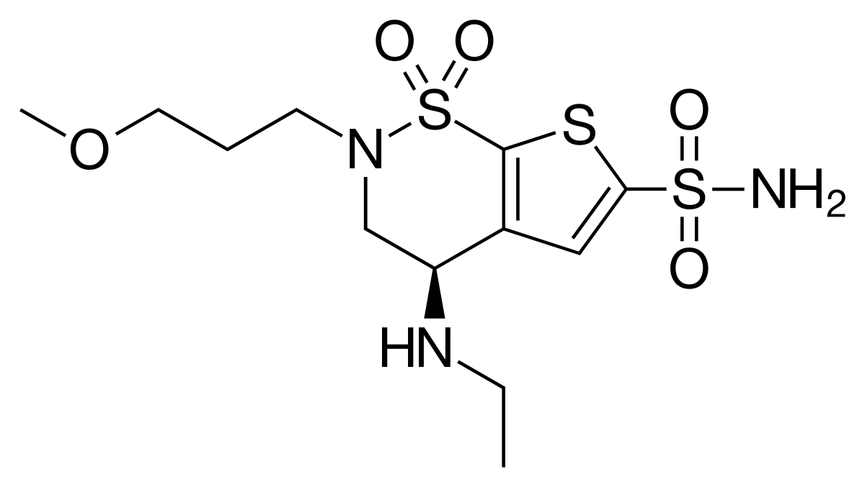
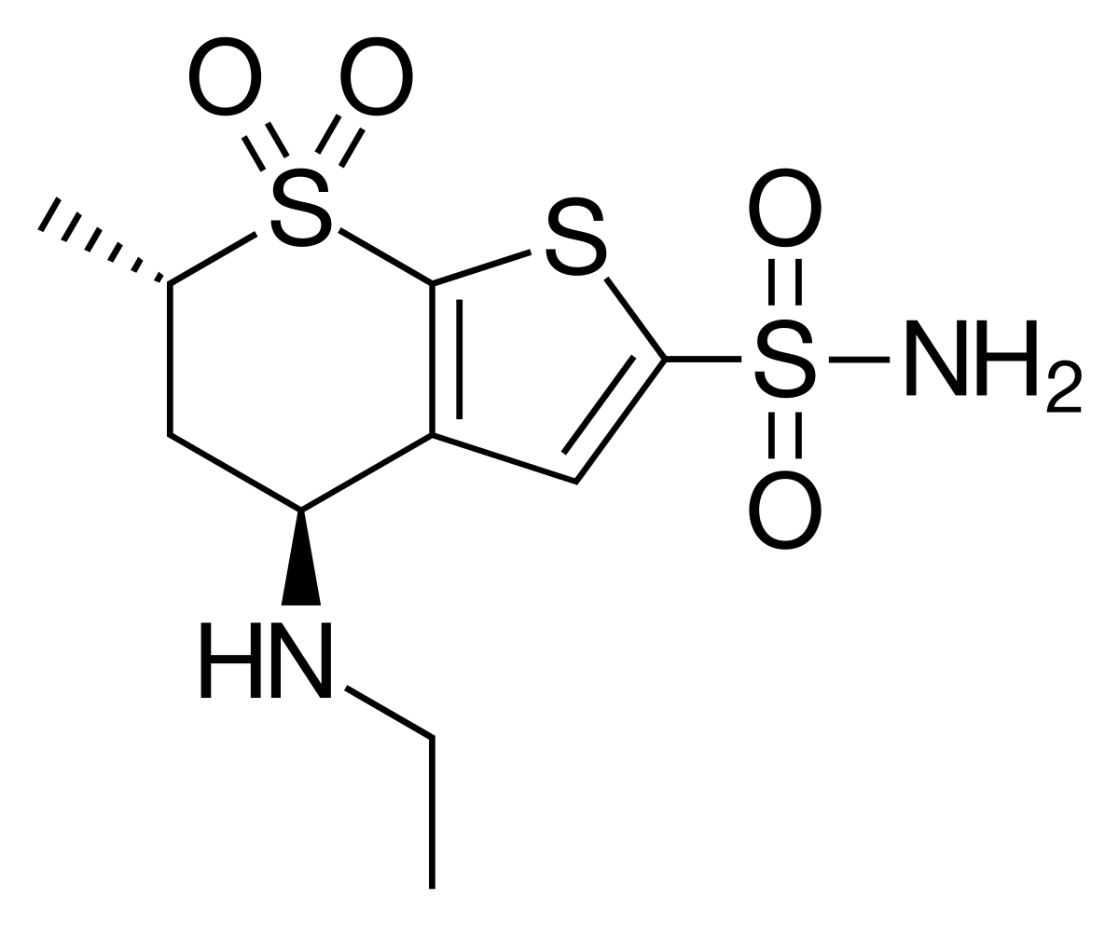
Notes:
These are used for glaucoma

Slide 11
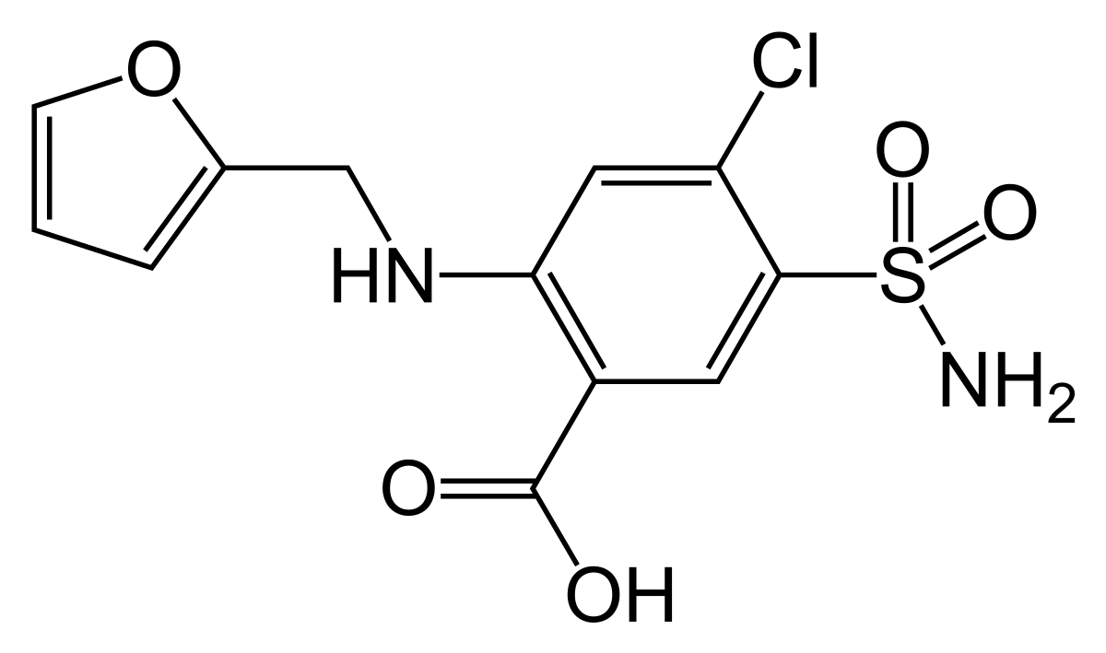
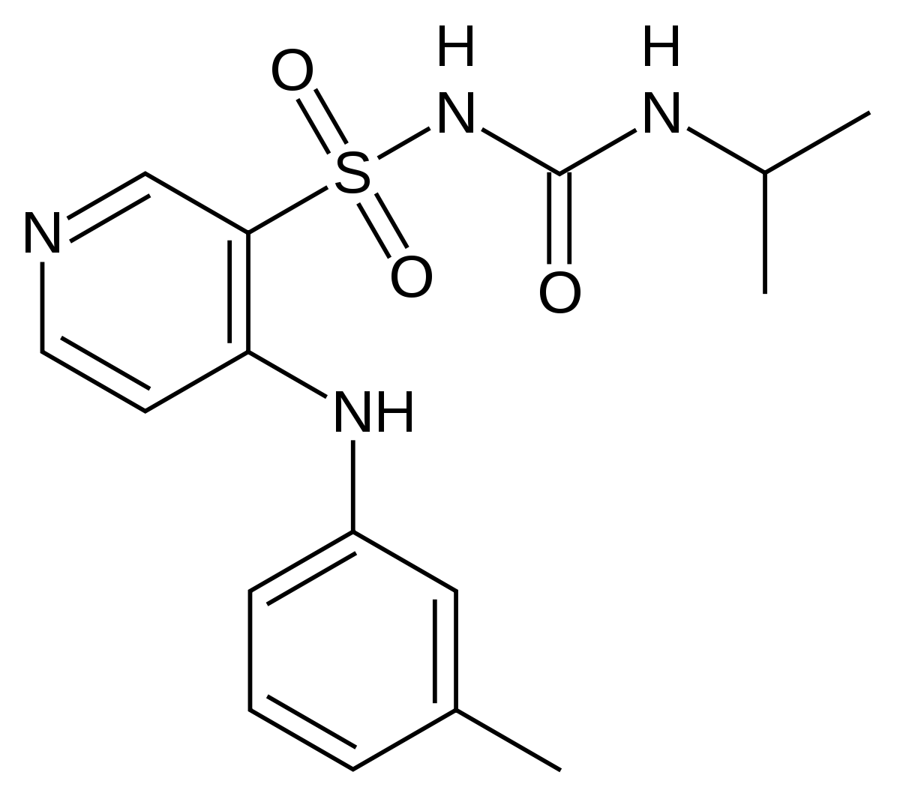
Loop Diuretics

Slide 12
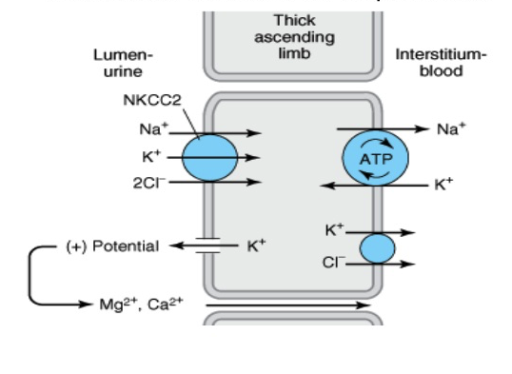

Slide 13
Loop Diuretic Side Effects:
Hyponatremia
Hypokalemia
Hypochloremia
Hypocalcemia
Hypomagnesemia
Hyperuricemia
Hyperglycemia
Cholesterol Levels
Ventricualr Arrythmias

Slide 14
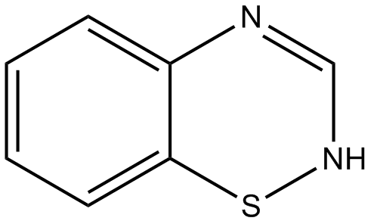
Thiazides

Slide 15
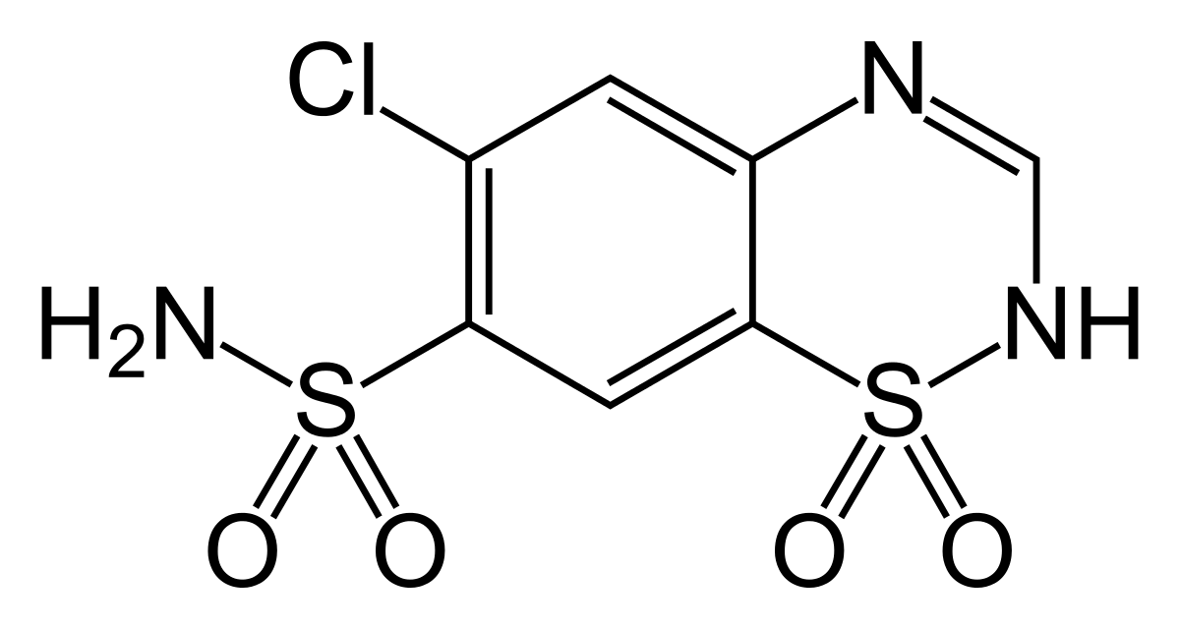
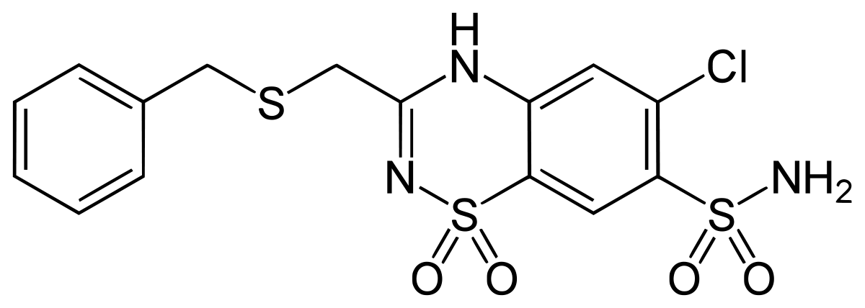
Notes:
chlorothiazide

Slide 16
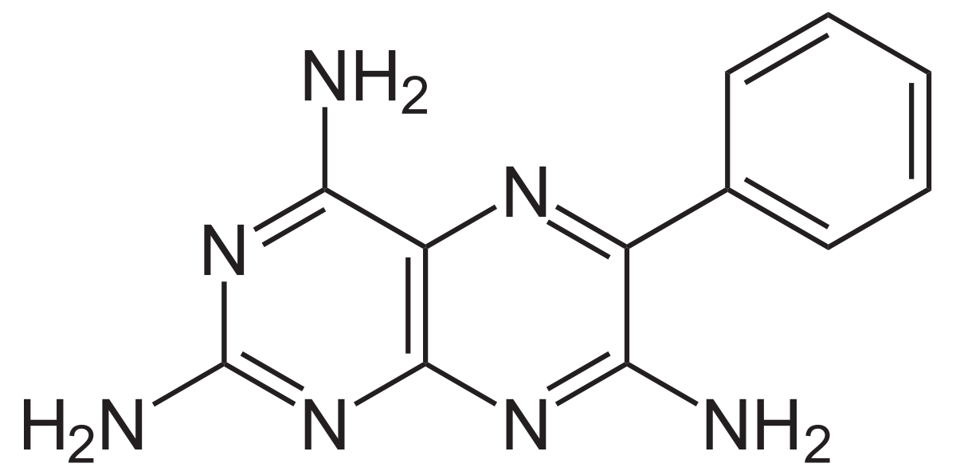
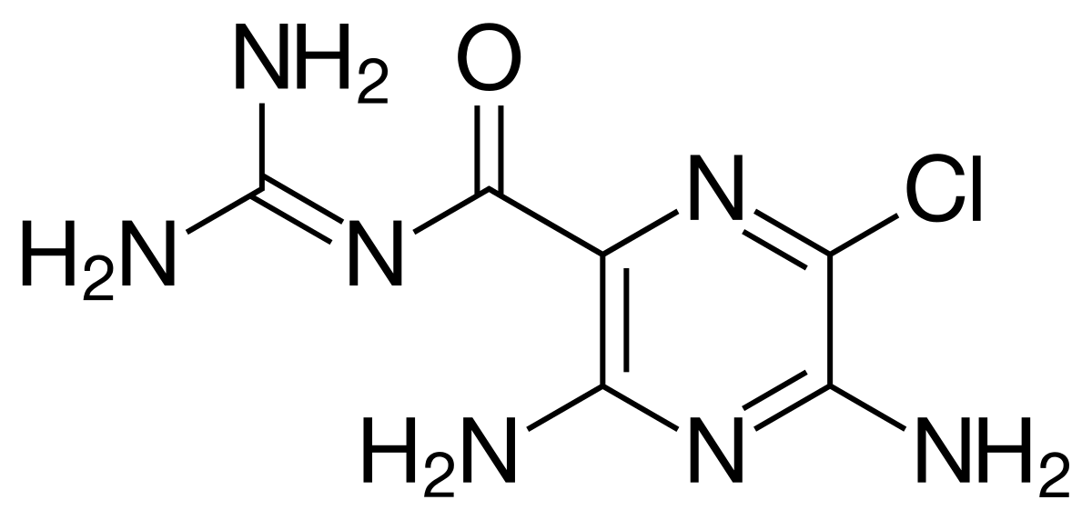
Potassium Sparing Diuretics

Slide 17
Corticosteroids
bethamethasone, (Celestone)
prednisone (Prednisone Intensol)
prednisolone (Orapred, Prelone)
triamcinolone (Aristospan Intra-Articular, Aristospan Intralesional, Kenalog)
methylprednisolone (Medrol, Depo-Medrol, Solu-Medrol)
dexamethasone

