Slide 1
Hypertension

Slide 2
Hypertension :
Treated with
Diuretics
Beta Blockers
ACE Inhibitors
AT antagonists

Slide 3
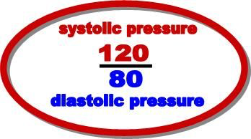
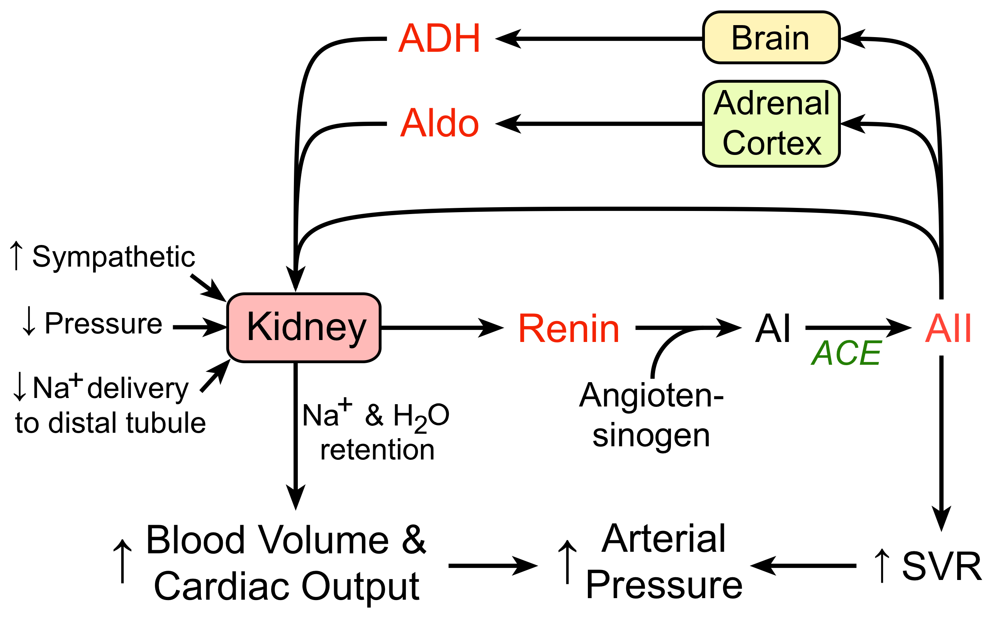

Slide 4
Angiotensinogen
Renin
Angiotensin I
ACE (Angiotensin Converting Enzyme)
Angiotensin II
Aminopeptidase
Angiotensin III

Slide 5
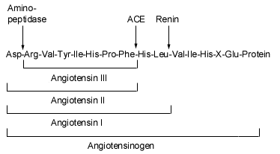

Slide 6
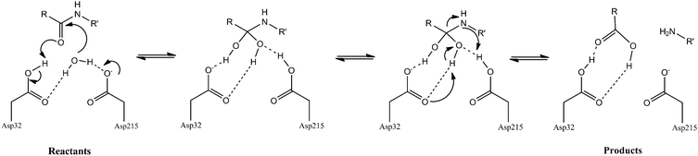
Renin : aspartyl protease
Notes:
Mouse Renin….

Slide 7
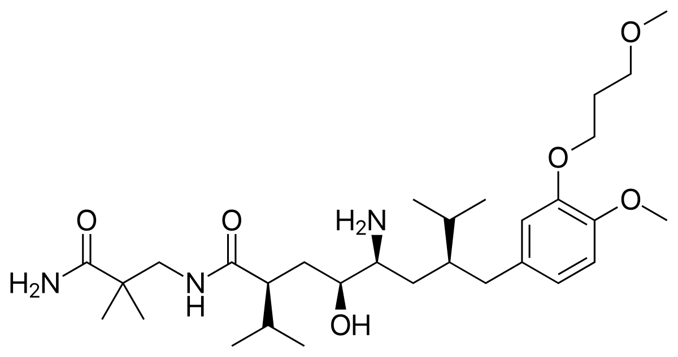
Aliskiren

Slide 8
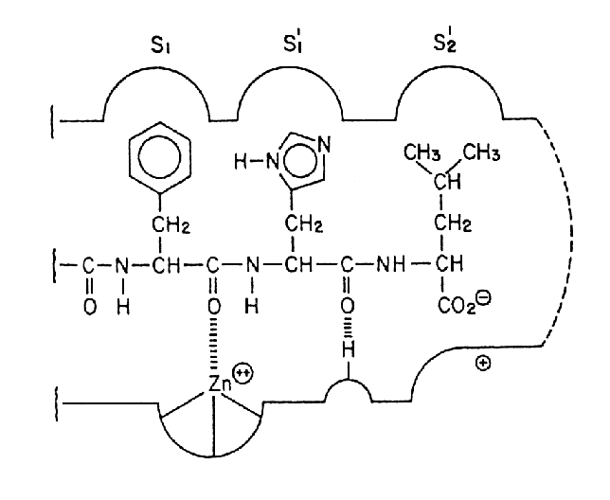
ACE Catalysis

Slide 10
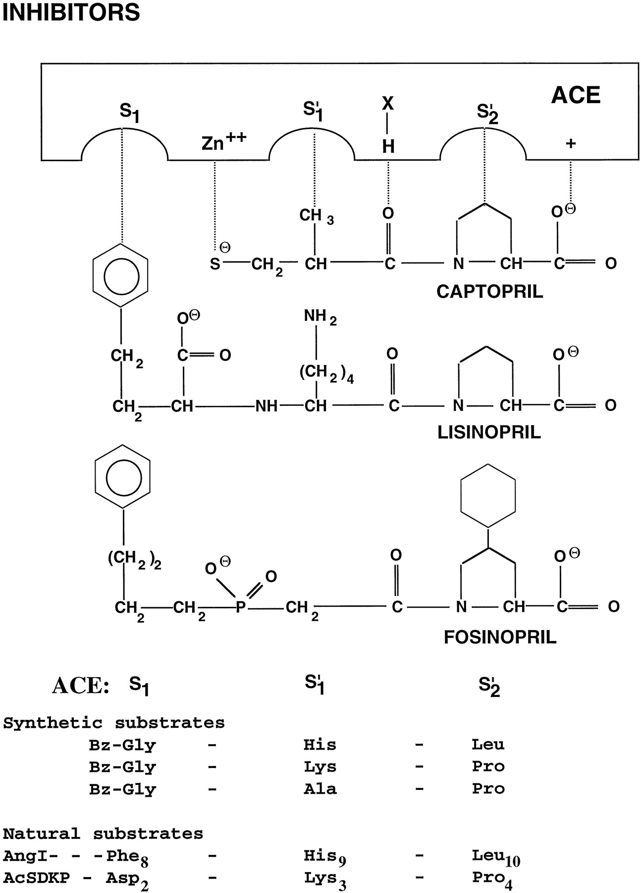

Slide 11
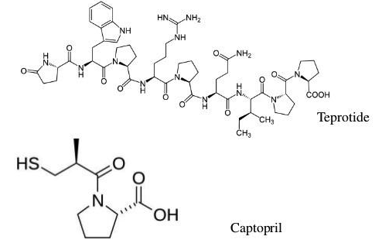
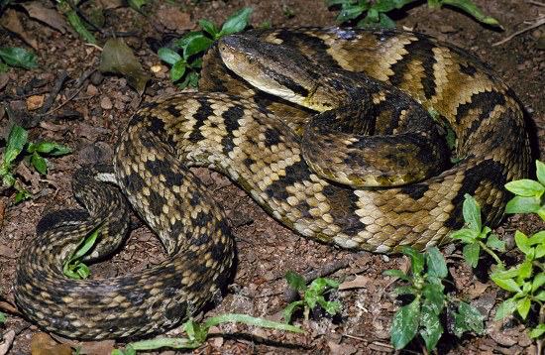
Bothrops jararaca

Slide 12
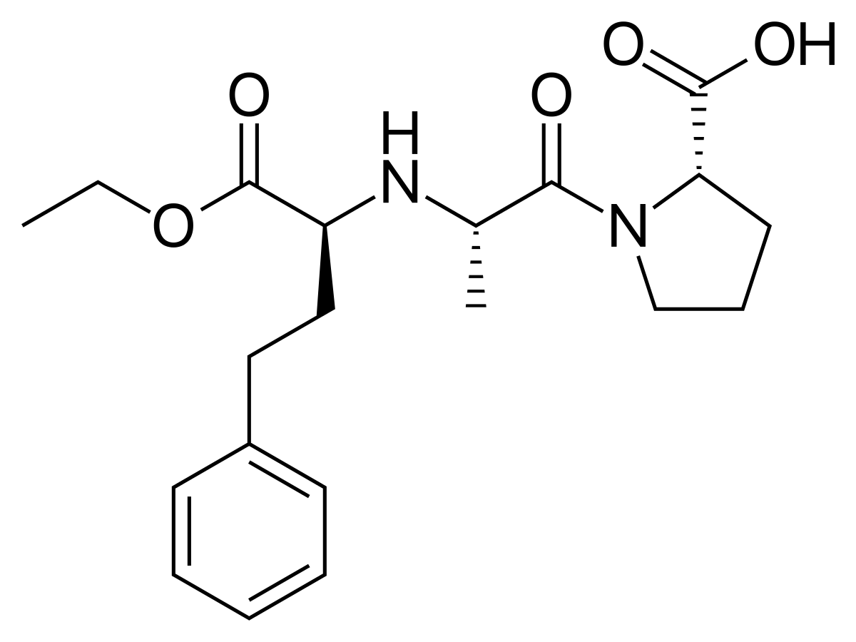
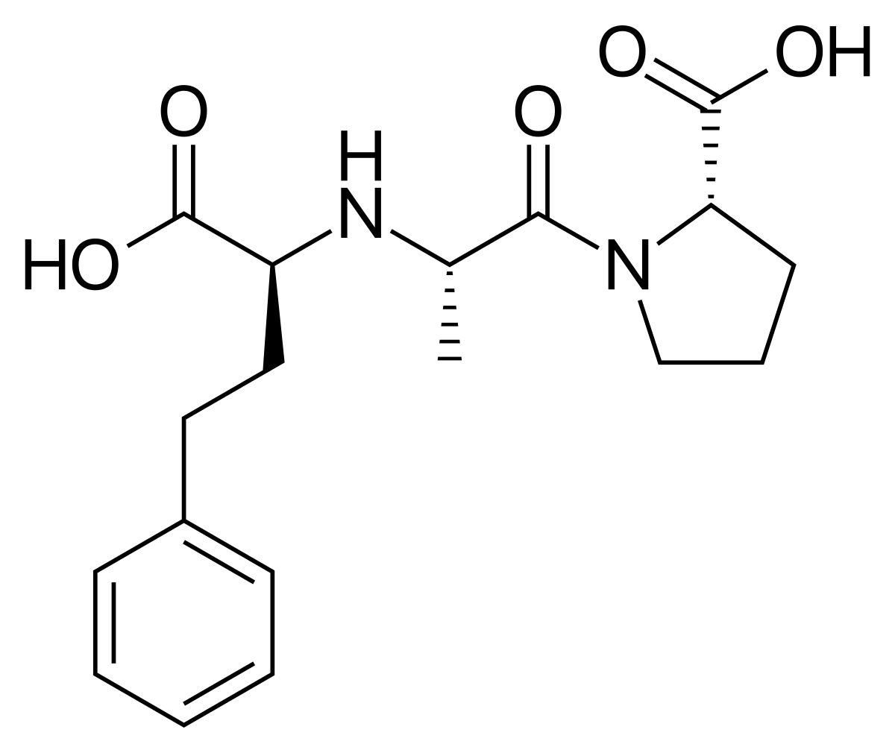
Enalaprilat
Enalapril

Slide 13
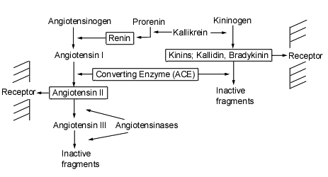

Slide 14
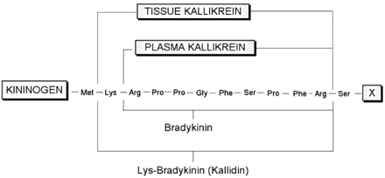

Slide 15
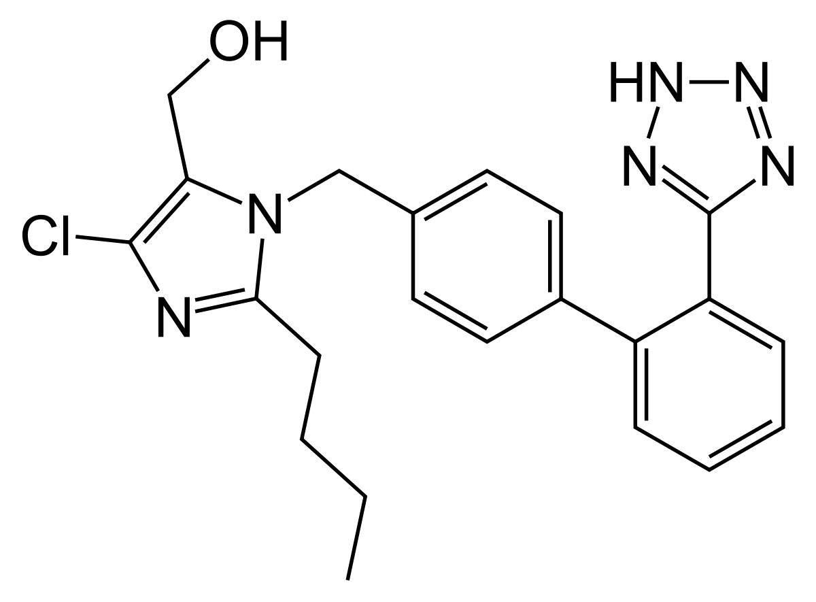
Angiotensin II Receptor Antagonist
Losartan

Slide 16
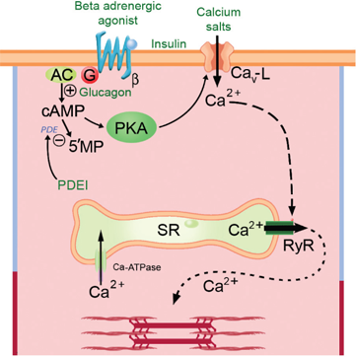
Calcium Channel Blockers

Slide 17
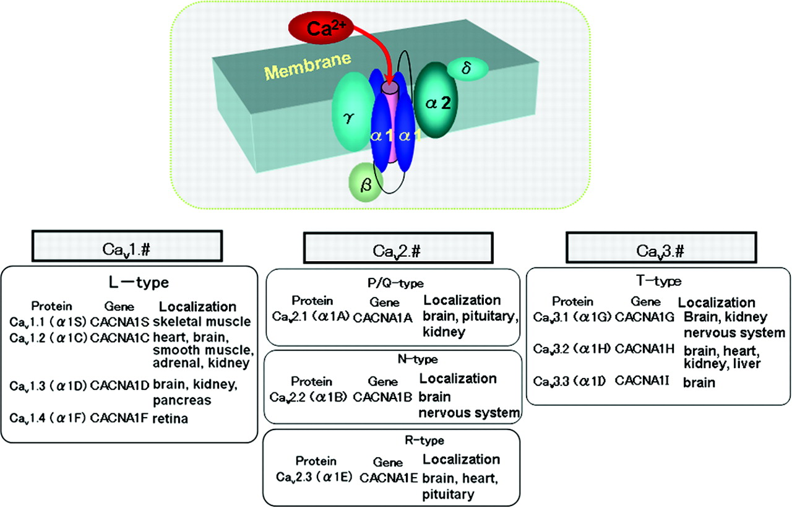
Ligand Gated
Voltage Gated
  L – Long
  N-Neuronal
  T-Transient
Types of Calcium Channels

Slide 18
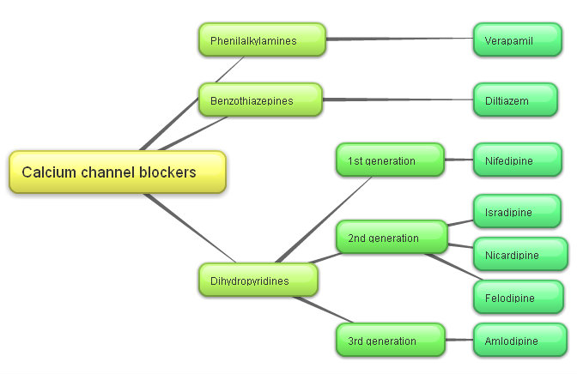
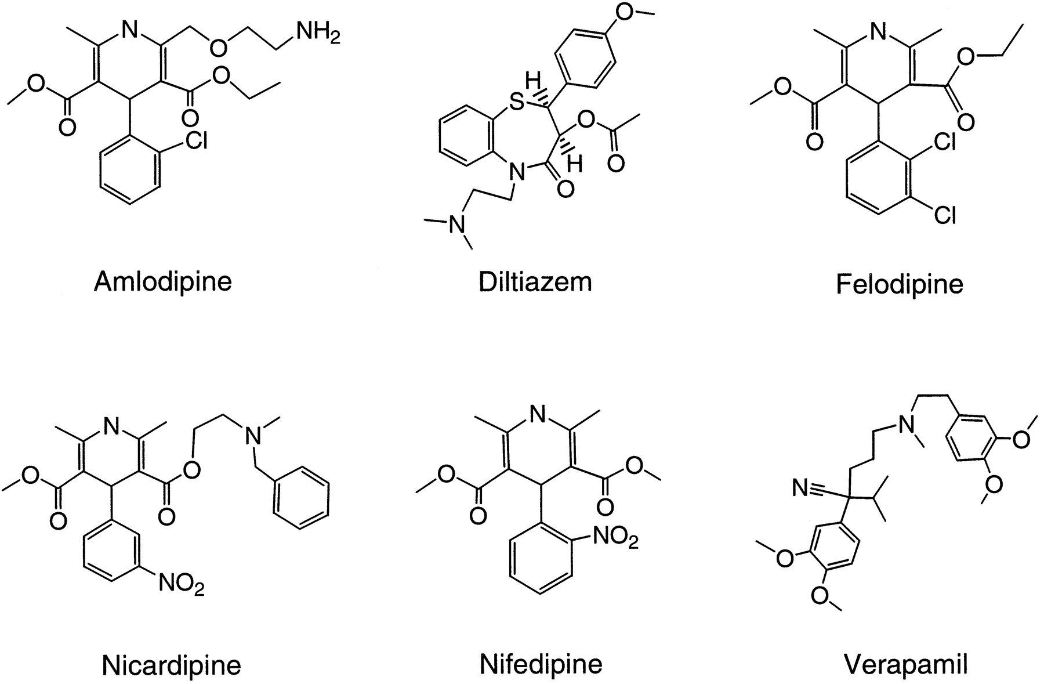

Slide 19
Angina:
Beta Blockers
Calcium Channel Blockers
Nitrates

Slide 20
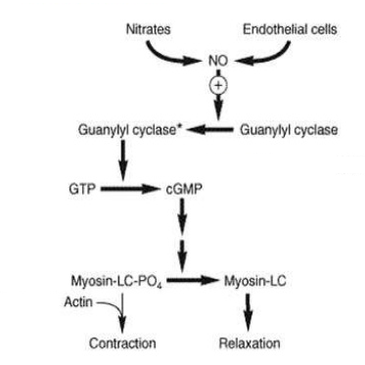

Slide 21
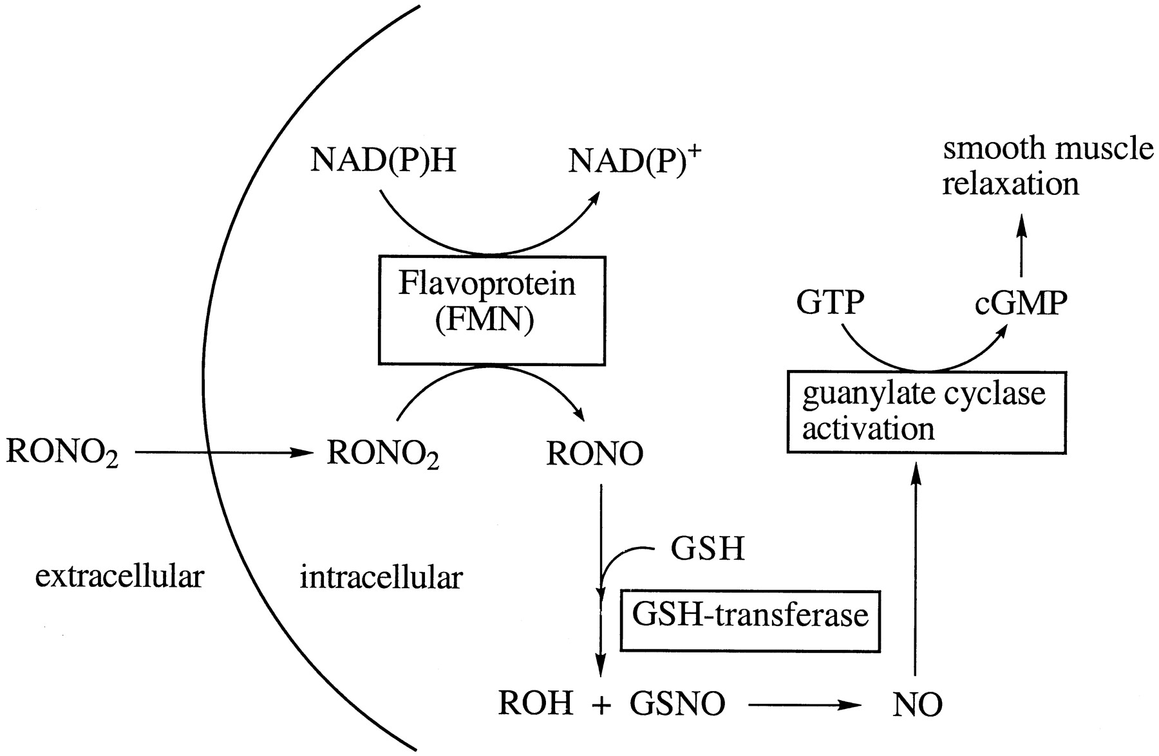

Slide 22
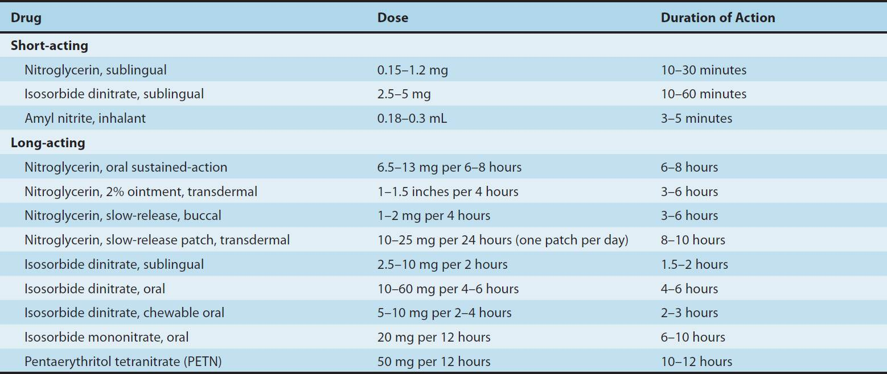
Nitrates

Slide 23
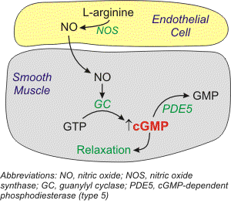
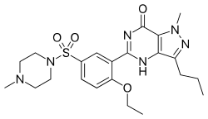
Sildenafil

Slide 24
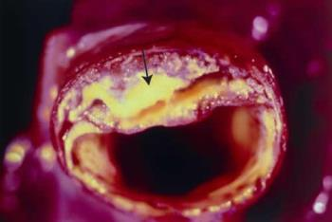
Atheroschlerosis
Arterioschlerosis

Slide 25
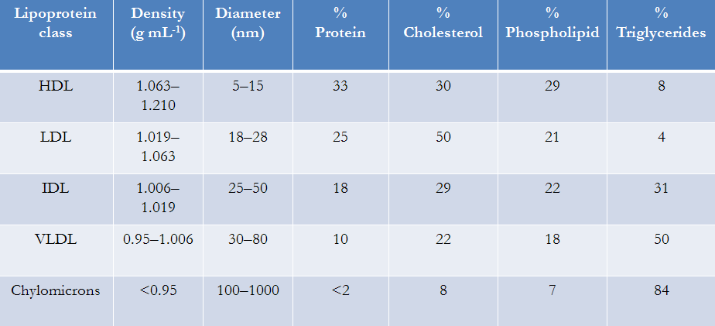
Hyperlipidemia

Slide 26
1. Bile Acid Sequestrants
2. Cholesterol Absorption Inhibitors
3. HMG CoA Reductase Inhibitors
4. Fibric Acid Derivatives
5. Niacin Derivatives

Slide 27
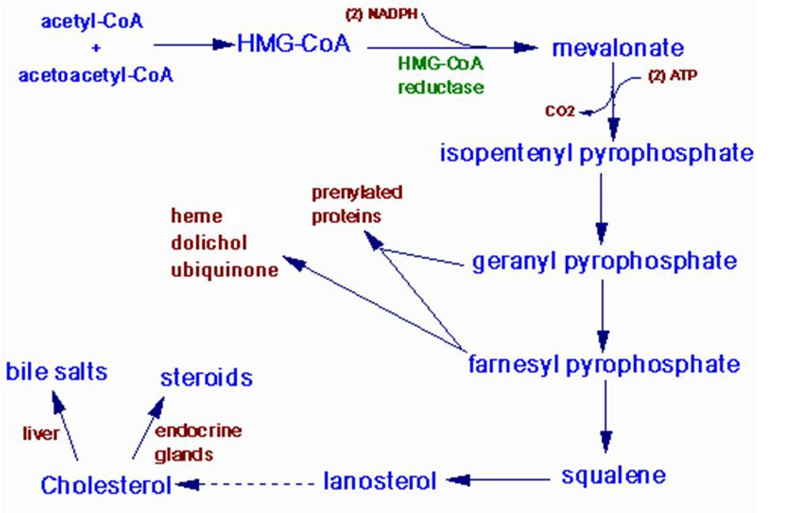
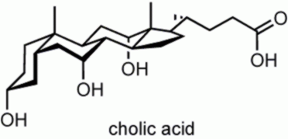

Slide 28
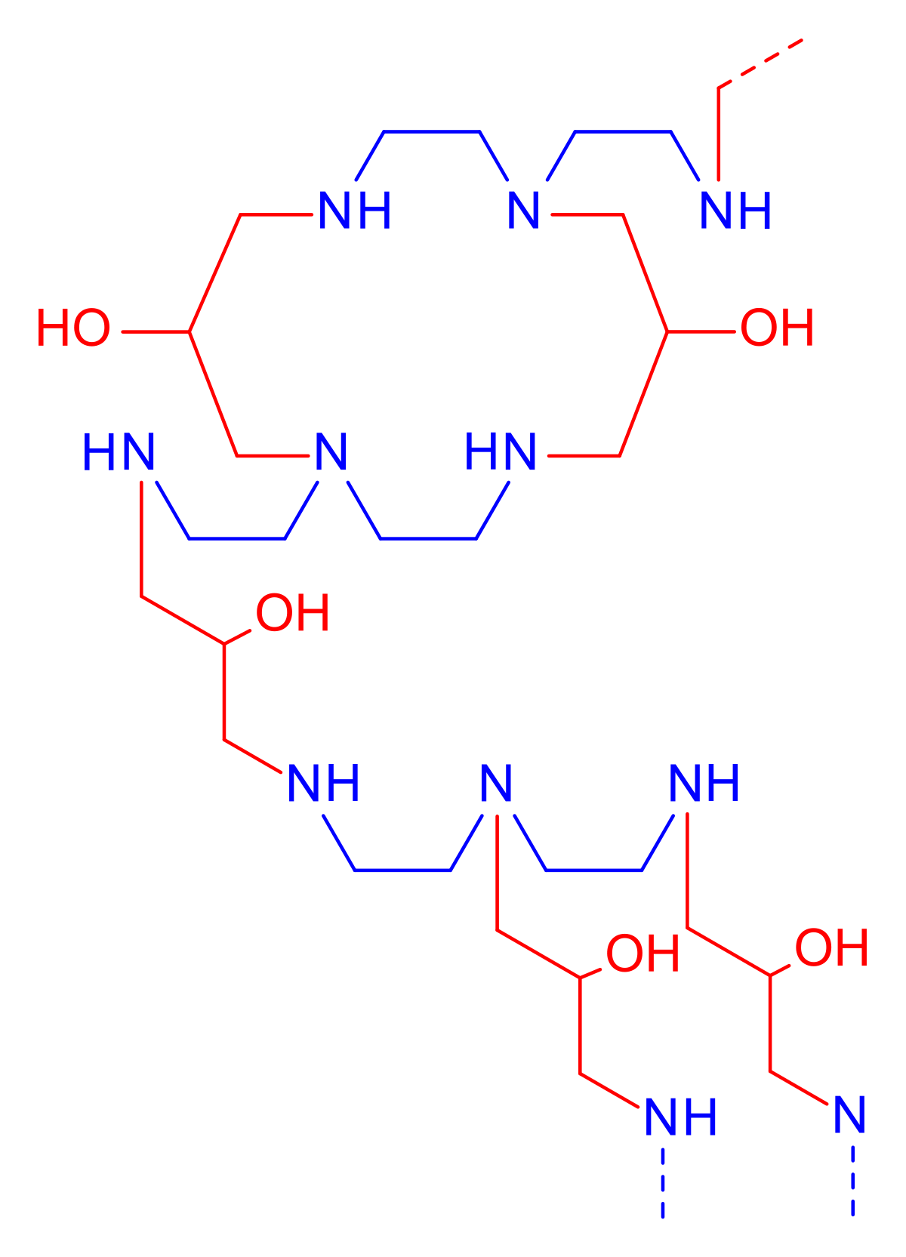
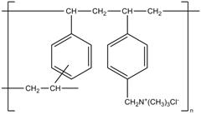
Bile Acid Sequestrants
Cholestyramine
Colestipol

Slide 29
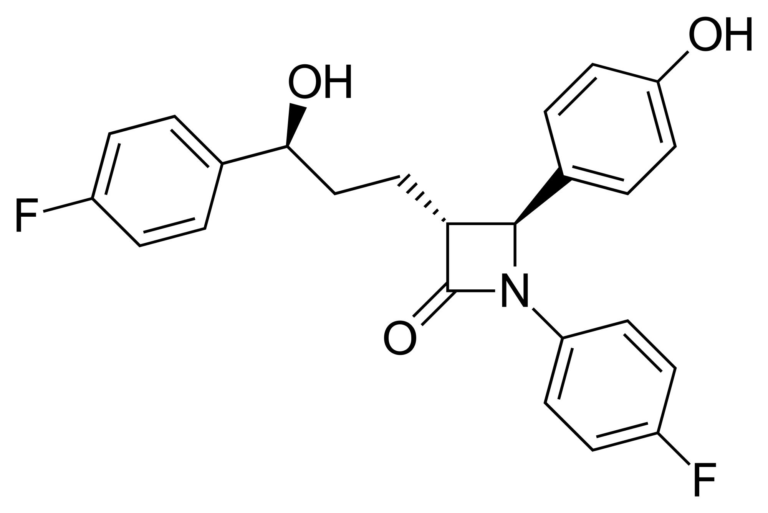
Cholesterol Absorption Inhibitors

Slide 31
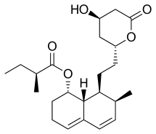
HMG CoA Reductase Inhibitors : Statins

Slide 32
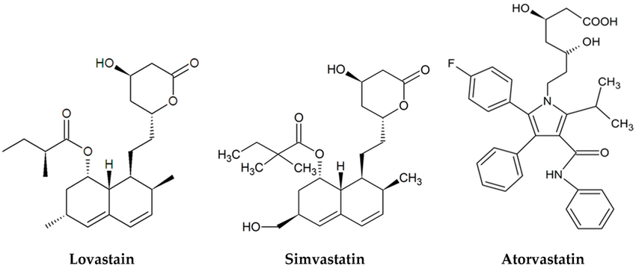
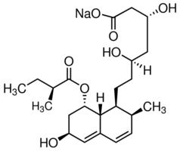
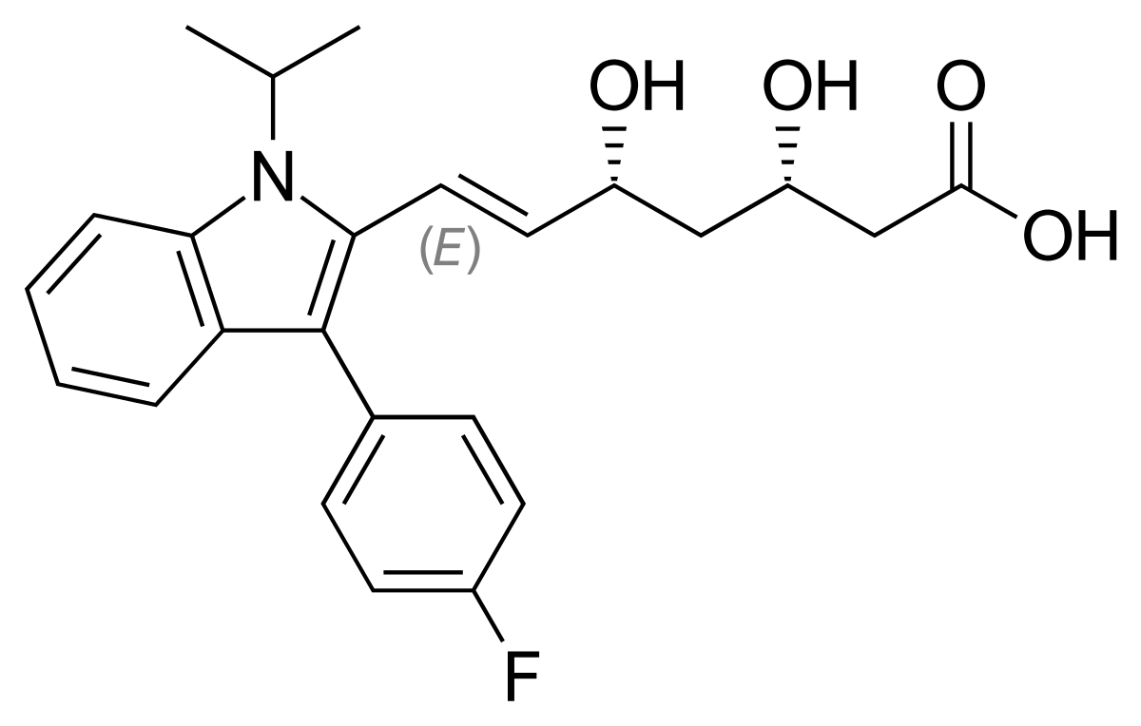
Pravastatin
Fluvastatin

Slide 33
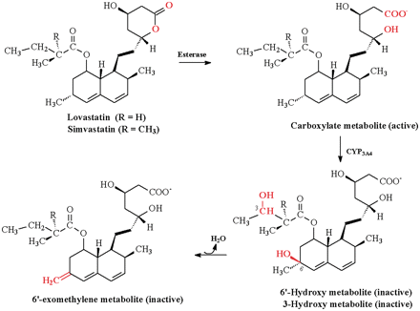

Slide 34
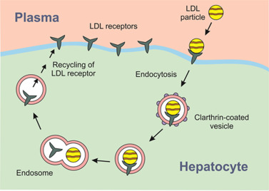

Slide 35
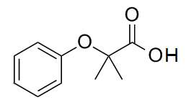
Fibrates

Slide 36
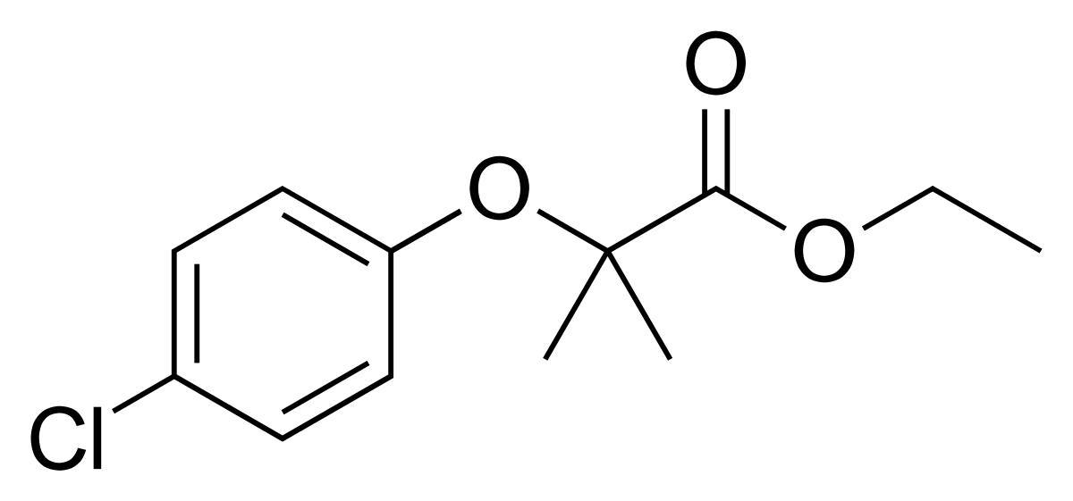
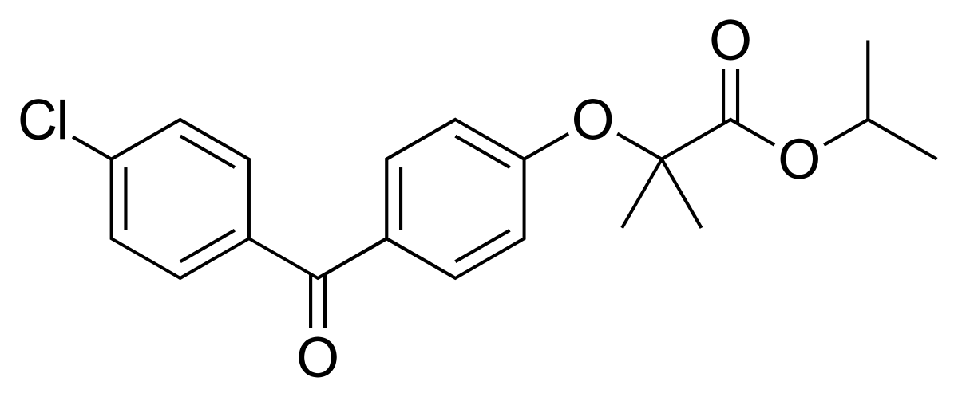
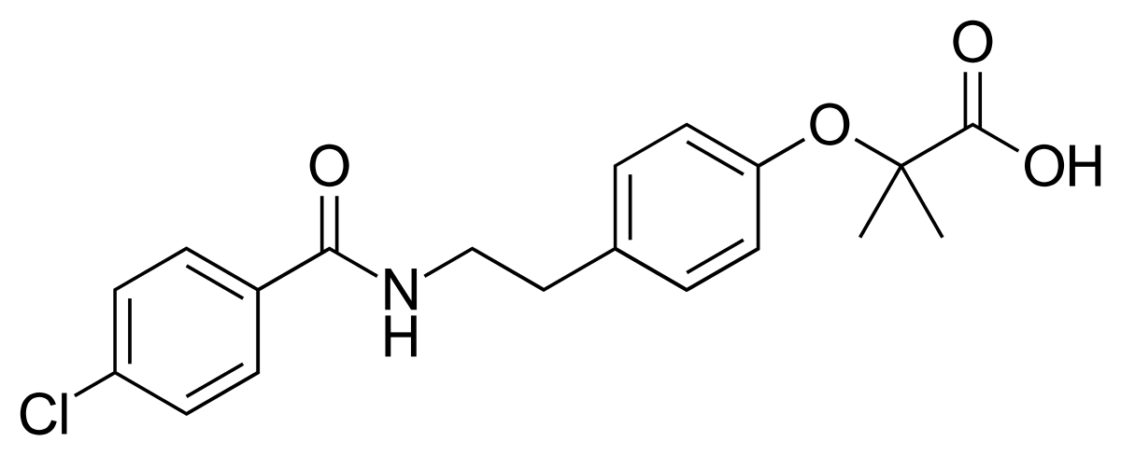
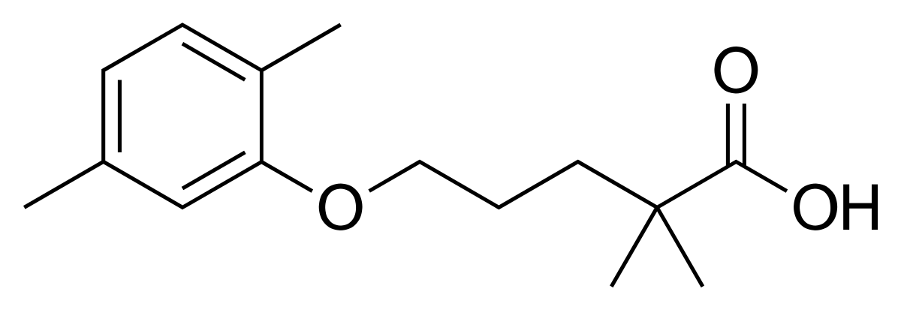
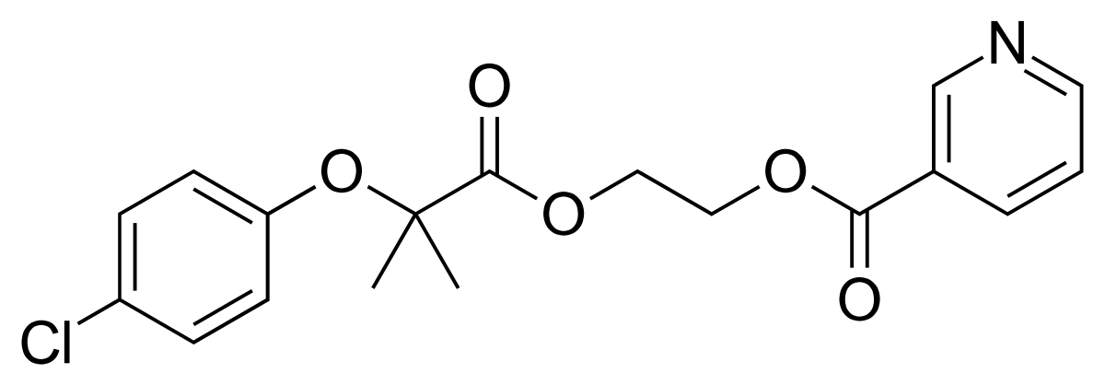

Slide 37
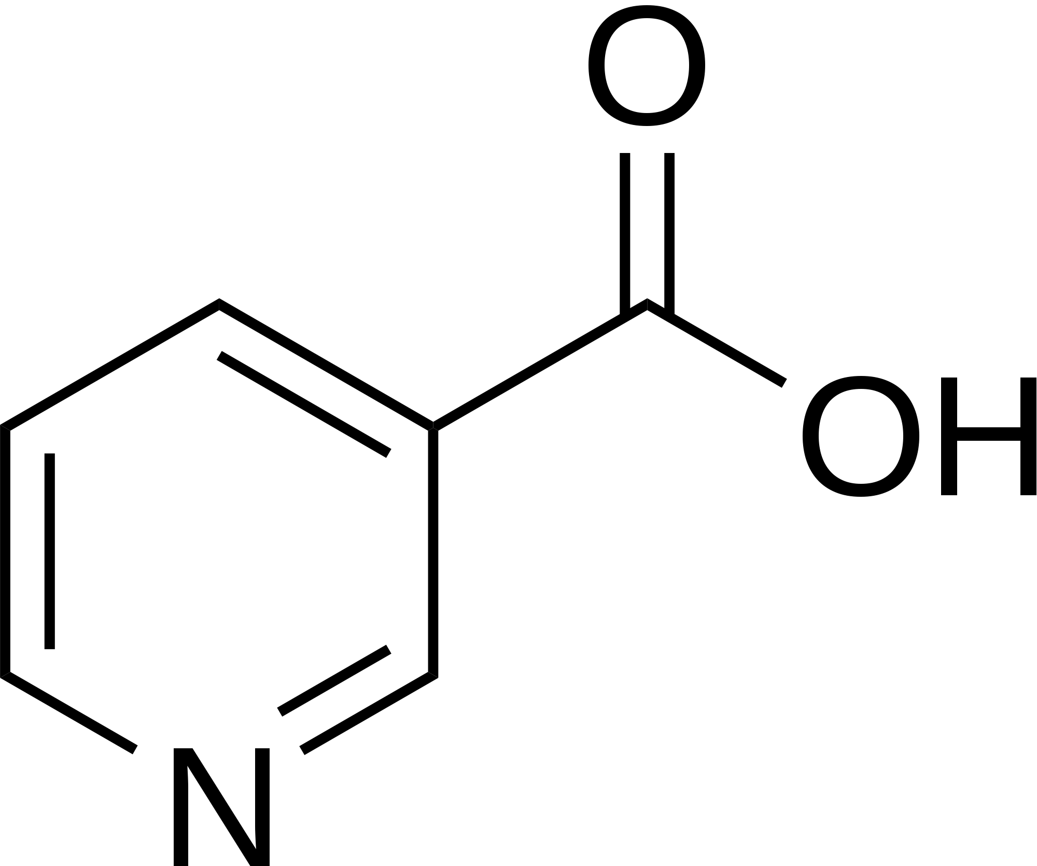
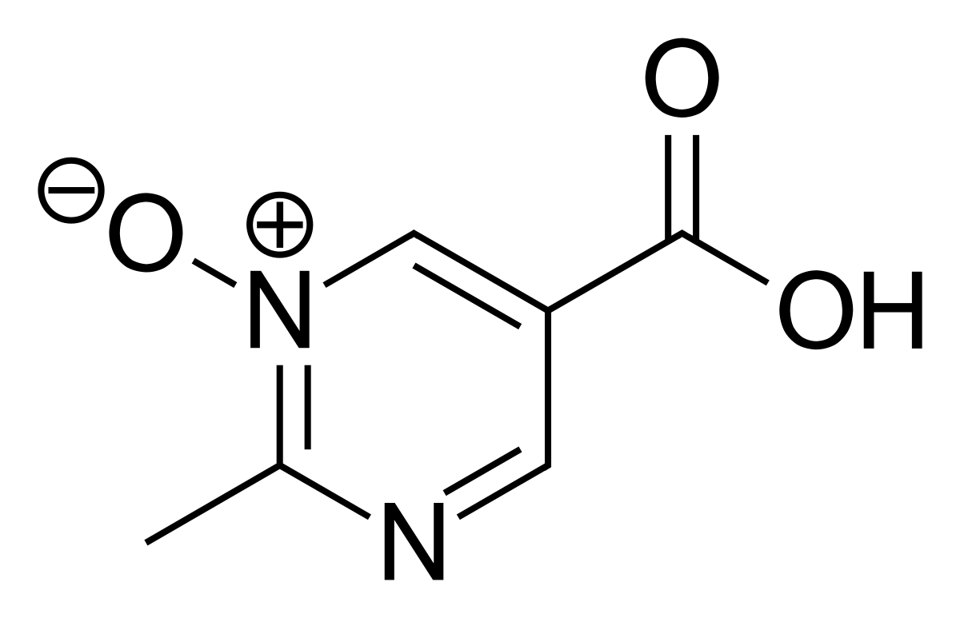
Niacin

