Slide 1
QSAR

Slide 2
Drug Design : modifications to lead compounds
Disjunction
Conjunction
Ring Opening/Closing
Change stereochemistry/orientation
Isosteric substitutions

Slide 3
Isosteres :
Examples :
-O- -NH- -CH₂-
-F -OH -NH₂ -CH₃
Grimm’s Law of Hydride
Displacement

Slide 4
Classification of Isosteres
Class I halogens, -OH, -SH, -NH₂, -CH₃
Class II O, S, Se, Te, NH, CH₂
Class III N, P, As, CH
Class IV C, Si, N⁺, P⁺ , S⁺, As⁺
Class V (annular isosteres) CH=CH, S, O, NH
Annular equivalents : these are substitutions made to atoms in a ring.
Example : -C=C- can be replaced by –S-
Bioisosteres

Slide 5
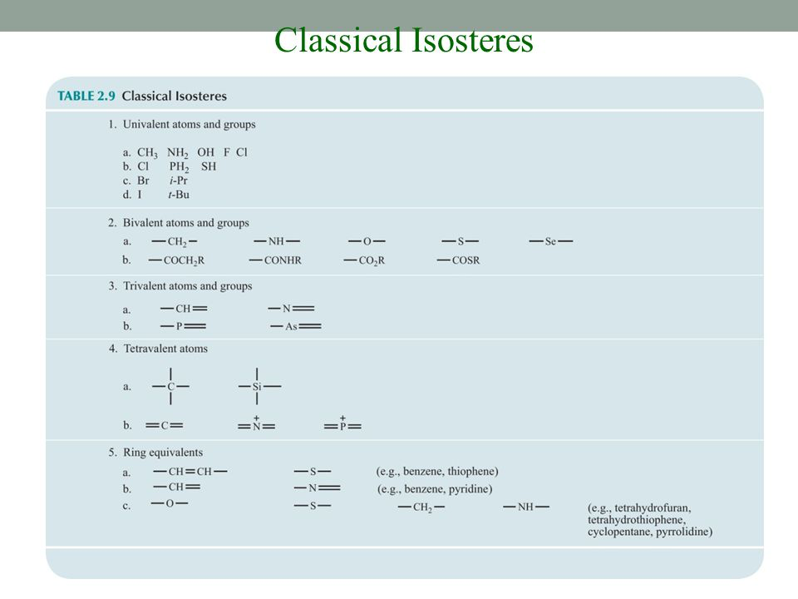

Slide 6
SAR
QSAR
Hansch Analysis

Slide 7
Hansch Recommendations for SAR

Slide 8
Physicochemical Properties for QSAR
Hydrophobicity
Electronic Properties
Steric Properties
Others: polar surface area, dipole moment, rotatable bonds, MW……

Slide 9
Hydrophobicity
Properties of Lipophilic Drugs:

Slide 10
Hydrophobicity
Described by log P
[drug]_{organic}
[drug]_{water}
P = -------------

Slide 11
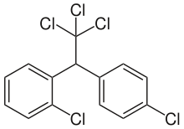
DDT (dichlorodiphenyltrichloroethane)
K_{ow} = 9.55 x 10⁵
If I put 0.0100 moles in 100 ml of water then equilibrate with 100 ml of octanol, how many moles will be in the octanol?
Notes:
Acts on sodium channels

Slide 12
Hydrophobicity of substituents

Slide 13
What is log P for ?
Is it more or less hydrophobic than ?

Slide 14
Electronic Properties
Hammet constant (σ)

Slide 15
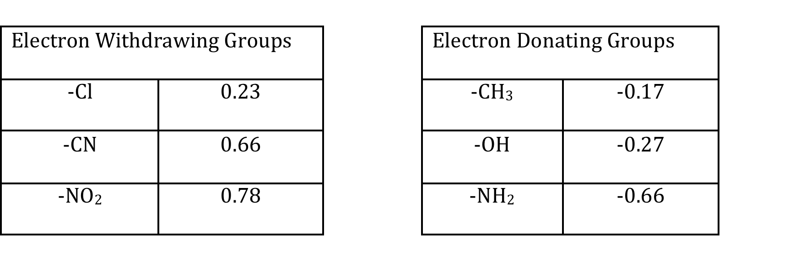

Slide 16
Steric Properties
Taft Parameter (E_{s})
Molar Refractivity (MR)

Slide 17

Antibacterial Activity
n

Slide 18
Drug Activity and Hydrophobicity : Anesthetics
Log P %required for effect
Ether 0.98 5%
CHCl₃ 1.97 1-2%
Halothane 2.3 0.7%

Slide 19
Drug Activity and Hydrophobicity : CNS side effects

Slide 20
Lipinski’s Rule of 5
Rule of 3

