Slide 1
pH Partition Theory

Slide 2
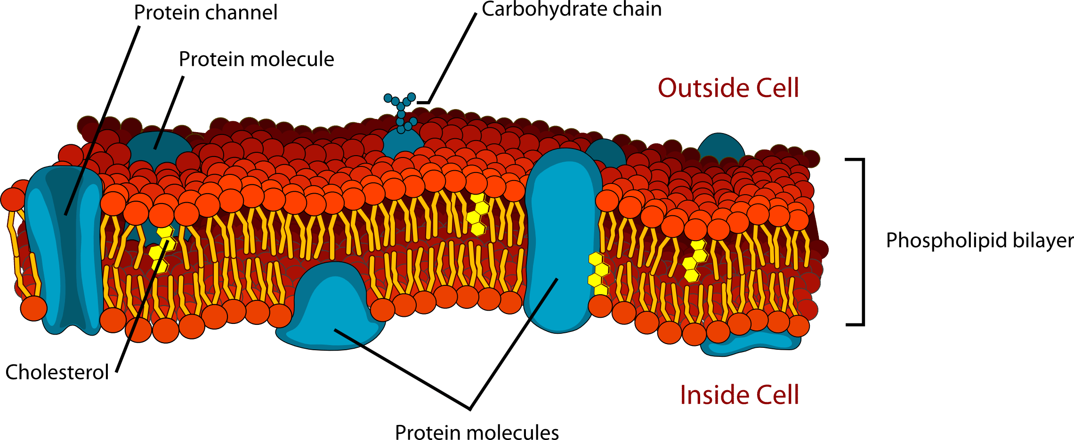
Membrane Solubility

Slide 3
pKa = 4.2
pKb = 9.4

Slide 4
Drug Administration
Enteral
Parenteral
Injections
Intravenous
Intramuscular
Subcutaneous
Transdermal
Mucous Membranes

Slide 5

Considerations for oral drugs…….
Drug Release
Time

Slide 6
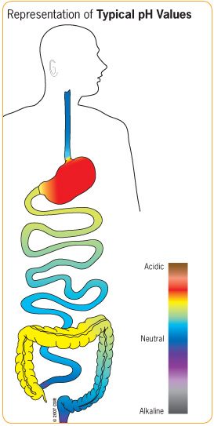

Slide 8
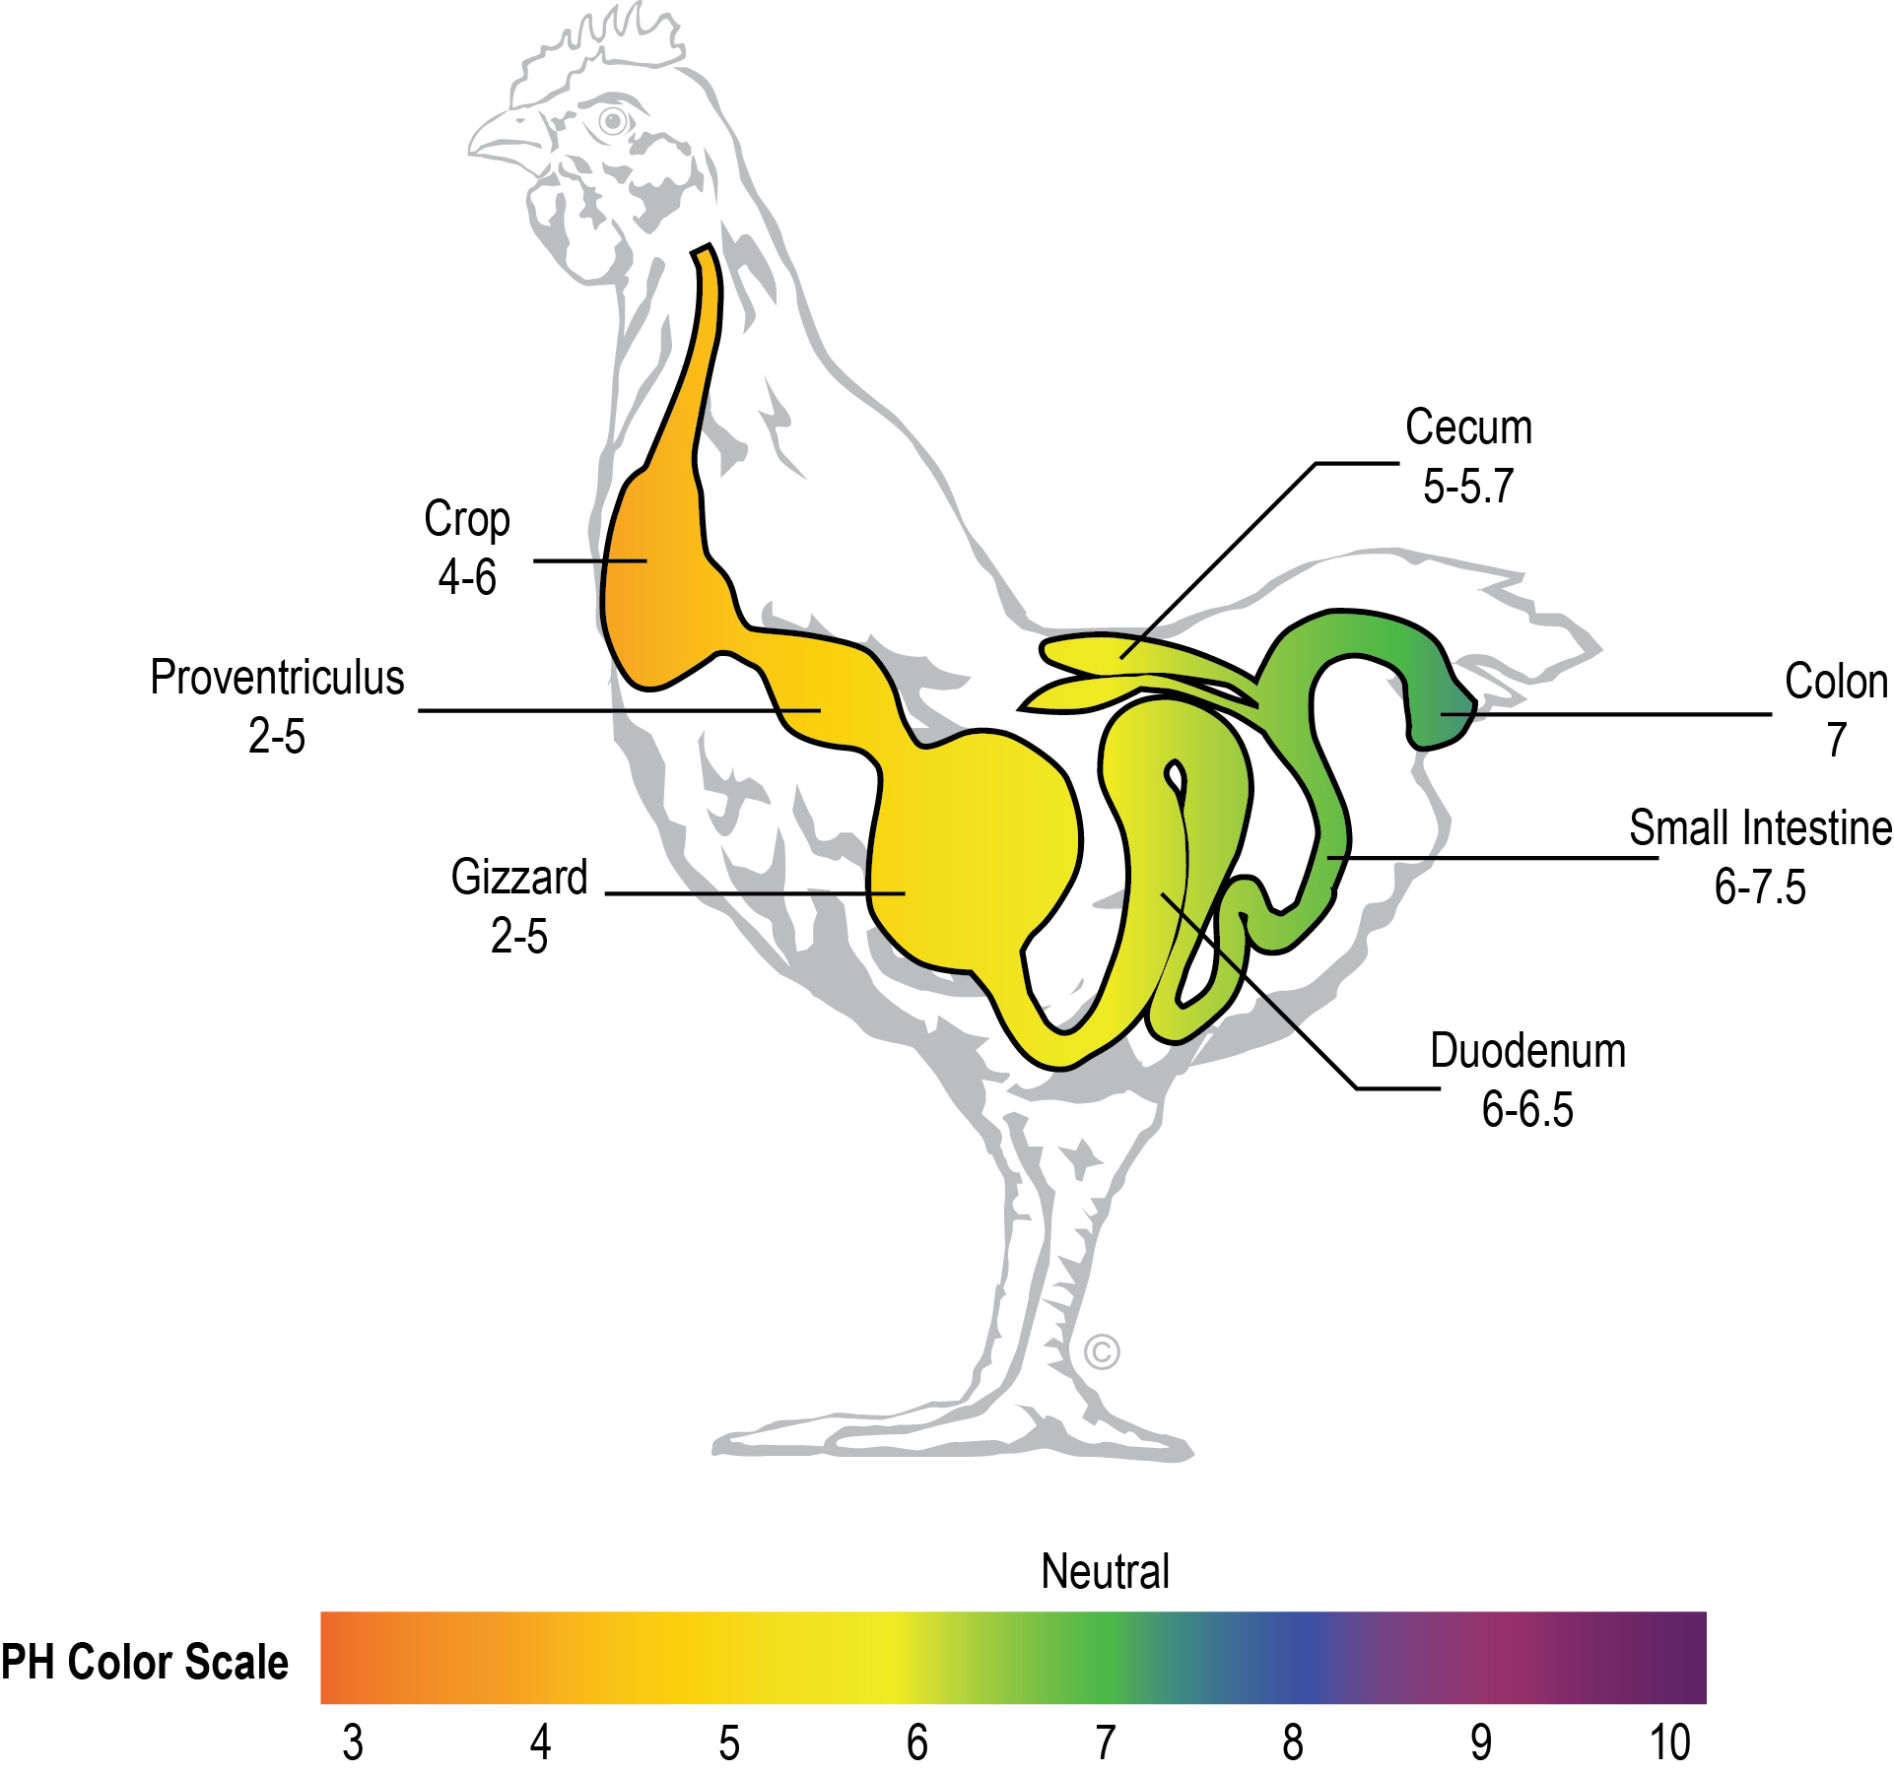
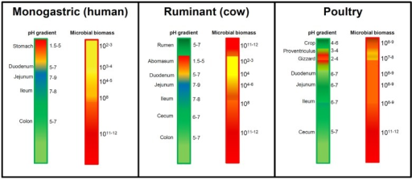

Slide 9
Salicylates

Slide 12
If the stomach has a pH of 1.3, what percentage of acetylsalicylic acid is ionized in the stomach? The pKa for ASA is 3.49.

Slide 13
pH Partition Theory
Gastrointestinal and other biological membranes act like lipid barriers
The unionized form of the drug is preferentially absorbed
Most drugs are absorbed by passive diffusion
Weakly acidic or neutral drugs may be absorbed in the stomach. Basic ones aren’t
The rate and amount of drug absorbed is related to its oil/H₂O partition coefficient

